Slide 1
Sampling
PhD Course

Slide 2
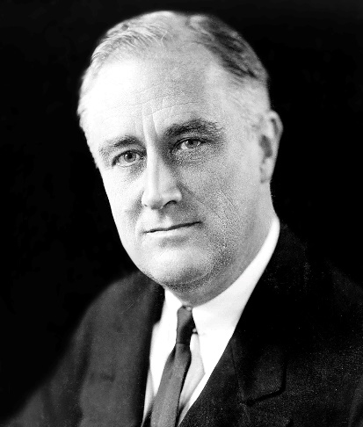
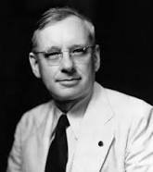
The 1936 presidential election proved a decisive battle, not only in shaping the nation’s political future but for the future of opinion polling. The Literary Digest, the venerable magazine founded in 1890, had correctly predicted the outcomes of the 1916,
Franklin D. Roosevelt
Alf Landon
1920, 1924, 1928, and 1932 elections by conducting polls. These polls were a lucrative venture for the magazine: readers liked them; newspapers played them up; and each “ballot” included a subscription blank. The 1936 postal card poll claimed to have asked one fourth of the nation’s voters which candidate they intended to vote for. In Literary Digest's October 31 issue, based on more than 2,000,000 returned post cards, it issued its prediction: Republican presidential candidate Alfred Landon would win 57 percent of the popular vote and 370 electoral votes.
Landon, 1,293,669; Roosevelt, 972,897
Final Returns in the Digest’s Poll of Ten Million Voters

Slide 3

The actual results of the election were 62% for Roosevelt against 38% for Landon (these were the parameters the poll was trying to measure). The sampling error in the Literary Digest poll was a whopping 19%, the largest ever in a major public opinion poll. Practically all of the sampling error was the result of sample bias.
The irony of the situation was that the Literary Digest poll was also one of the largest and most expensive polls ever conducted, with a sample size of around 2.4 million people! At the same time the Literary Digest was making its fateful mistake, George Gallup was able to predict a victory for Roosevelt using a much smaller sample of about 50,000 people.
This illustrates the fact that bad sampling methods cannot be cured by increasing the size of the sample, which in fact just compounds the mistakes. The critical issue in sampling is not sample size but how best to reduce sample bias.

Slide 5
Basic Concepts
Population The entire set of individuals or other entities to which study findings are to be generalized.
Sample A subset of a population that is used to study the population as a whole.
Elements The individual members of the population whose characteristics are to be measured.

Slide 6
Basic Concepts
Sampling frame A list of all elements or other units
containing the elements in a population.
Enumeration units Units that contain one or more elements and that are listed in a sampling frame.
Sampling units Units listed at each stage of a multistage
sampling design.

Slide 7
Basic Concepts
Sampling error Any difference between the characteristics of a sample and the characteristics of a population. The larger the sampling error, the less representative the sample.
Target population A set of elements larger than or different from the population sampled and to which the researcher would like to generalize study findings.

Slide 8
Basic Concepts
Census Research in which information is obtained through
the responses that all available members of an entire population give to questions.
In case of small population. In some circumstances, it may be feasible to skirt the issue of generalizability by conducting a census— studying the entire population of interest—rather than drawing a sample.
Executing a census to order the government every 10 years.

Slide 9
Basic Concepts
Probability sampling method A sampling method that relies on a random, or chance, selection method so that the probability of selection of population elements is known.
Nonprobability sampling method Sampling method in which the probability of selection of population elements is unknown.

Slide 10
Basic Concepts
Probability of selection The likelihood that an element will be selected from the population for inclusion in the sample. In a census of all elements of a population, the probability that any particular element will be selected is 1.0. If half of the elements in the population are sampled on the basis of chance (say, by tossing a coin), the probability of selection for each element is one half, or .5. As the size of the sample as a proportion of the population decreases, so does the probability of selection.

Slide 11
Basic Concepts
Random sampling A method of sampling that relies on a random, or chance, selection method so that every element of the sampling frame has a known probability of being selected.
Nonrespondents People or other entities who do not participate in a study although they are selected for the sample.

Slide 12
Basic Concepts
Systematic bias Overrepresentation or underrepresentation of some population characteristics in a sample due to the method used to select the sample. A sample shaped by systematic sampling error is a biased sample.

Slide 13
Basic Concepts
Simple random sampling A method of sampling in which
every sample element is selected only on the basis of chance, through a random process.
Random number table A table containing lists of numbers that are ordered solely on the basis of chance; it is used for drawing a random sample.

Slide 14
Basic Concepts
Random digit dialing The random dialing by a machine of numbers within designated phone prefixes, which creates a random sample for phone surveys.
Replacement sampling A method of sampling in which sample
elements are returned to the sampling frame after being
selected, so they may be sampled again. Random samples may be selected with or without replacement.

Slide 15
Basic Concepts
Systematic random sampling A method of sampling in which
sample elements are selected from a list or from sequential files.
Sampling interval The number of cases from one sampled case to
another in a systematic random sample.
Periodicity A sequence of elements (in a list to be sampled) that varies in some regular, periodic pattern.

Slide 16
Basic Concepts
Stratified random sampling A method of sampling in which
sample elements are selected separately from population strata that are identified in advance by the researcher.
Proportionate stratified sampling
Sampling method in which elements are selected from strata in exact proportion to their representation in the population.

Slide 17
Basic Concepts
Disproportionate stratified sampling
Sampling in which elements are selected from strata in different proportions from those that appear in the population.

Slide 18
Basic Concepts

Slide 19
Basic Concepts
Cluster Sampling in which elements are selected in
two or more stages, with the first stage being the random selection of naturally occurring clusters and the last stage being the random selection of elements within clusters.
Cluster A naturally occurring, mixed aggregate of elements of the population.

Slide 21
Basic Concepts
Availability sampling Sampling in which elements are selected on the basis of convenience.
Elements are selected for availability sampling because they’re available or easy to find. Thus, this sampling method is also known as a haphazard, accidental, or convenience sample.
There are many ways to select elements for an availability sample:
Standing on street corners and talking to whoever walks by, asking questions of employees who have time to talk when they pick up their paycheck at a personnel office, or approaching particular individuals at opportune times while observing activities in a social setting.

Slide 22

Basic Concepts
Quota sampling A nonprobability sampling method in which elements are selected to ensure that the sample represents certain characteristics in proportion to their prevalence in the population.

Slide 24
Basic Concepts
Purposive sampling A nonprobability sampling method in which elements are selected for a purpose, usually because of their unique position.
In purposive sampling, each sample element is selected for a purpose, usually because of the unique position of the sample elements. Purposive sampling may involve studying the entire population of some limited group (directors of shelters for homeless adults) or a subset of a population (mid-level managers with a reputation for efficiency). Or a purposive sample may be a “key informant survey,” which targets individuals who are particularly knowledgeable about the issues under investigation.

Slide 26

Basic Concepts
Snowball sampling A method of sampling in which sample
elements are selected as they are identified by successive informants or interviewees.
Snowball sampling is useful for hard-to-reach or hard-to-identify populations for which there is no sampling frame, but the members of which are somewhat interconnected (at least some members of the population know each other). It can be used to sample members of groups such as drug dealers, prostitutes, practicing criminals, participants in Alcoholics Anonymous groups, gang leaders, informal organizational leaders, and homeless persons.

Slide 28
Basic Concepts
Inferential statistics A mathematical tool for estimating how likely it is that a statistical result based on data from a random sample is representative of the population from which the sample is assumed to have been selected.
Random sampling error (chance sampling error) Differences between the population and the sample that are due only to chance factors (random error), not to systematic sampling error.
Random sampling error may or may not result in an unrepresentative sample. The magnitude of sampling error due
to chance factors can be estimated statistically.

Slide 29

Sampling
Population – A group that includes all the cases (individuals, objects, or groups) in which the researcher is interested.
Sample – A relatively small subset from a population.

Slide 30
Representative sample
A sample that “looks like” the population from which it was selected in all respects that are potentially relevant to the study. The distribution of characteristics among the elements of a representative sample is the same as the distribution of those characteristics among the total population. In an unrepresentative sample, some characteristics are overrepresented or underrepresented.

Slide 31

Representative sample
The sample should reflect the properties of the population as we see the whole sea in a drop. That is, the sample should be representative. The conclusions drawn from a non-representative sample are ineligible, distorted. The applied statistical methods and estimation errors will be valid if the sample we are reporting is representative!

Slide 32
A representative sample is a small quantity of something that accurately reflects the larger entity. An example is when a small number of people accurately reflect the members of an entire population. In a classroom of 12 students, in which two third the students are male and one tird are female, a representative sample might include four students: three males and one females

Slide 34
Random Sampling
Simple Random Sample – A sample designed in such a way as to ensure that
(1) every member of the population has an equal chance of being chosen and
(2) every combination of N members has an equal chance of being chosen.
This can be done using a computer, calculator, or a table of random numbers

Slide 35
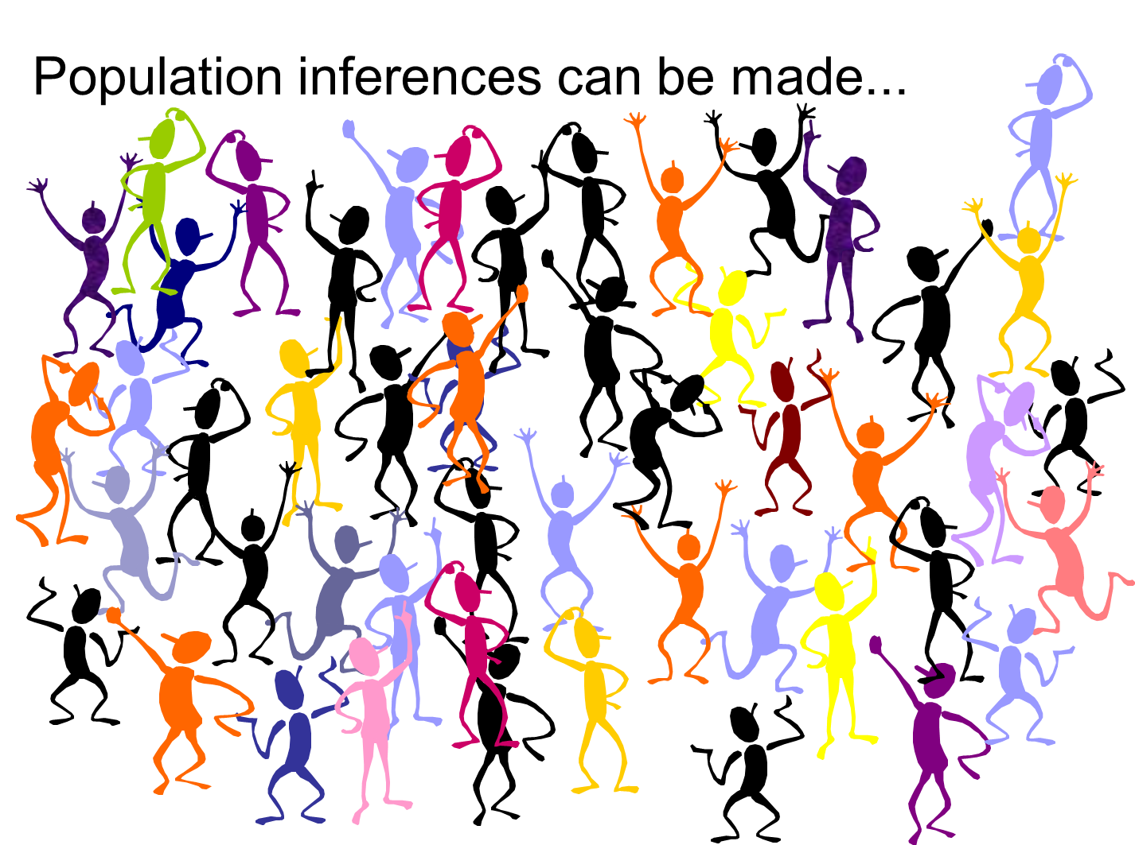

Slide 36
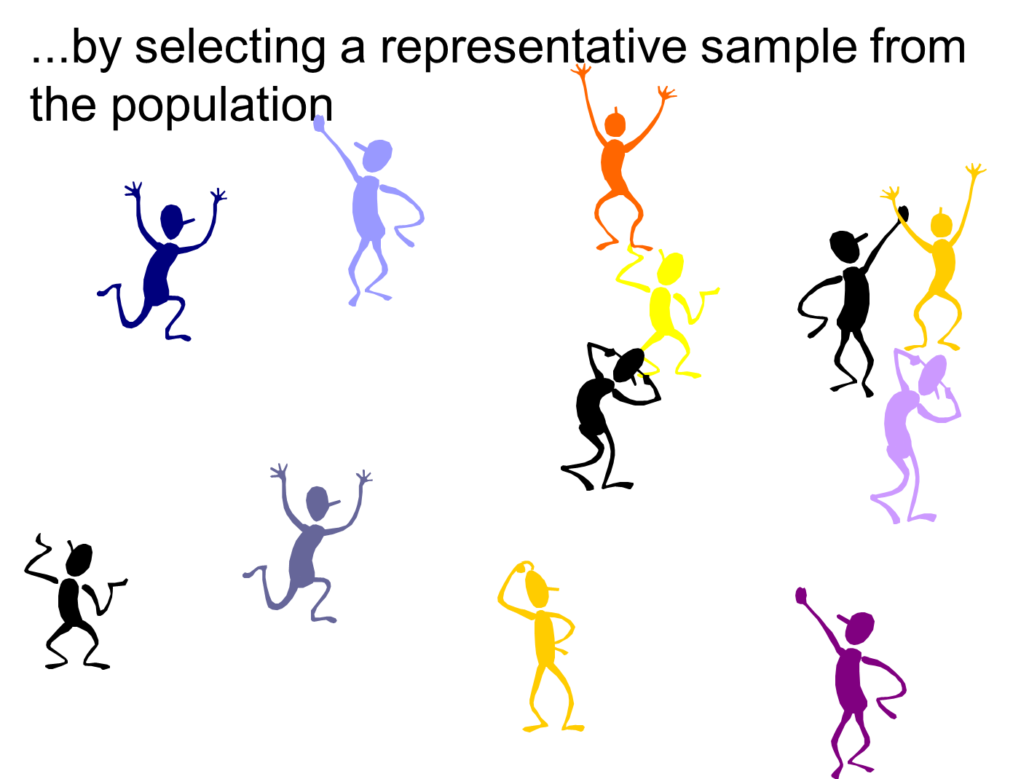

Slide 37
Random Sampling
Systematic random sampling – A method of sampling in which every Kth member (K is a ration obtained by dividing the population size by the desired sample size) in the total population is chosen for inclusion in the sample after the first member of the sample is selected at random from among the first K members of the population.

Slide 38
Systematic Random Sampling
Suppose the population size is N = 100
The desired sample element number is n = 20
N/n=5
Randomly we select a number from 1-5: eg. 4th
Starting from the 4th, we select all 5th into the sample

Slide 39
Systematic Random Sampling

Slide 40
Stratified Random Sampling
Proportionate stratified sample – The size of the sample selected from each subgroup is proportional to the size of that subgroup in the entire population. (Self weighting)
Disproportionate stratified sample – The size of the sample selected from each subgroup is disproportional to the size of that subgroup in the population. (needs weights)

Slide 41
Disproportionate Stratified Sample

Slide 42
Stratified Random Sampling
Stratified random sample – A method of sampling obtained by
(1) dividing the population into subgroups based on one or more variables central to our analysis and
(2) then drawing a simple random sample from each of the subgroups

Slide 44
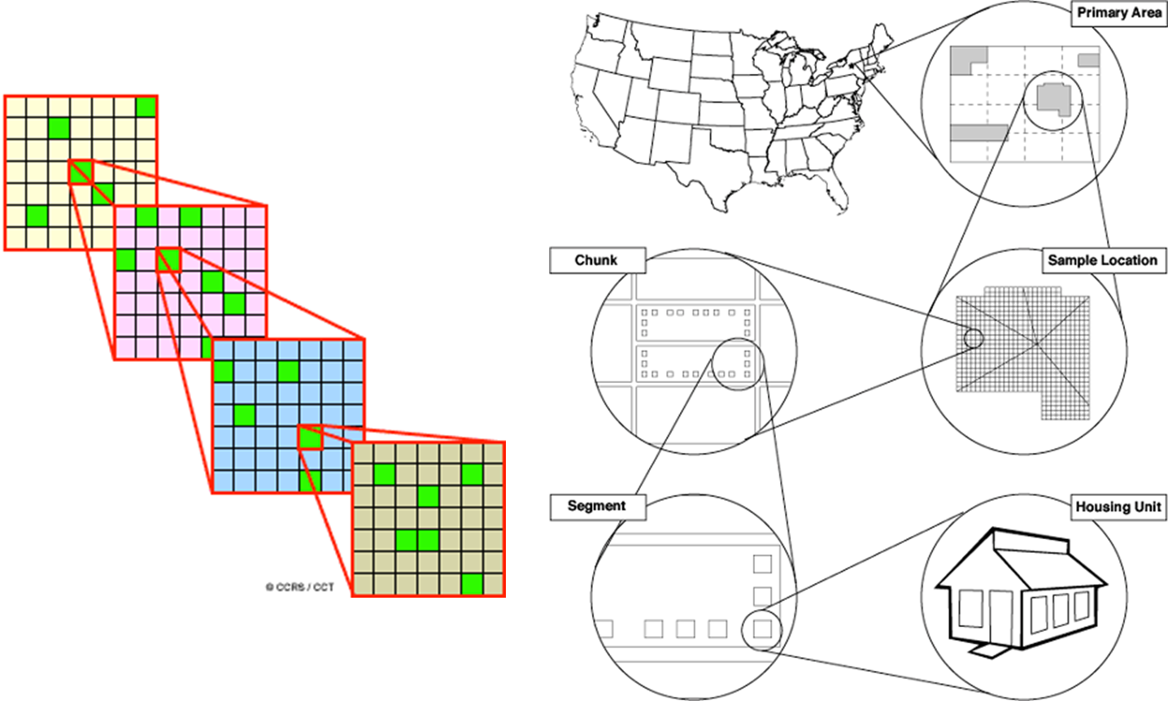
More Stages Sampling

Slide 45
The sampling procedure
The sampling procedure consists of 5 steps:
Determination of target population
Determination of the sampling frame
Determination of the sampling technique
Determination of sample size
Sampling performed

Slide 46
Determining the Sample Size

Slide 47
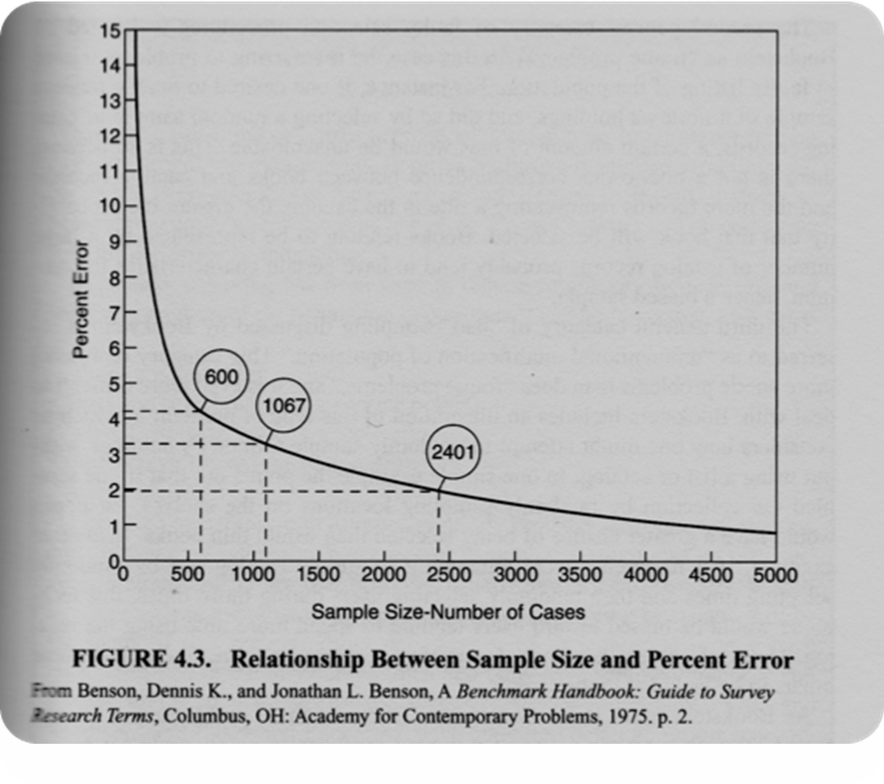
The more accurate information is needed, the larger the sample.
But the more the sample grows, the smaller the improvement with the increase in sample size.

Slide 48
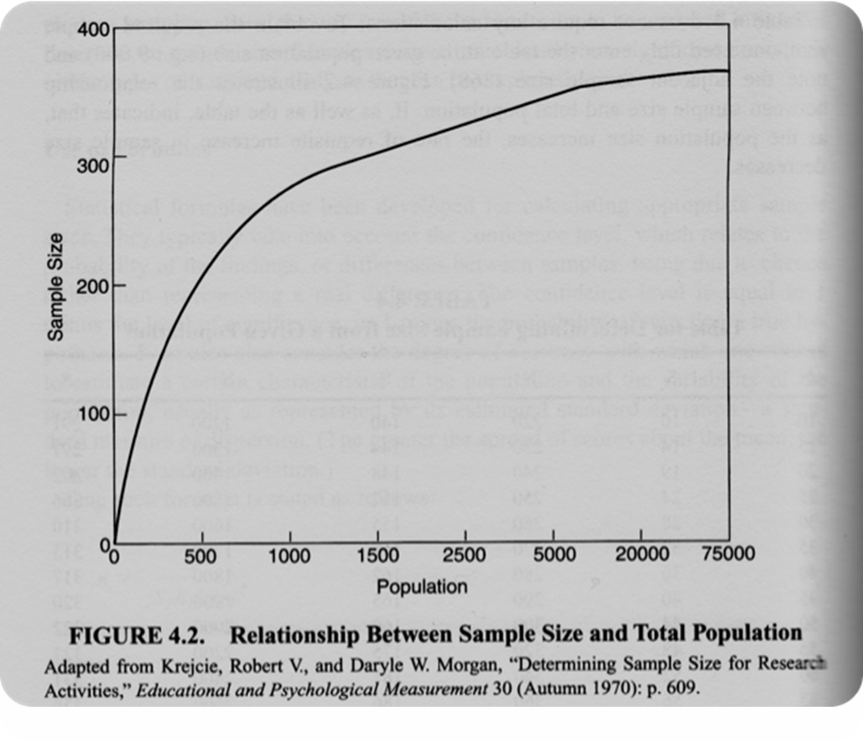
Relationship between sample size and total population

Slide 49
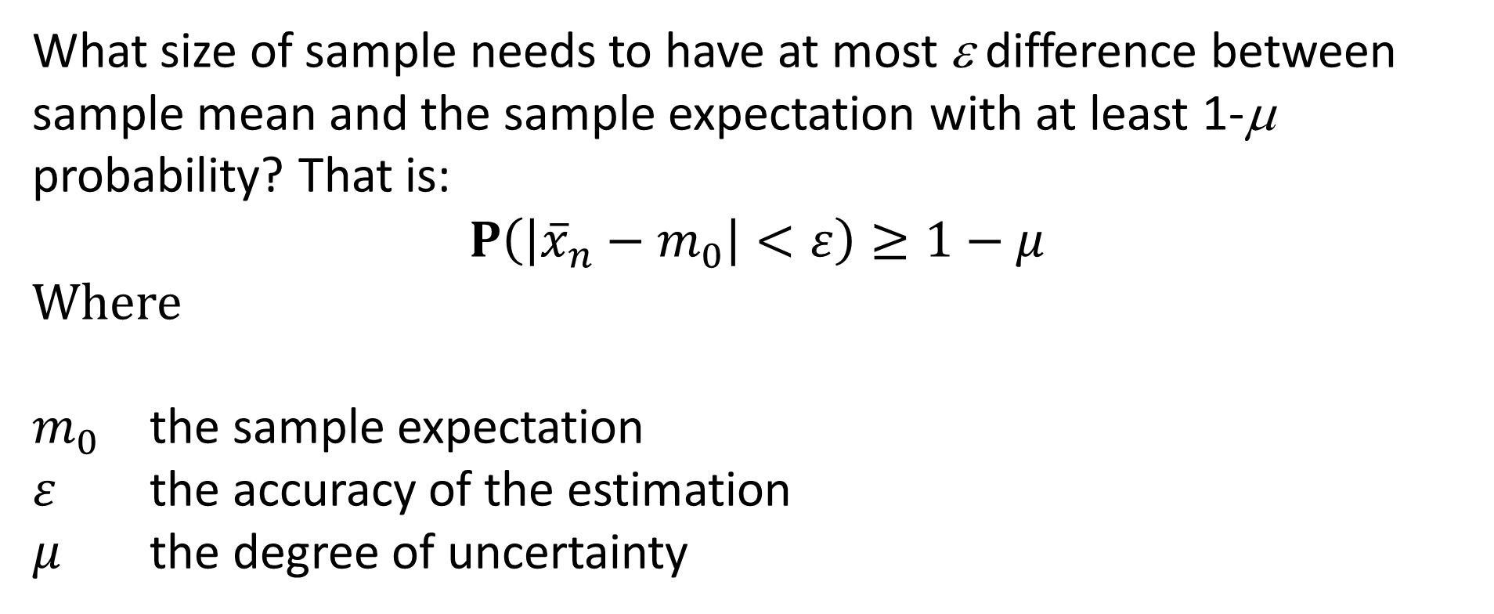
Determine the minimum sample size required
What size of sample needs to have at most ε difference between sample mean and the sample expectation with at least 1-μ probability? That is:
$$P\left(\left|{\overline{x}}_{n}−m_{0}\right|<ε\right)≥1−μ$$
Where
$m_{0}$ the sample expectation
$ε$ the accuracy of the estimation
$μ$ the degree of uncertainty

Slide 50
Relationship between sample size, accuracy and reliability
If we know two value among the n sample size, ε accuracy and μ reliability, we can give lower limit to the third parameter:

Slide 51
Parametric Methods
Determination of the sample size for a normal distribution with known σ deviation:
⇒
where

Slide 52
σ=1
σ=2

Slide 53
Parametric Methods
Determination of the sample size for a normal distribution with unknown σ deviation:
⇒
where
pdf of the Student distribution with df n-1.
standard variance of the mean

Slide 54
Nonparametric methods
From the Central Limit Theorem we get:
⇒

Slide 55
First, we will prove three lemmas that can be used to create criterias for the sample size required for the given estimation accuracy.

Slide 77
Nonparametric methods
Estimating the sample size using the Hoeffding inequality if our observations are in the interval (a, b)
⇒

Slide 78
Nonparametric methods
Estimation of the deviation and the uncertainty, if known the sample size n

Slide 79
Nonparametric methods
Estimation of sample size n based on Bernstein's inequality, if our measurements are fall into the interval (a, b) and known the sample deviation σ.
⇒

Slide 80
Nonparametric methods
Estimation of the deviation and the uncertainty in this case, if known the sample size n

Slide 81
The Chernoff inequality refers to the tail distribution of a binomial variable, thus allowing a parametric estimation method. This suggests that smaller sample values can be justified than for non-parametric Hoeffding and Bernstein inequalities.

Slide 82
Estimating the minimum number of sample size n based on Chernoff's inequality:
where
probability of the lower tail
probability of the upper tail
p the probability what estimated
ε the accuracy of the estimation

Slide 83
Comparison of the sample size estimations
Moivre Laplace
Csernov
Bernstein
Hoeffding
p=0,01,ε=0,01,μ=0,1
268
588
793
14979
p=0,01,ε=0,005,μ=0,1
1071
2737
2772
59915
p=0,01,ε=0,02,μ=0,1
67
175
248
3745
p=0,01,ε=0,02,μ=0,05
95
228
306
4611
p=0,01,ε=0,01,μ=0,05
380
765
976
18444
* With Moivre-Laplace, we get the best estimate but it is proven that when p$≈$0 or p$≈$1 convergence is slow, ie the method can not be applied at this cases.

