Slide 1
Regression Analysis
PhD Course

Slide 19
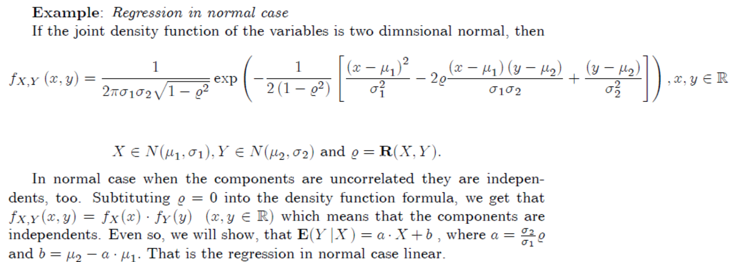

Slide 21
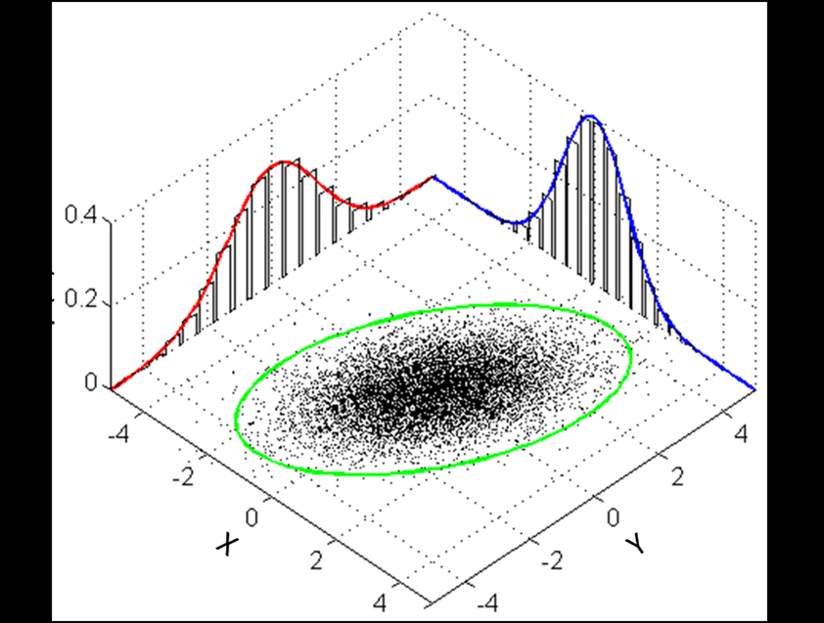
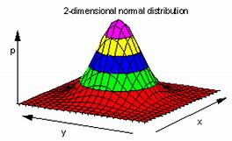

Slide 22
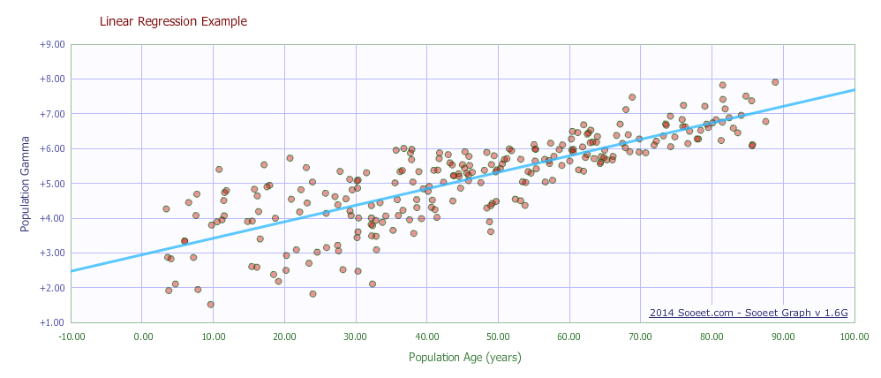
Linear Regression

Slide 25
Method of the Least Squares

Slide 28
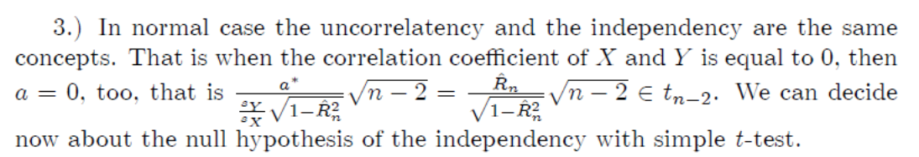

Slide 40
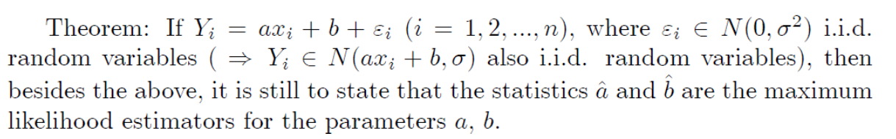


Slide 47
Reducing the regression function having two parameters into linear regression problem

Slide 49
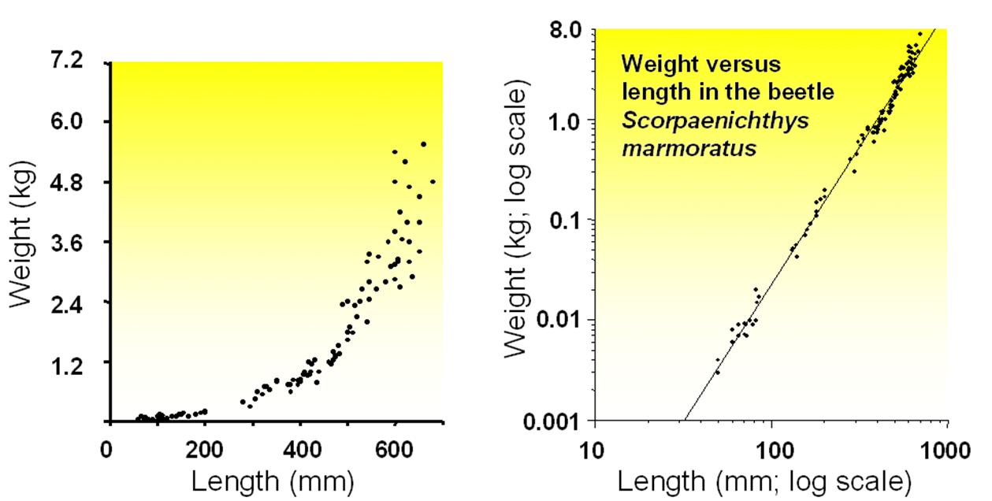

Slide 50
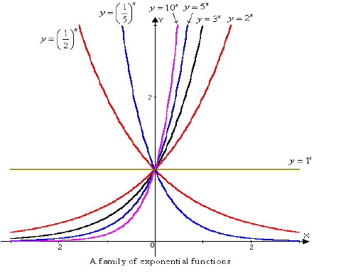

Slide 51
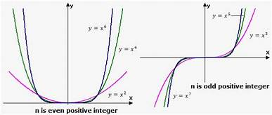

Slide 52
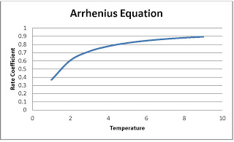

Slide 53
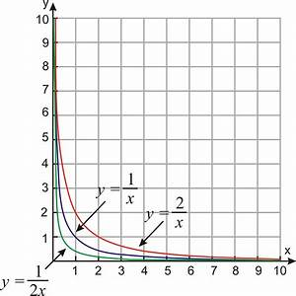

Slide 54
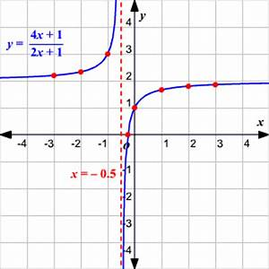

Slide 55
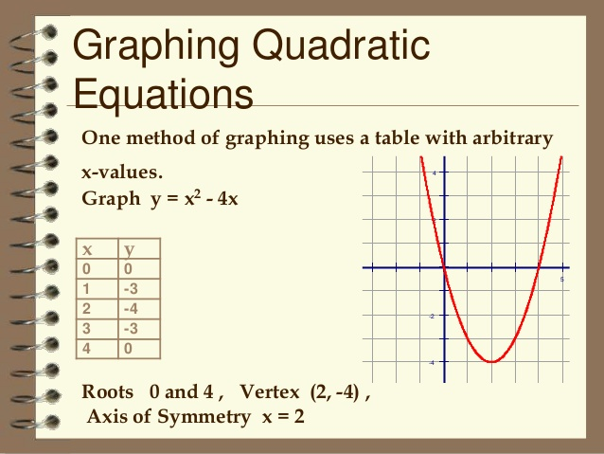

Slide 56
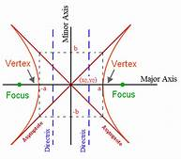

Slide 57
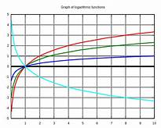

Slide 58
Coefficient of determination, R-square
The coefficient of determination, R², is useful because it gives the proportion of the variance (fluctuation) of one variable that is predictable from the other variable. It is a measure that allows us to determine how certain one can be in making predictions from a certain model/graph. The coefficient of determination is the ratio of the explained variation to the total variation. The coefficient of determination is such that 0<R²<1, and denotes the strength of the linear association between x and y. The coefficient of determination represents the percent of the data that is the closest to the line of best fit. For example, if R=0.922, then R²=0.850, which means that 85% of the total variation in y can be explained by the linear relationship between x and y (as described by the regression equation). The other 15% of the total variation in y remains unexplained. The coefficient of determination is a measure of how well the regression line represents the data. If the regression line passes exactly through every point on the scatter plot, it would be able to explain all of the variation. The further the line is away from the points, the less it is able to explain.
"R²×100 percent of the variation in y is reduced by taking into account predictor x" or:
"R²×100 percent of the variation in y is 'explained by' the variation in predictor x."

Slide 59
Coefficient of determination, R-square
Estimation from the sample is

Slide 60
Coefficient of determination, R-square

Slide 61
Coefficient of determination, R-square

Slide 62
Coefficient of determination, R-square

Slide 63
Coefficient of determination, R-square
Continuing (5)

Slide 64
Coefficient of determination, R-square
Continuing (5)

Slide 70
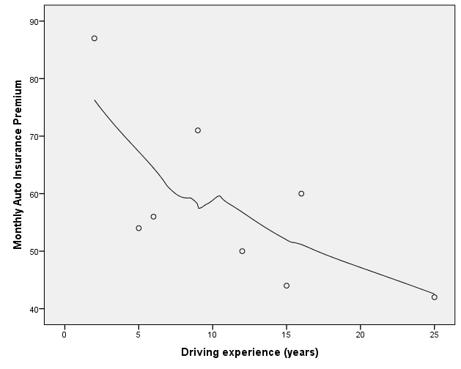
Nadaraja regression

