Slide 1
Examples for sufficient statistics

Slide 2
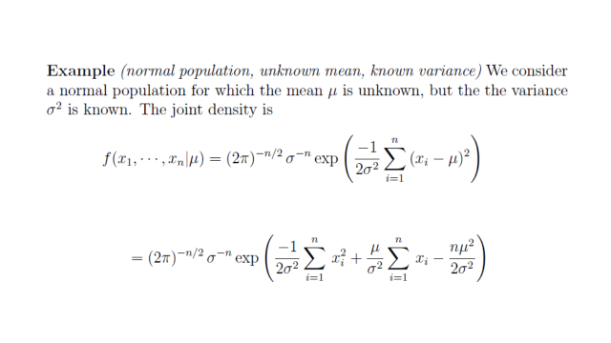

Slide 7
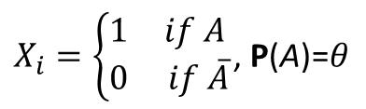
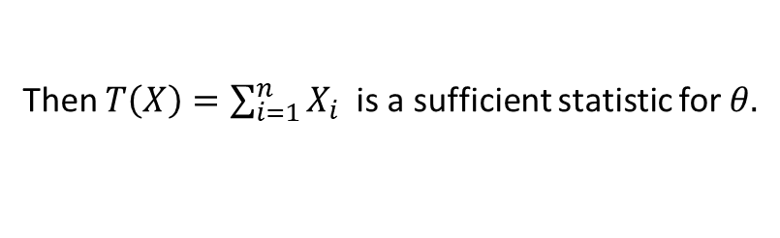
Next example is discrete. Prove that when the sample is Bernoulli distributed with parameter $θ$, ie
$X_{i}=\left\{\begin{matrix}1 & if A \\ 0 & if \overline{A}\end{matrix}\right.$, P(A)=$θ$
Then $T\left(X\right)=\sum_{i=1}^{n}{X_{i}}$ is a sufficient statistic for $θ.$

Slide 9
Efficiency

Slide 29
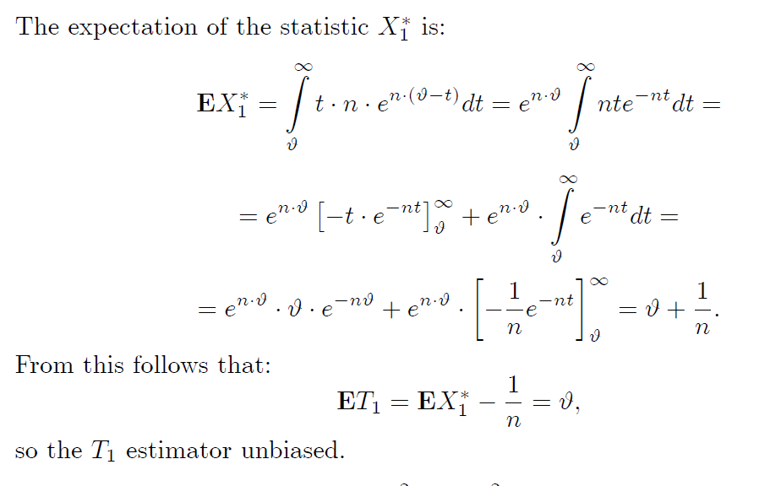

Slide 37
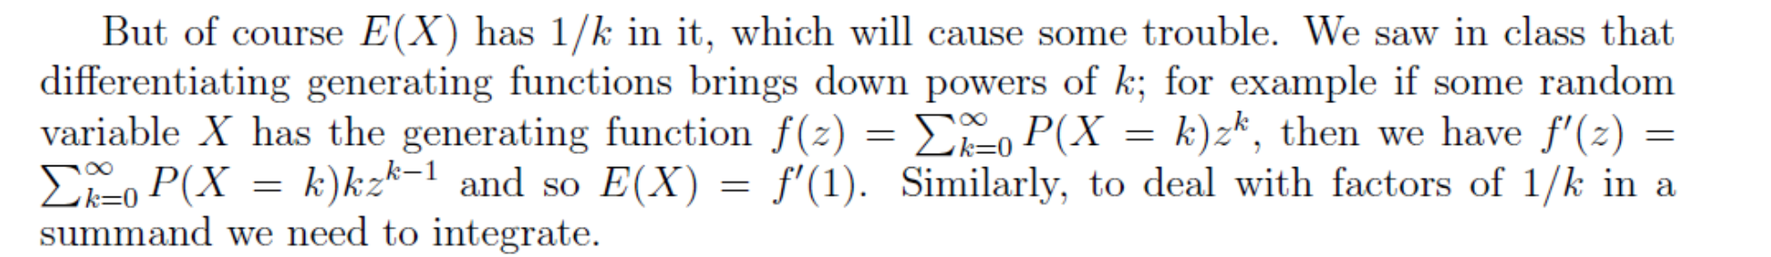

Slide 61


Slide 66


