Slide 1
Nonparametric tests
PhD course

Slide 2
Nonparametric tests
If the distribution of the population (the statistical sample) is not considered to be known, then we are talking about nonparametric tests.
In that case, our preliminary assumptions are very general, but natural; eg. assume that the pattern is continuous or we assume that the variance is finite, etc.
Since we have less assumptions at start (they are the a priori assumptions), we will need samples of larger numbers than we would for parametric tests to deduct our conclusions.
The distribution of the test statistics is only known as asymptotically.

Slide 3
Types of the nonparametric tests
Goodness of Fit Tests
H₀: The distribution of the analyzed variable is the same as hypothetical
Chi-Square Goodness of Fit Test
One-sample Kolmogorov Smirnov test
Graphical Methods: P-P and Q-Q tests
Tests for Independence
H₀: The variables analyzed are independent
Chi-Square Test for Independence
Tests of Homogeneity
H₀: The variables analyzed are distributed equally
Chi square test, Two-samples Kolmogorov-Smirnov, Wilcoxon, Mann-Whitney U, Kruskal-Wallis H, Friedmann, Levene etc.

Slide 4
Chi Square tests
Introduction

Slide 5
Chi Square tests

Slide 6
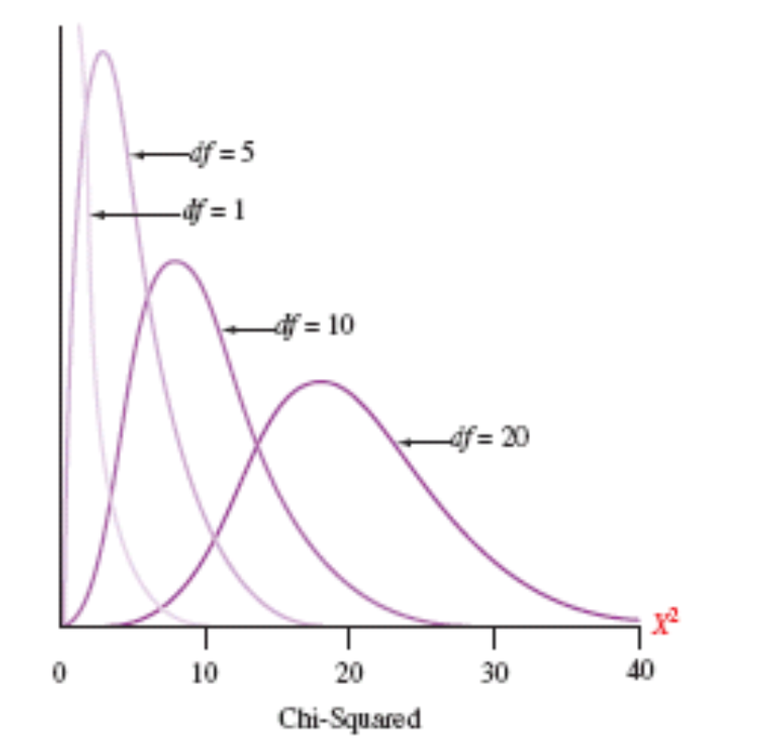
Chi-Square Distributions

Slide 7
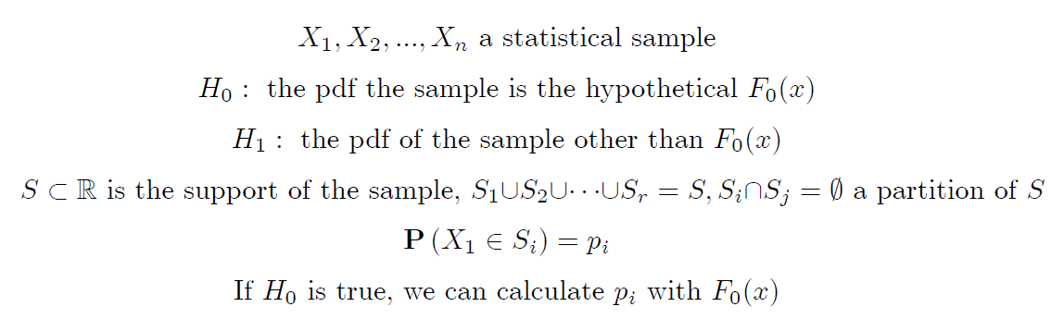
Chi Square tests
Testing goodness of fit

Slide 8
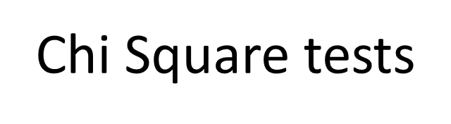
Testing goodness of fit

Slide 9
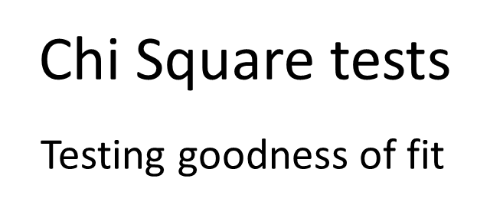
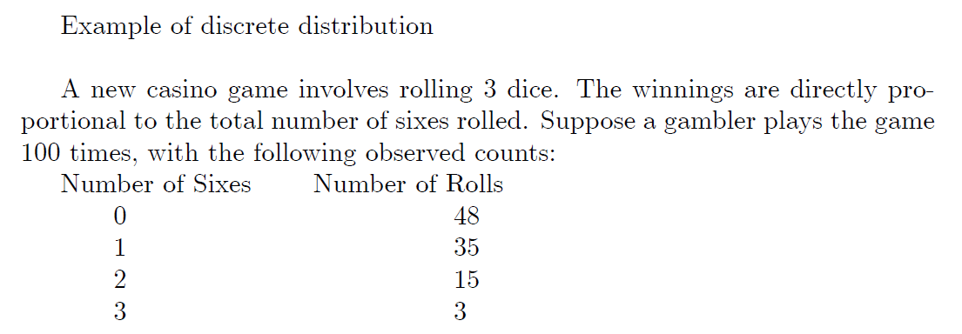
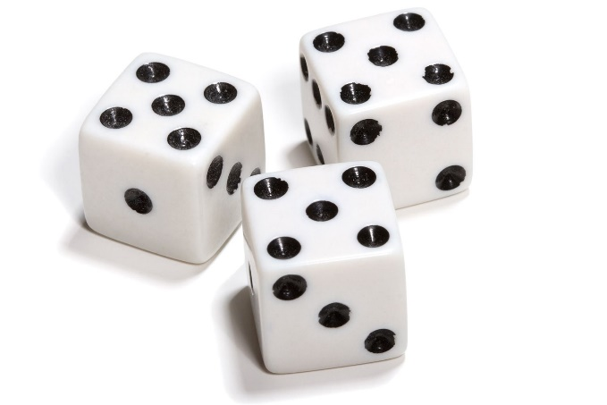

Slide 12
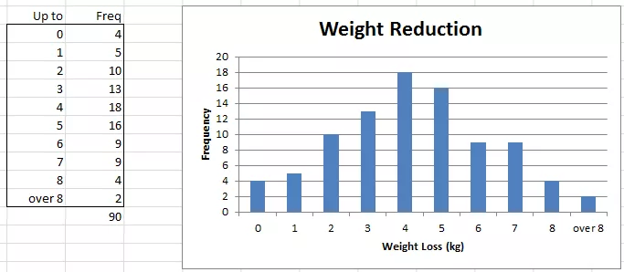
Example 1: 90 people were put on a weight gain program. The following frequency table shows the weight gain (in kilograms). Test whether the data is normally distributed with mean 4 kg and standard deviation of 2.5 kg.

Slide 13
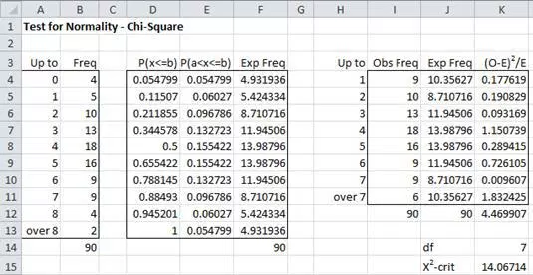

Slide 15
Goodness of fit test In case of unknown parameters

Slide 16
Goodness of fit test In case of unknown parameters

Slide 17
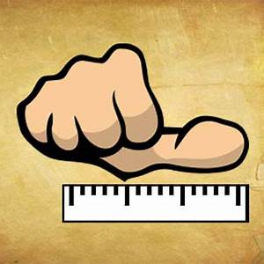
„rules of thumb”
A sample with a sufficiently large size is assumed. If a chi squared test is conducted on a sample with a smaller size, then the chi squared test will yield an inaccurate inference. The researcher, by using chi squared test on small samples, might end up committing a Type II error.
Adequate expected cell counts. Some require 5 or more, and others require 10 or more. A common rule is 5 or more in all cells of a 2-by-2 table, and 5 or more in 80% of cells in larger tables, but no cells with zero expected count. When this assumption is not met, Yates's correction is applied.

Slide 18
Chi square test for independence

Slide 19
Chi square test for independence

Slide 20
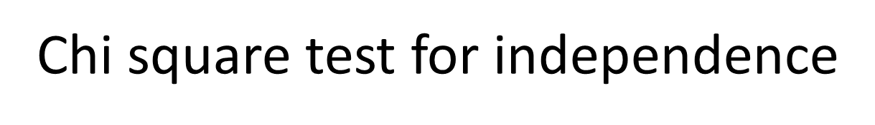

Slide 21
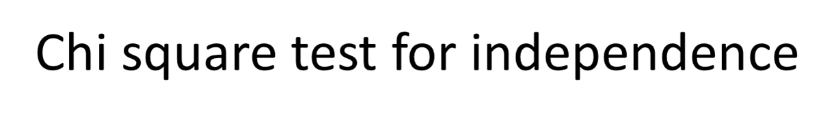

Slide 24
Example: Political Affiliation and Opinion and Tax Reform
Let's apply the Chi-square Test of Independence to our example where we have as random sample of 500 U.S. adults who are questioned regarding their political affiliation and opinion on a tax reform bill. We will test if the political affiliation and their opinion on a tax reform bill are dependent at a 5% level of significance. The observed contingency table is given in the next slide. Also we often want to include each cell's expected count and contribution to the Chi-square test statistic which can be done by the software

Slide 28
Chi square test for homogeneity

Slide 29
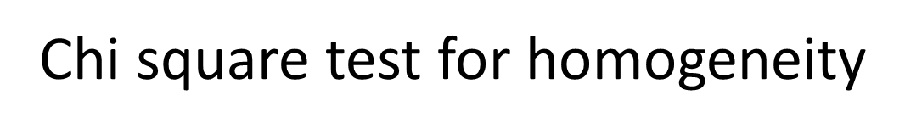

Slide 32
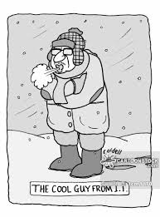
Compare the distributions of the january temperatures of Budapest between the periods 1780-1900 and 1901-2015.

Slide 33
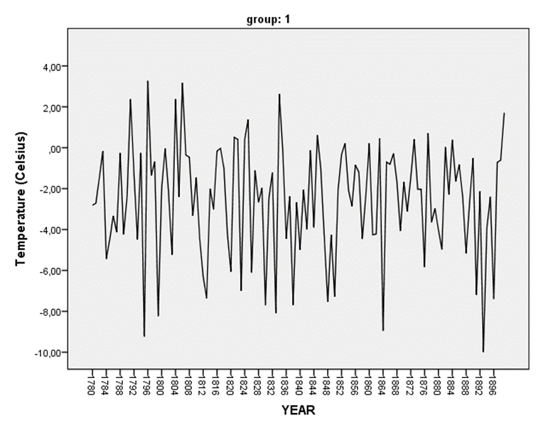
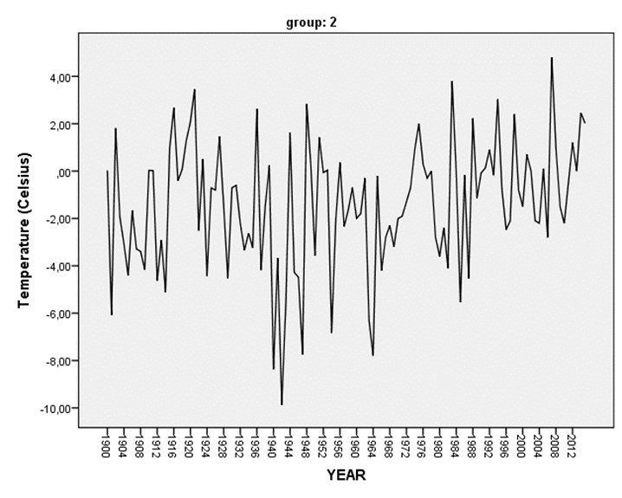

Slide 34
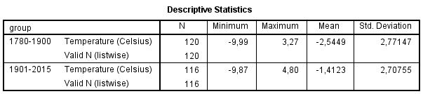
n=210, m=116

Slide 35
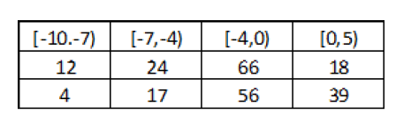
The assumption of the homogeneity is rejected.

Slide 36
One sample Kolmogorov-Smirnov test

Slide 37


Slide 41
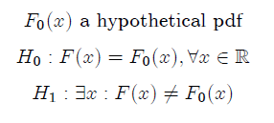

Slide 43

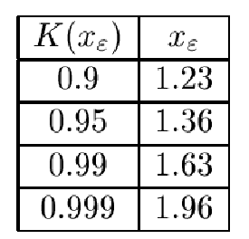
Kolmogorov-Smirnov pdf

Slide 44
EXAMPLE

Slide 46
EXAMPLE
Ordering the sample:
0.23, 0.33, 0.42, 0.43, 0.52, 0.53, 0.58, 0.58, 0.64, 0.76

Slide 47
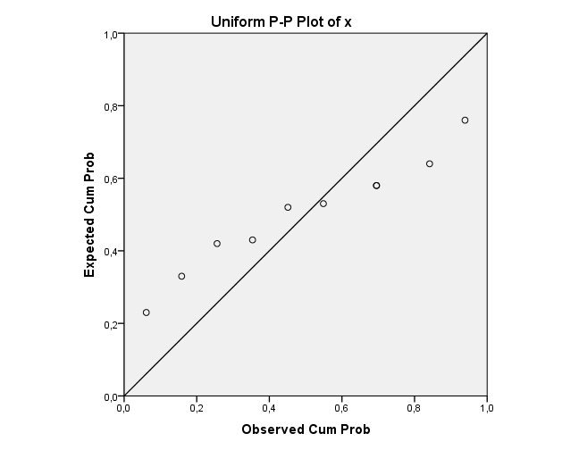
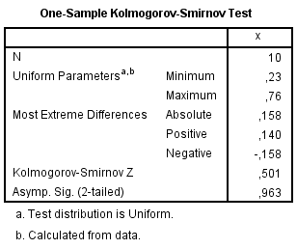
Executed with SPSS

Slide 48
Two samples Kolmogorov Smirnov test
Testing homogeneity

Slide 49
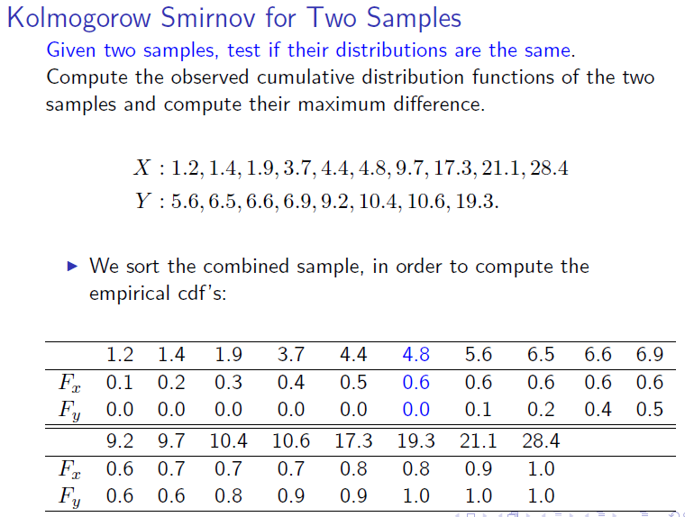

Slide 52
N=n+m

Slide 53
Kruskal-Wallis test
Testing homogeneity of p independent samples

Slide 54
Kruskal-Wallis test

Slide 55

Post Hoc Test:
If the null hypothesis is rejected for we execute Mann-Whitney test for each sample pairs to detect differences.

Slide 56
Wilcoxon test

Slide 57
Wilcoxon test

Slide 58
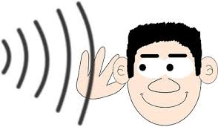
Example
Suppose we wanted to know if people's ability to report words accurately was
affected by which ear they heard them in. To investigate this, we performed a
dichotic listening task. Each participant heard a series of words, presented randomly
to either their left or right ear, and reported the words if they could. Each participant
thus provided two scores: the number of words that they reported correctly from their
left ear, and the number reported correctly from their right ear. Do participants report
more words from one ear than the other? Although the data are measurements on a
ratio scale ("number correct" is a measurement on a ratio scale), the data were found
to be positively skewed (i.e. not normally distributed) and so we use the Wilcoxon
test.
In the next slide are the data. It looks like, on average, more words are reported if they are
presented to the right ear. However it's not a big difference, and not all participants
show it. Therefore we'll use a Wilcoxon test to assess whether the difference between
the ears could have occurred merely by chance.

Slide 59
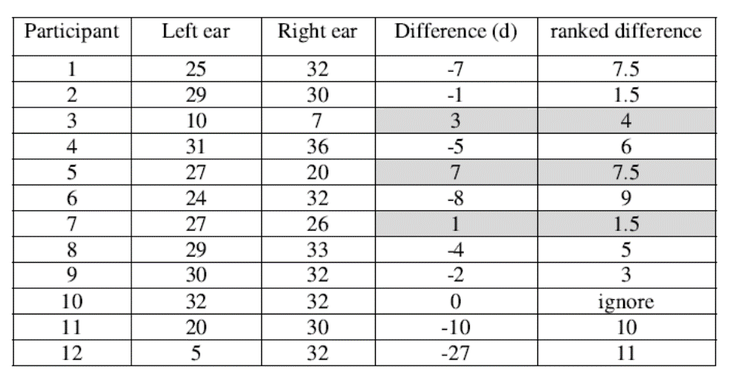
R₊=4+7.5+1.5=13,
R₋=7.5+1.5+6+9+5+3+10+11=53
The null hypothesis is rejected.

Slide 60
Friedman test

Slide 61


Slide 63

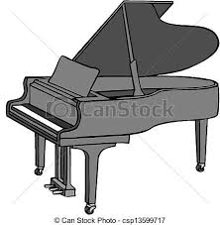

Friedman test example
The venerable auction house of Snootly & Snobs will soon be putting three fine 17th-and 18th-century violins, A, B, and C, up for bidding. A certain musical arts foundation, wishing to determine which of these instruments to add to its collection, arranges to have them played by each of 10 concert violinists. The players are blindfolded, so that they cannot tell which violin is which; and each plays the violins in a randomly determined sequence (BCA, ACB, etc.).
They are not informed that the instruments are classic masterworks; all they know is that they are playing three different violins. After each violin is played, the player rates the instrument on a 10-point scale of overall excellence (1=lowest, 10=highest). The players are told that they can also give fractional ratings, such as 6.2 or 4.5, if they wish. The results are shown in the adjacent table. For the sake of consistency, the n=10 players are listed as "subjects."

Slide 64
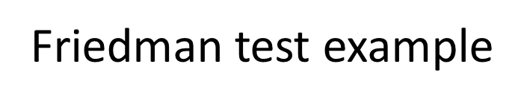

Slide 65
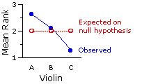
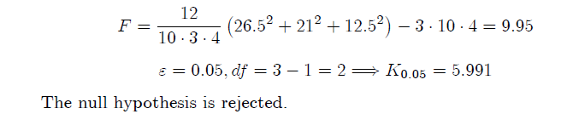
The musical arts foundation can therefore conclude with considerable confidence that the observed differences among the mean rankings for the three violins reflect something more than mere random variability, something more than mere chance coincidence among the judgments of the expert players.

Slide 66
Levene's test

Slide 67
Levene's test

Slide 68
Levene's test

Slide 69
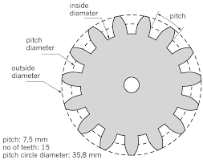
Example

Slide 70
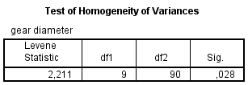

Example
p=10; n_{i}=10, i=1,…,10; n=100
df₁=p-1=10-1=9, df2=n-p=100-90=90
The null hypothesis is accepted, i.e. the branch of the gears have identical variances.

