Slide 1
Nearest Neighbor Decision Rule
PhD Course

Slide 2
The distance function (the metric)

Slide 3
Examples

Slide 4
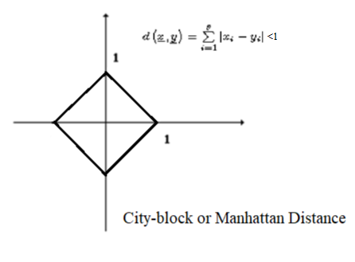
Unit Circle Representations

Slide 5
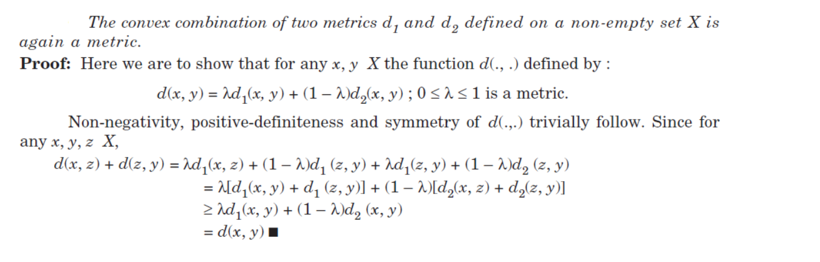
Constructing Metrics 1.

Slide 6
Constructing Metrics 2.

Slide 8
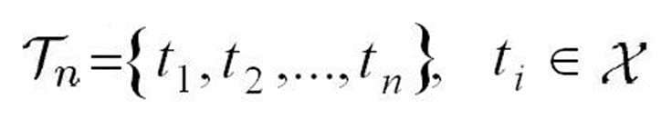

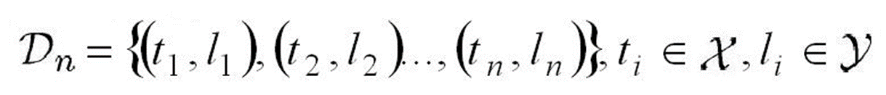
Nearest Neighbor Decision Rule
The set of all training points
The feature space (a metric space)
The set of classes
The training set

Slide 9


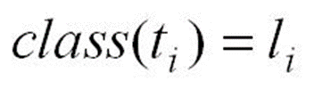
Nearest Neighbor Decision Rule
The ith training point
The ith ‚teaching’ the class of the ith training point
where

Slide 10
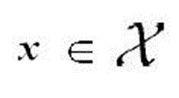
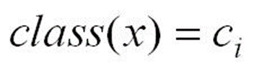
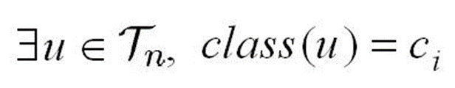
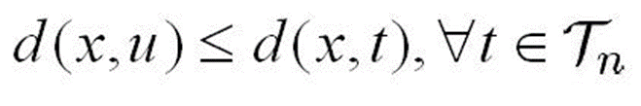
Nearest Neighbor Decision Rule
a point with unknown category (query point)
if
such that
if

Slide 11
Cover-Hart inequality for M > 2

Slide 12
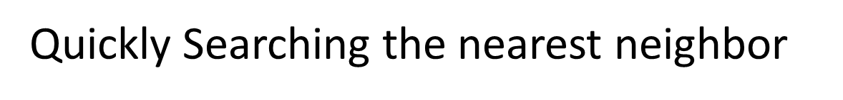
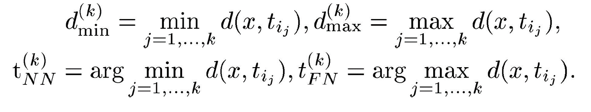
Notations:

Slide 13
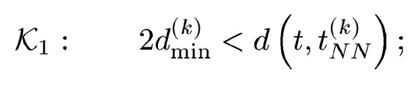
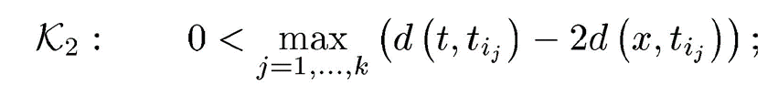
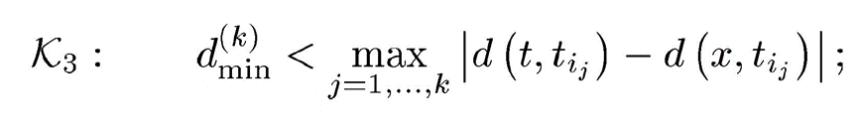
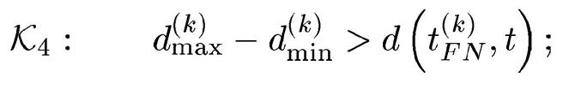
Quickly Searching the nearest neighbor
THEOREM: The learning point should not be the nearest neighbor of the query point x if one of the following exclusion criteria is true:

Slide 15
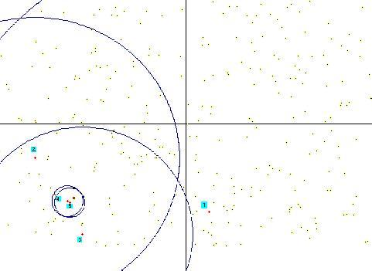
The K₁ exclusion criteria
the query point

Slide 19
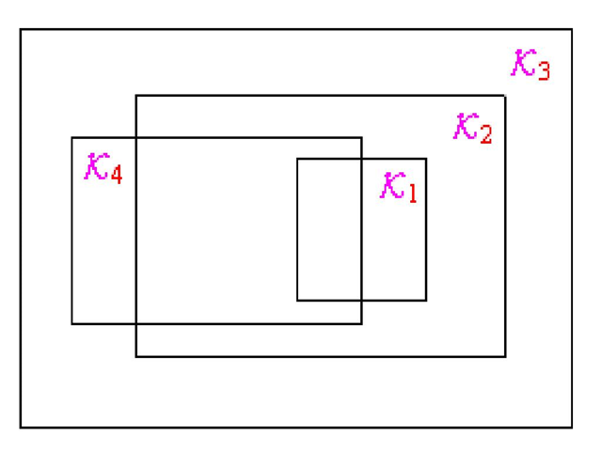
The force connection between exclusion criterias

Slide 20
Cluster Analysis

Slide 21
Algorithm Description
What is Cluster Analysis?
Cluster analysis groups data objects based only on
information found in data that describes the objects and their
relationships.
Goal of Cluster Analysis
The objects within a group be similar to one another and
different from the objects in other groups

Slide 22

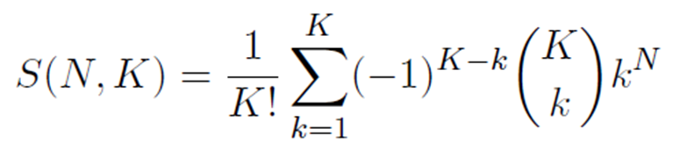
Theoretically if we would also be able to work out all possible grouping then we can select the best one.
How many ways can we group N elements into groups K?
This is too big number to do so. We need algorithms which create good groupings, then we can choose a "very good" among this.

Slide 23
Algorithm Description
Types of Clustering
Partitioning and Hierarchical Clustering
Hierarchical Clustering
A set of nested clusters organized as a hierarchical tree
Partitioning Clustering
- A division data objects into non-overlapping subsets
(clusters) such that each data object is in exactly one subset

Slide 24
Algorithm Description
Hierarchical Clustering
A Partitional Clustering

Slide 25
Algorithm Description
What is K-means?
1. Partitional clustering approach
2. Each cluster is associated with a centroid (center point)
3. Each point is assigned to the cluster with the closest centroid
4. Number of clusters, K, must be specified

Slide 26
Algorithm Statement
Basic Algorithm of K-means

Slide 27
Algorithm Statement
Details of K-means
1. Initial centroids are often chosen randomly.
- Clusters produced vary from one run to another
2. The centroid is (typically) the mean of the points in the cluster.
3.‘Closeness’ is measured by Euclidean distance, cosine similarity, correlation,
etc.
4. K-means will converge for common similarity measures mentioned above.
5. Most of the convergence happens in the first few iterations.
- Often the stopping condition is changed to ‘Until relatively few points
change clusters’

Slide 28
Example of K-means
Select three initial centroids

Slide 29
Example of K-means
Assigning the points to nearest K clusters and re-compute the centroids

Slide 30
Example of K-means
K-means terminates since the centroids converge to certain points and do not change.

Slide 31
Example of K-means

Slide 32
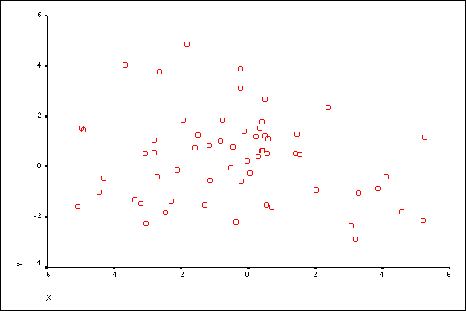
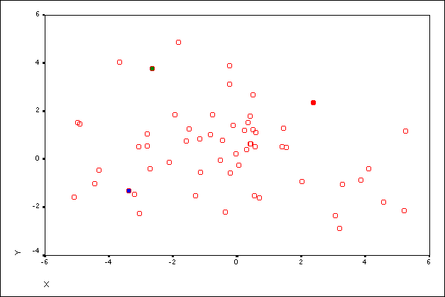
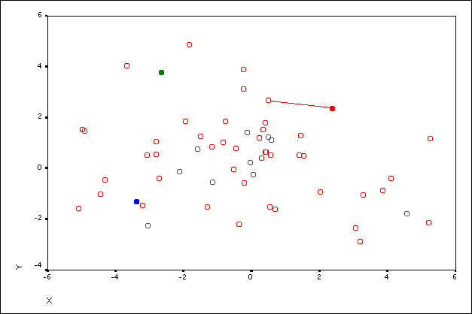
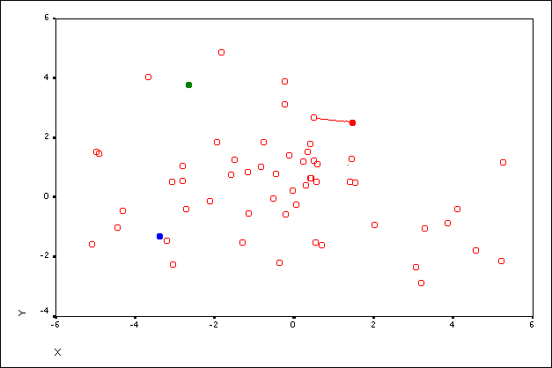
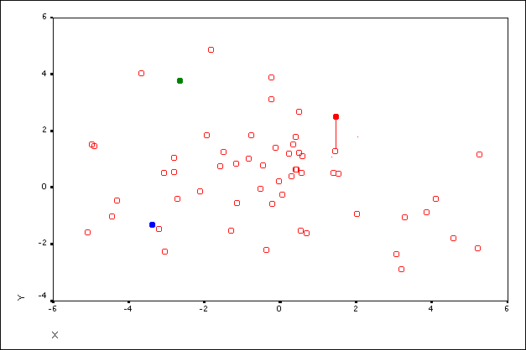
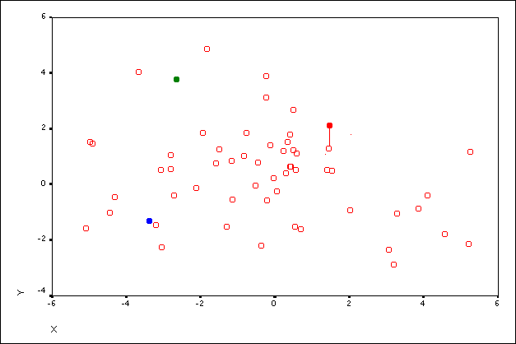
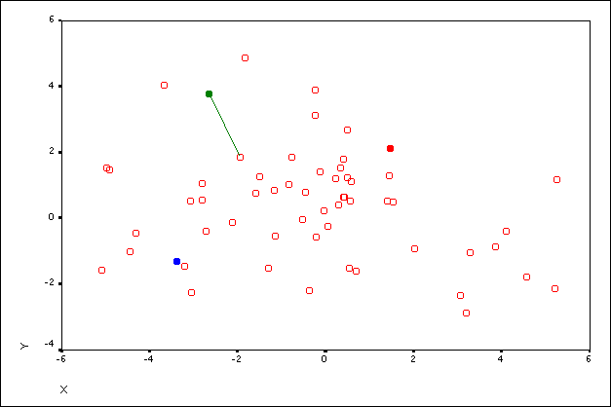
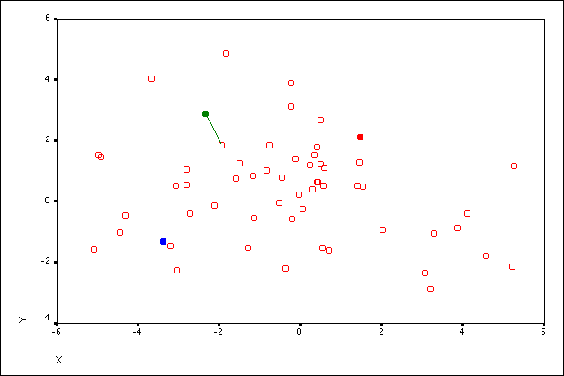

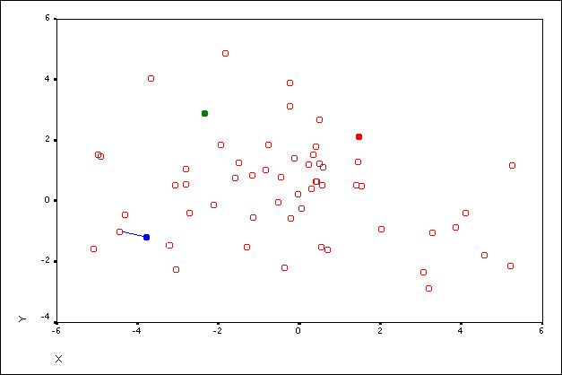
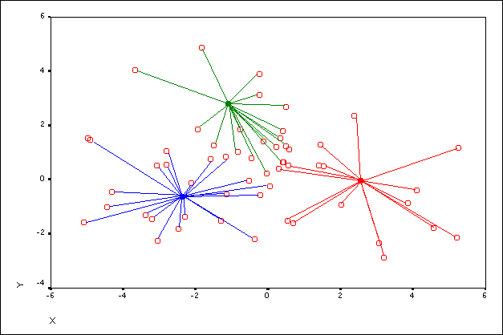
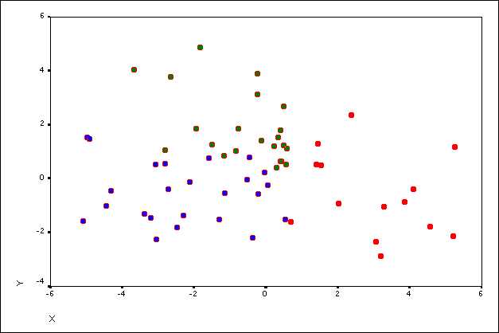
2018. 04. 24.
Dr Ketskeméty László előadása
32

Slide 33
Problem about K
How to choose K?
Use another clustering method, then estimate it…
2. Run algorithm on data with several different values of K and choose the value what seems to be better.
3. Use the prior knowledge about the characteristics of the problem.

Slide 34
Problem about initialize centers
How to initialize centers?
- Random Points in Feature Space
- Random Points From Data Set
- Look For Dense Regions of Space
- Space them uniformly around the feature space

Slide 35
Cluster Quality
Since any data can be clustered, how do we know our clusters are meaningful?
  The size (diameter) of the cluster vs The inter-cluster distance
  Distance between the members of a cluster and the cluster’s center
  Diameter of the smallest sphere
The ability to discover some or all the hidden patterns

Slide 36
Cluster Quality

Slide 37
Limitation of K-means
K-means has problems when clusters are of differing
Sizes
Densities
Non-globular shapes
K-means has problems when the data contains
outliers.

Slide 38


Slide 39
Limitation of K-means
Non-convex/non-round-shaped clusters: Standard K-means fails!

Slide 40
Limitation of K-means
Clusters with different densities:

Slide 41
The McQUEEN algorithm (1967)

Slide 42


Slide 45
(Proof of the MCQueen Theorem)

Slide 46
(Proof of the MCQueen Theorem)

Slide 47
(Proof of the MCQueen Theorem)

Slide 48
(Proof of the MCQueen Theorem)
So
(Here we use the (*) assumption: )

Slide 49
Hierarchical Clustering

Slide 50
Hierarchical Clustering
Agglomerative (bottom-up) Clustering
1 Start with each example in its own singleton cluster
2 At each time-step, greedily merge 2 most similar clusters
3 Stop when there is a single cluster of all examples, else go to 2
Divisive (top-down) Clustering
1 Start with all examples in the same cluster
2 At each time-step, remove the “outsiders” from the least cohesive cluster
3 Stop when each example is in its own singleton cluster, else go to 2
Agglomerative is more popular and simpler than divisive (but less accurarate)

Slide 51
Hierarchical Clustering
(Dis)similarity between clusters
We know how to compute the dissimilarity d(x_{i}, x_{j}) between two elements.
How to compute the dissimilarity between two clusters R and S?
Min-link or single-link: results in chaining (clusters can get very large)
Max-link or complete-link: results in small, round shaped clusters
Average-link: compromise between single and complexte linkage

Slide 52
Hierarchical Clustering
(Dis)similarity between clusters

Slide 53
K-means Clustering vs Hierarchical Clustering
k-means clustering produces a single partitioning
Hierarchical Clustering can give different partitionings depending on the level-of-resolution we are looking at
k-means clustering needs the number of clusters to be specified
Hierarchical clustering doesn’t need the number of clusters to be specified
k-means clustering is usually more efficient run-time wise
Hierarchical clustering can be slow (has to make several merge/split decisions)
No clear consensus on which of the two produces better clustering

Slide 54
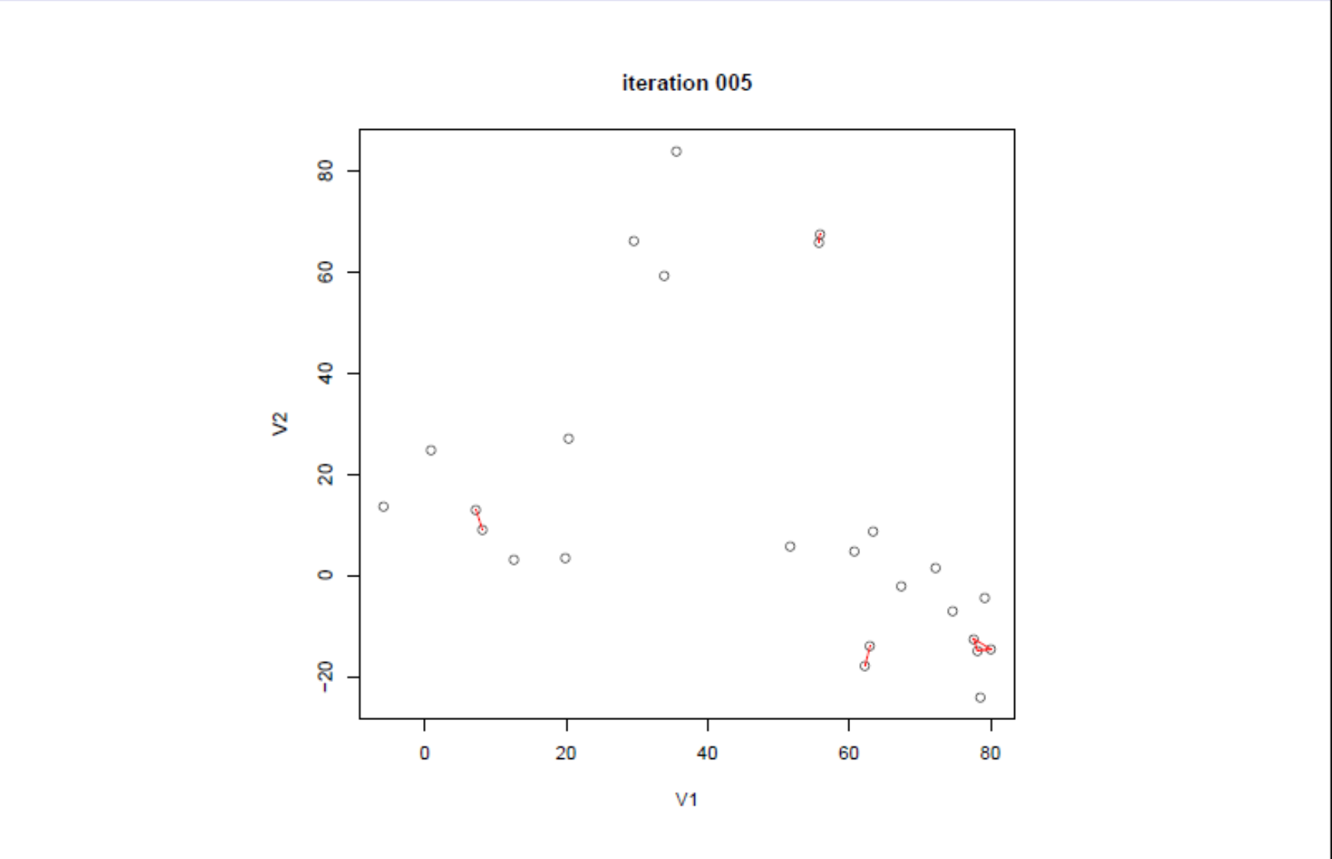
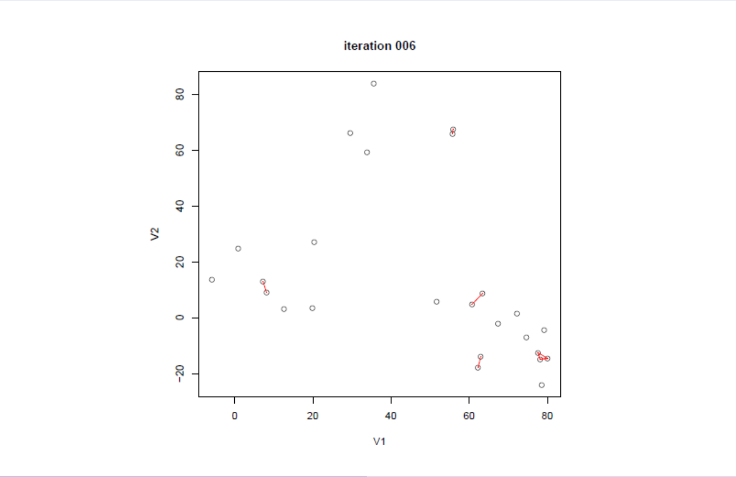
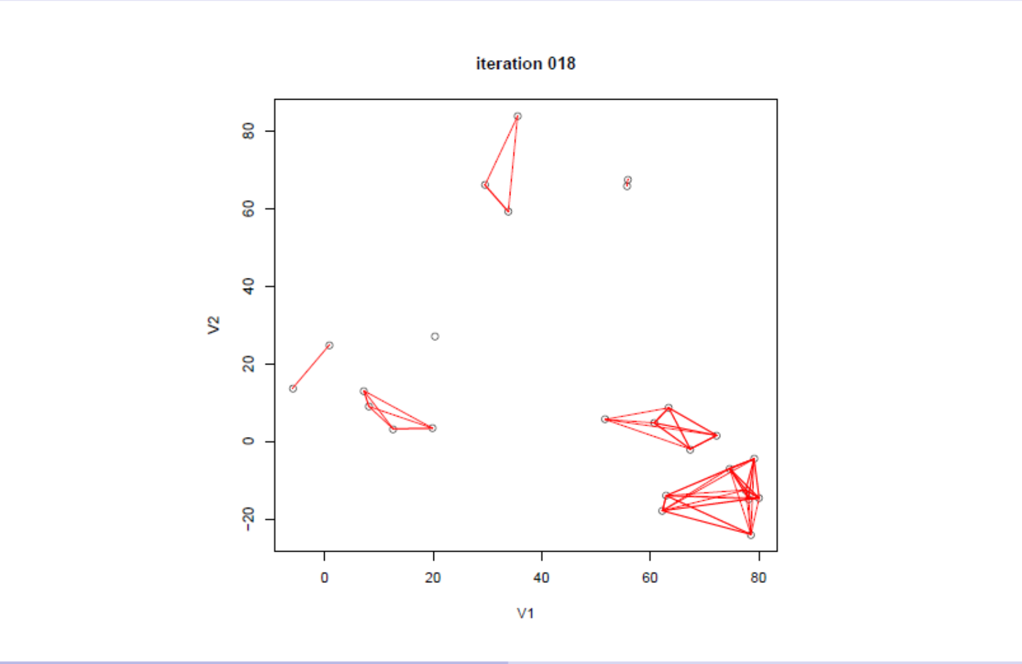
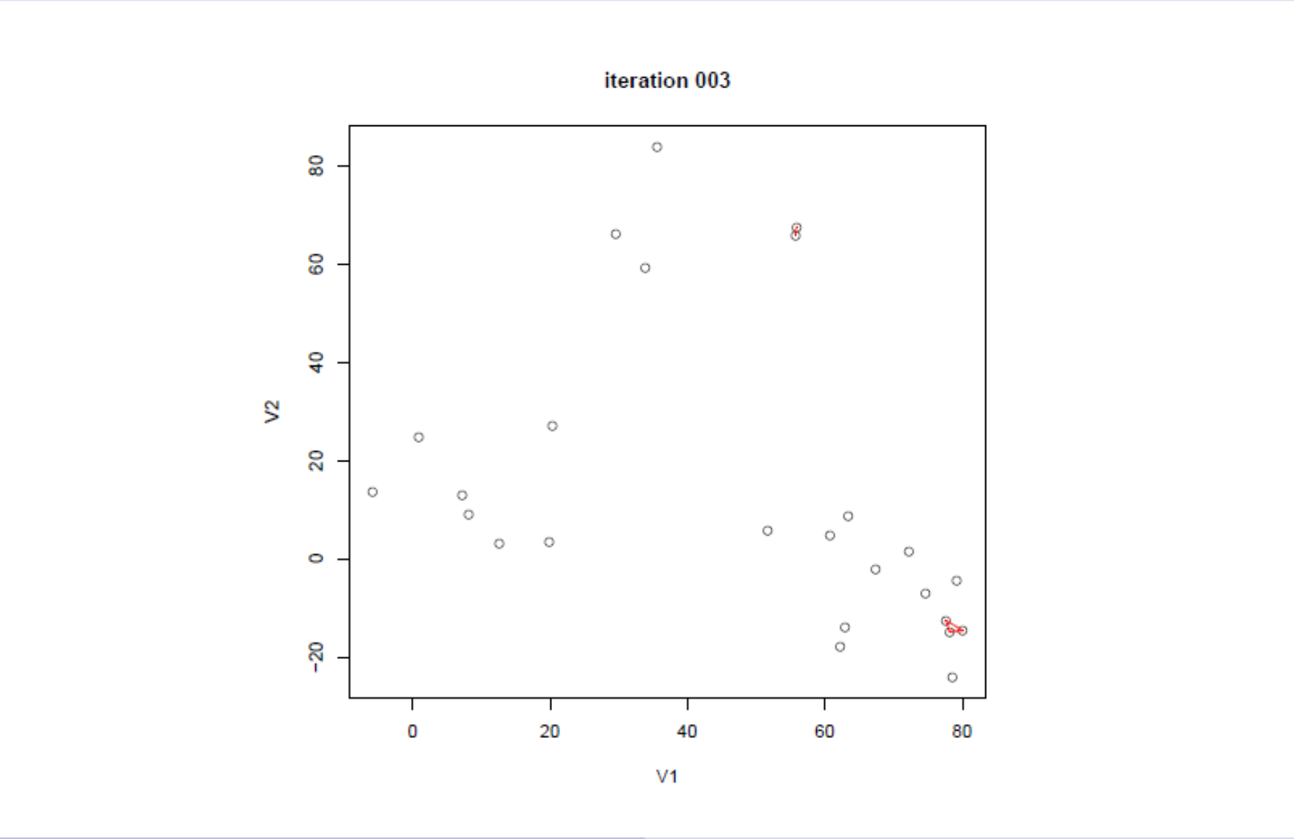
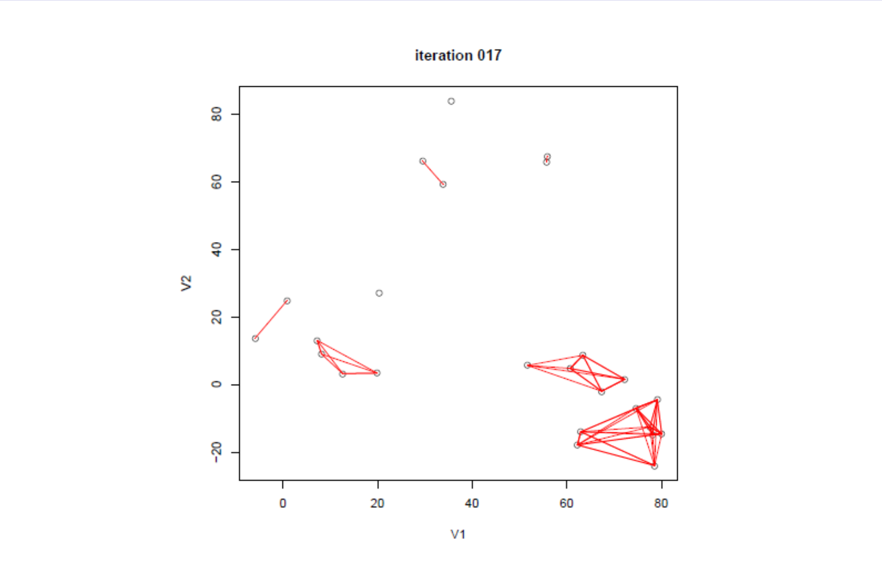
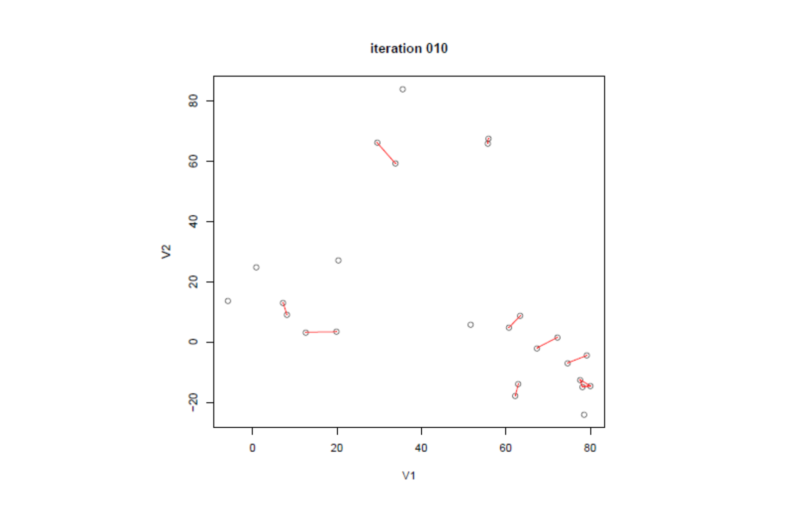
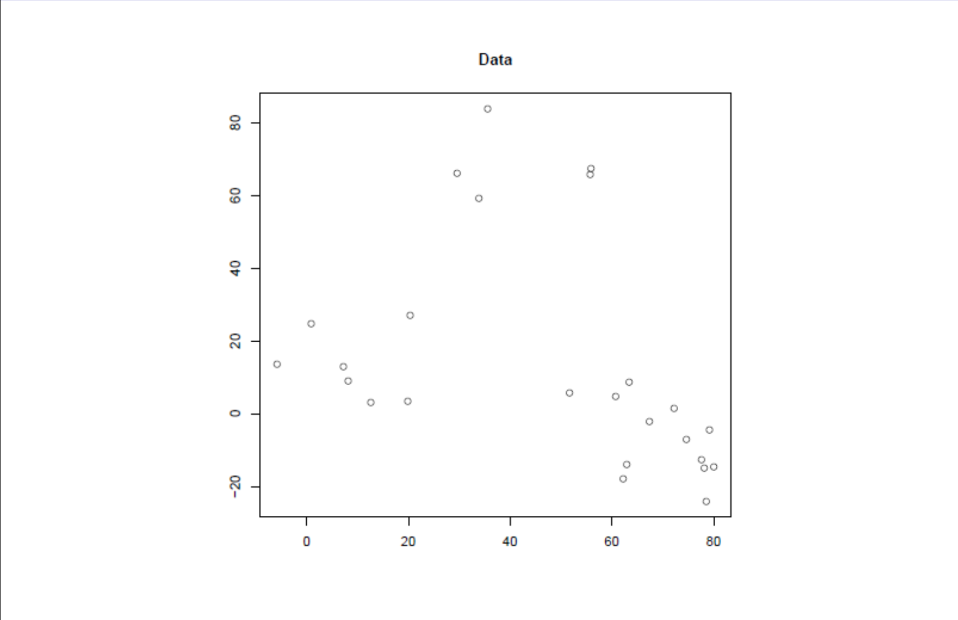
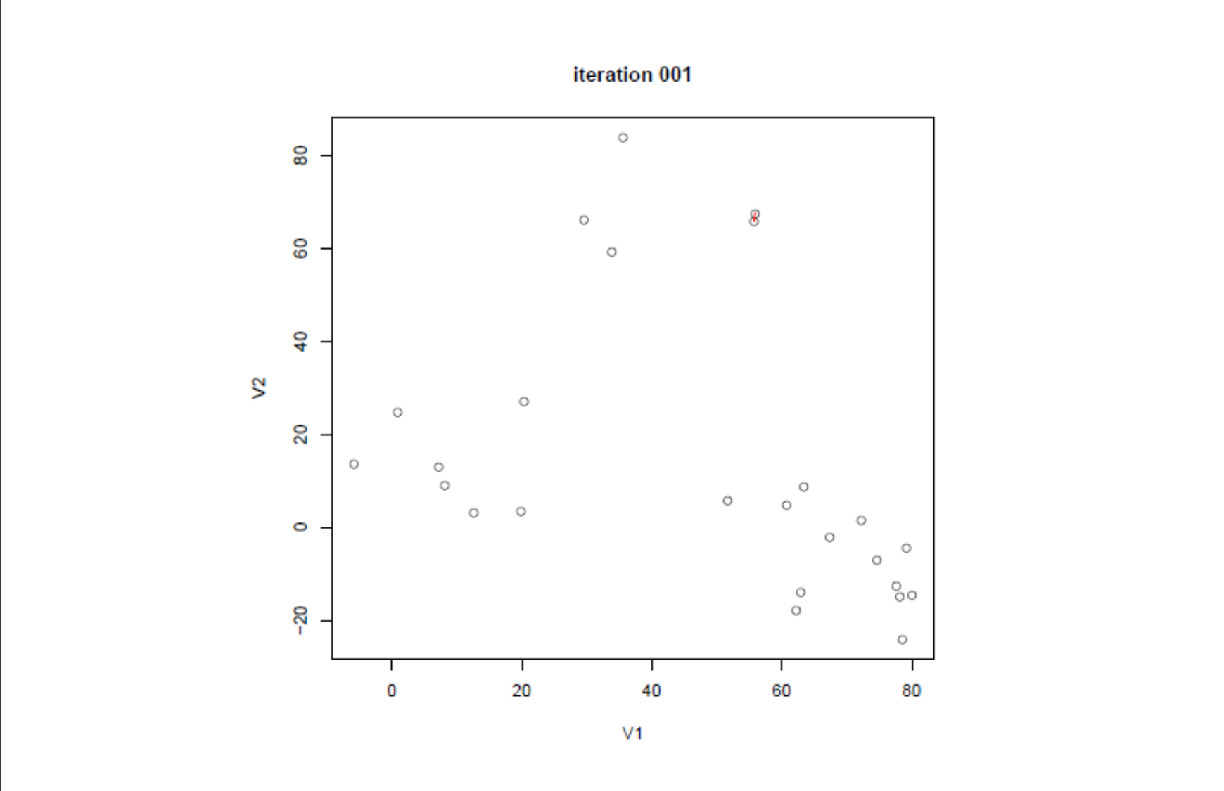
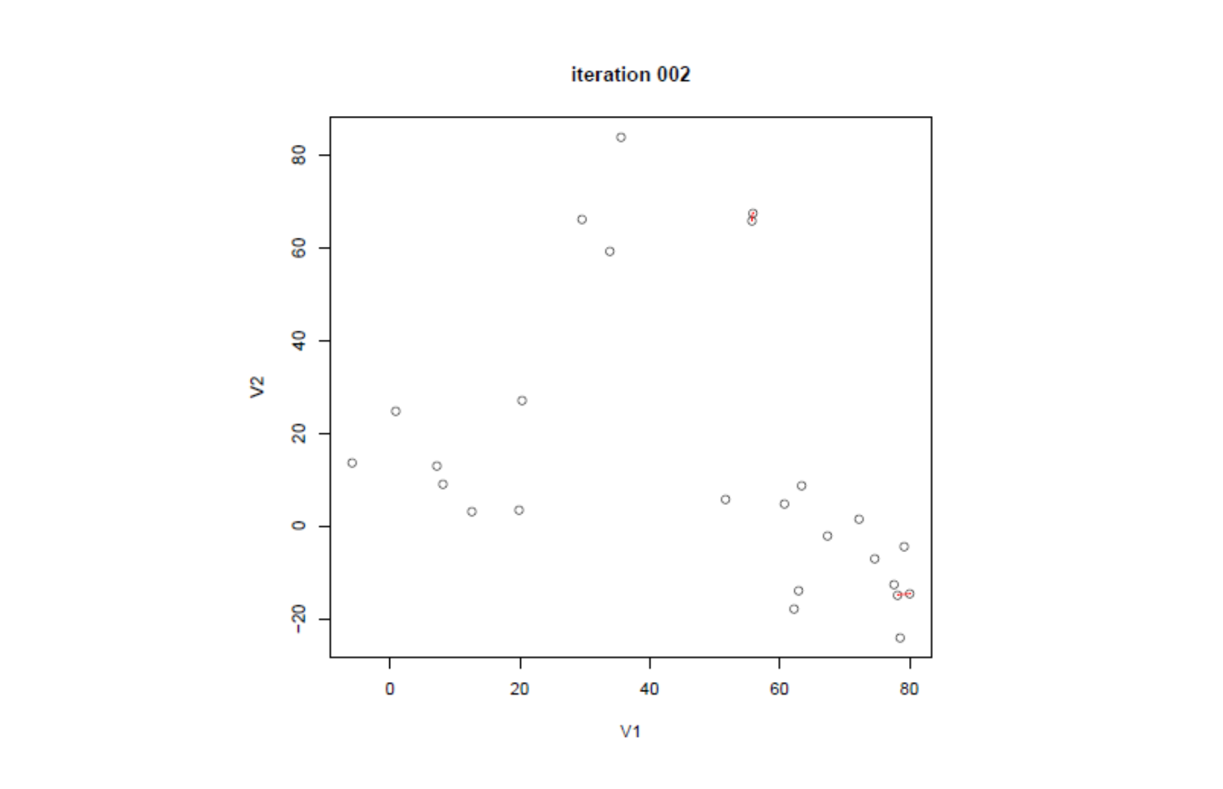
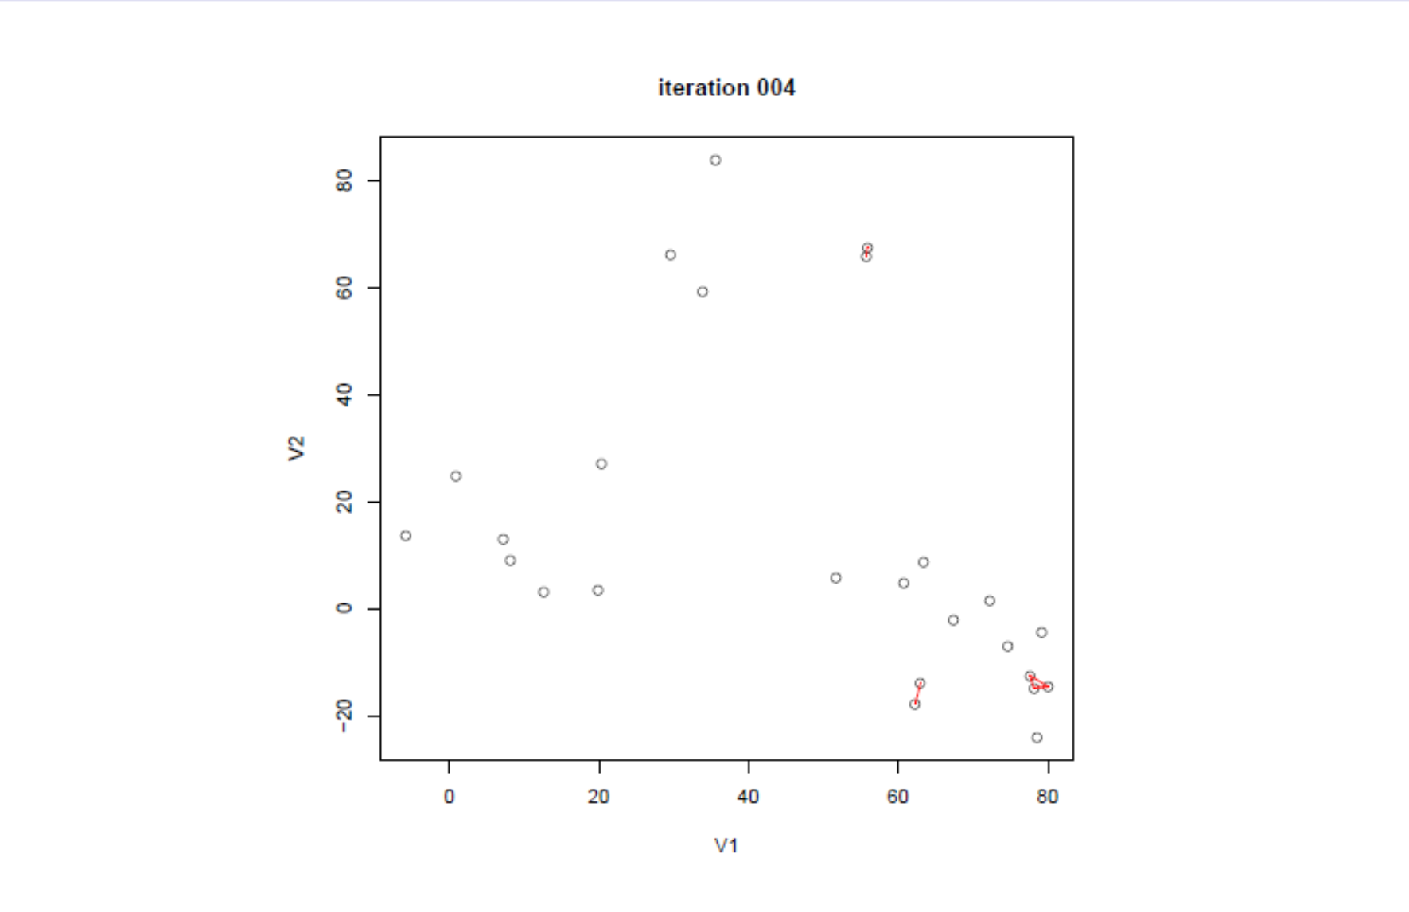
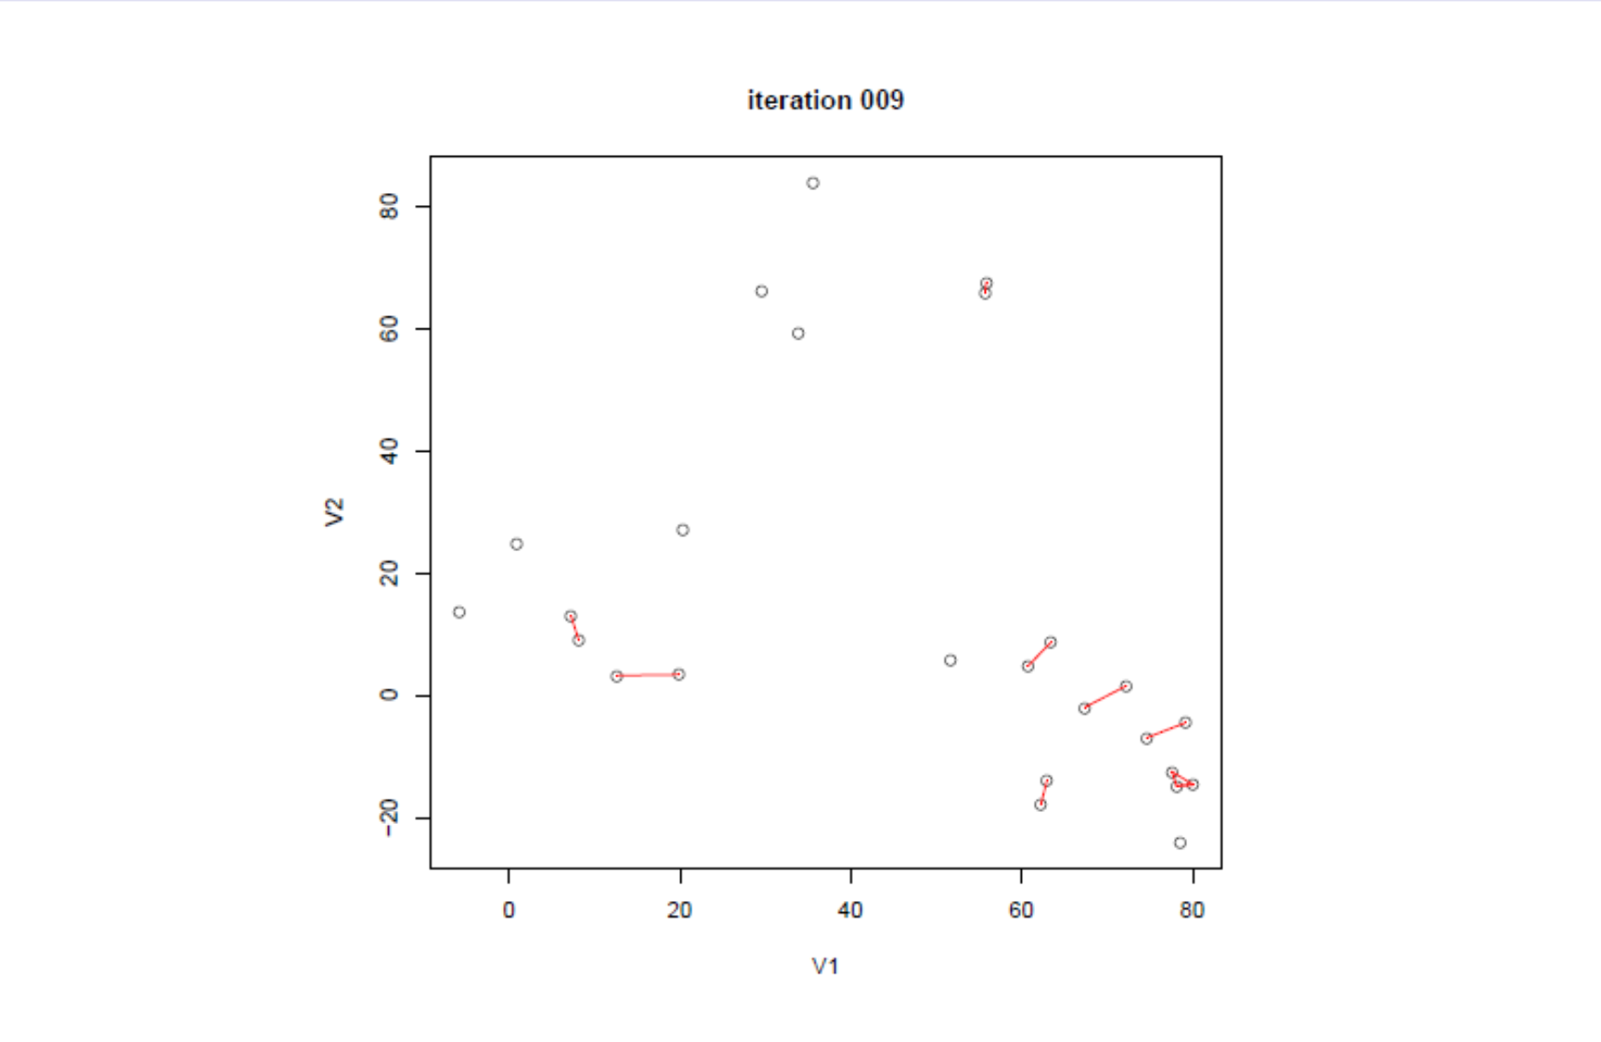
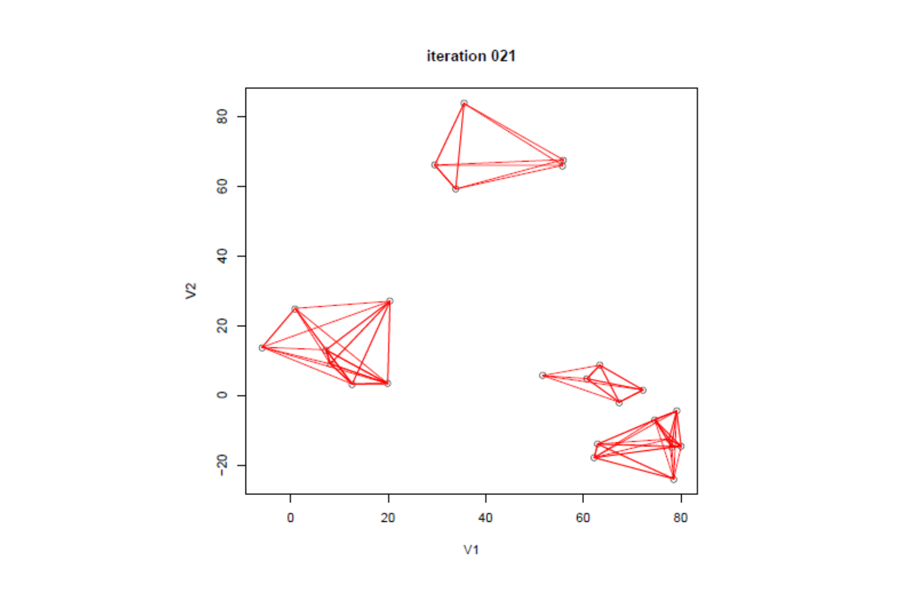
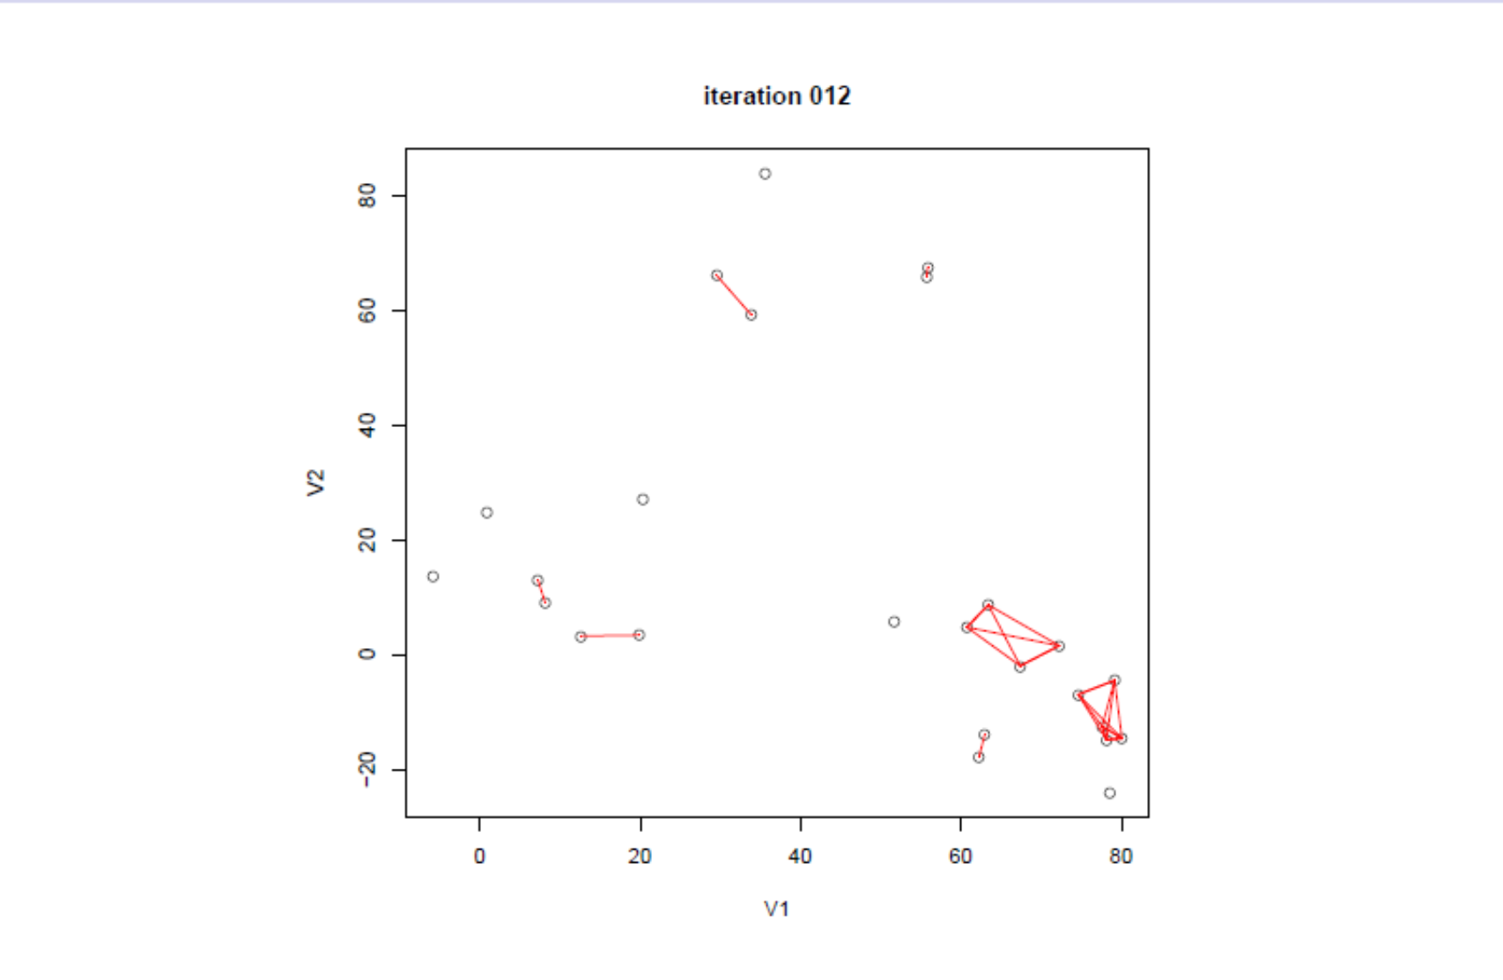
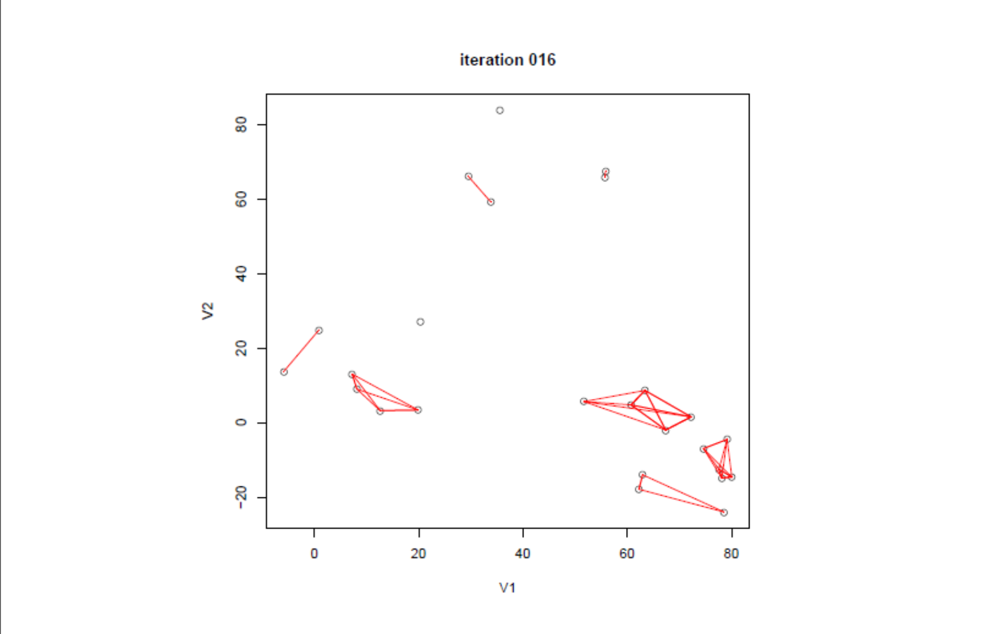
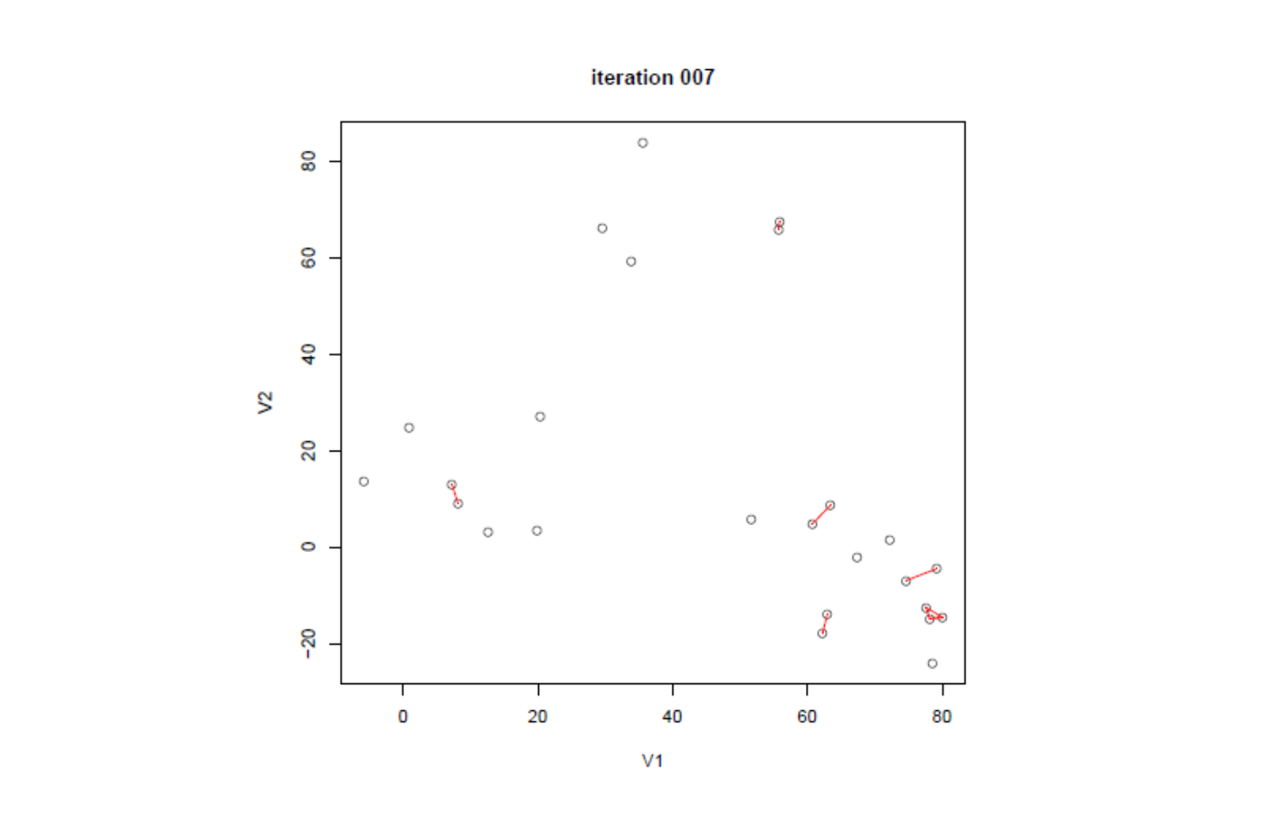
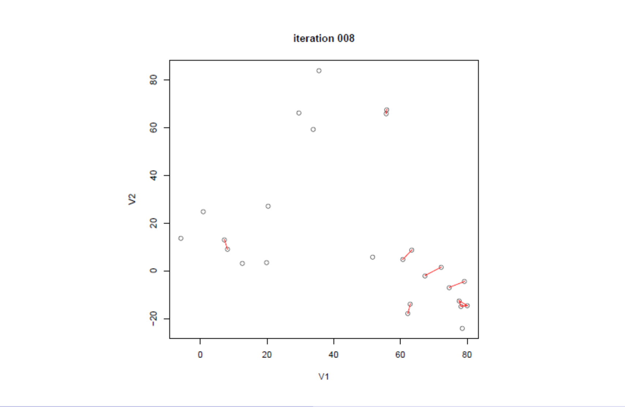
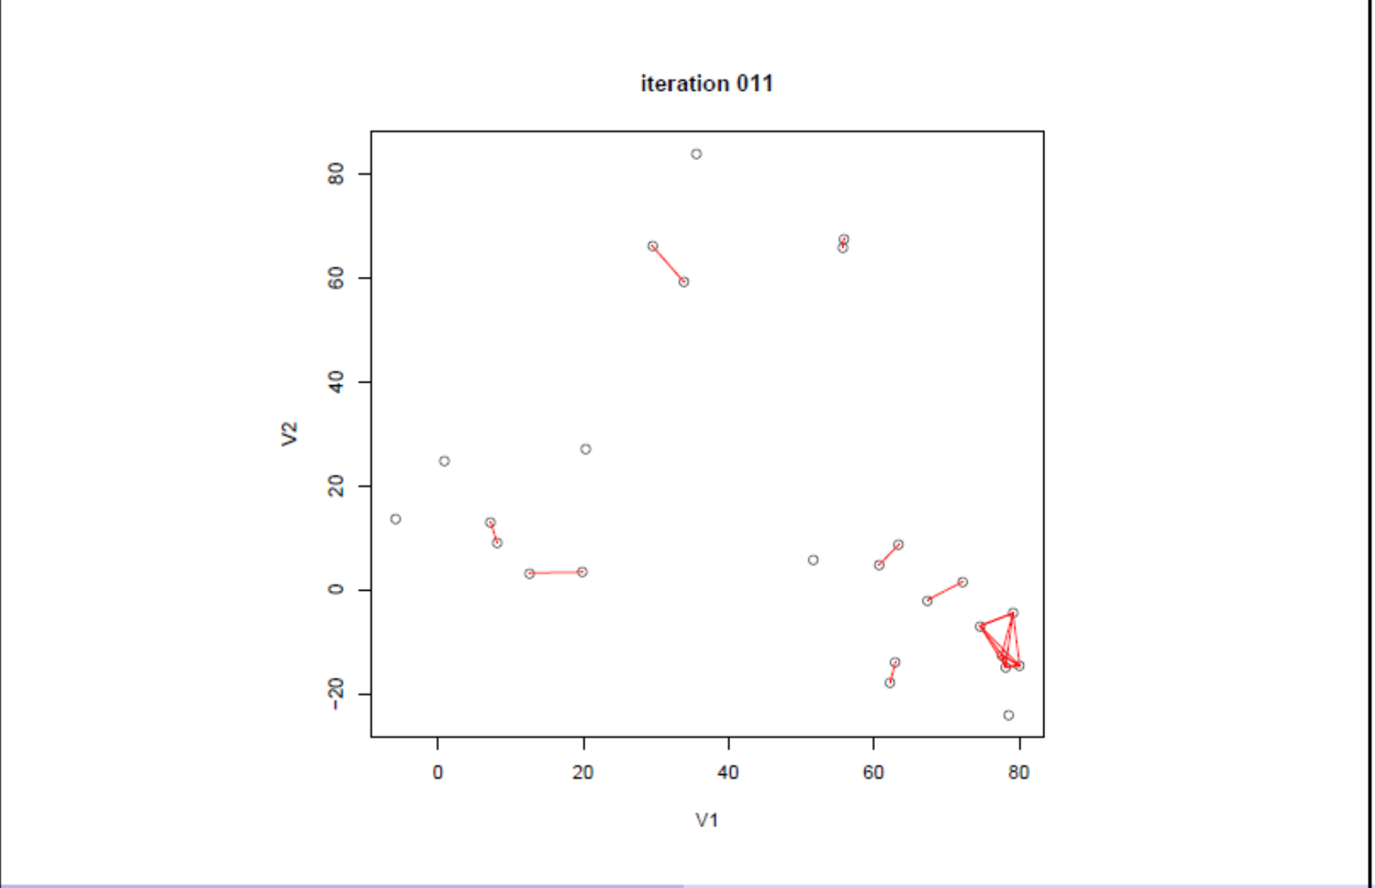
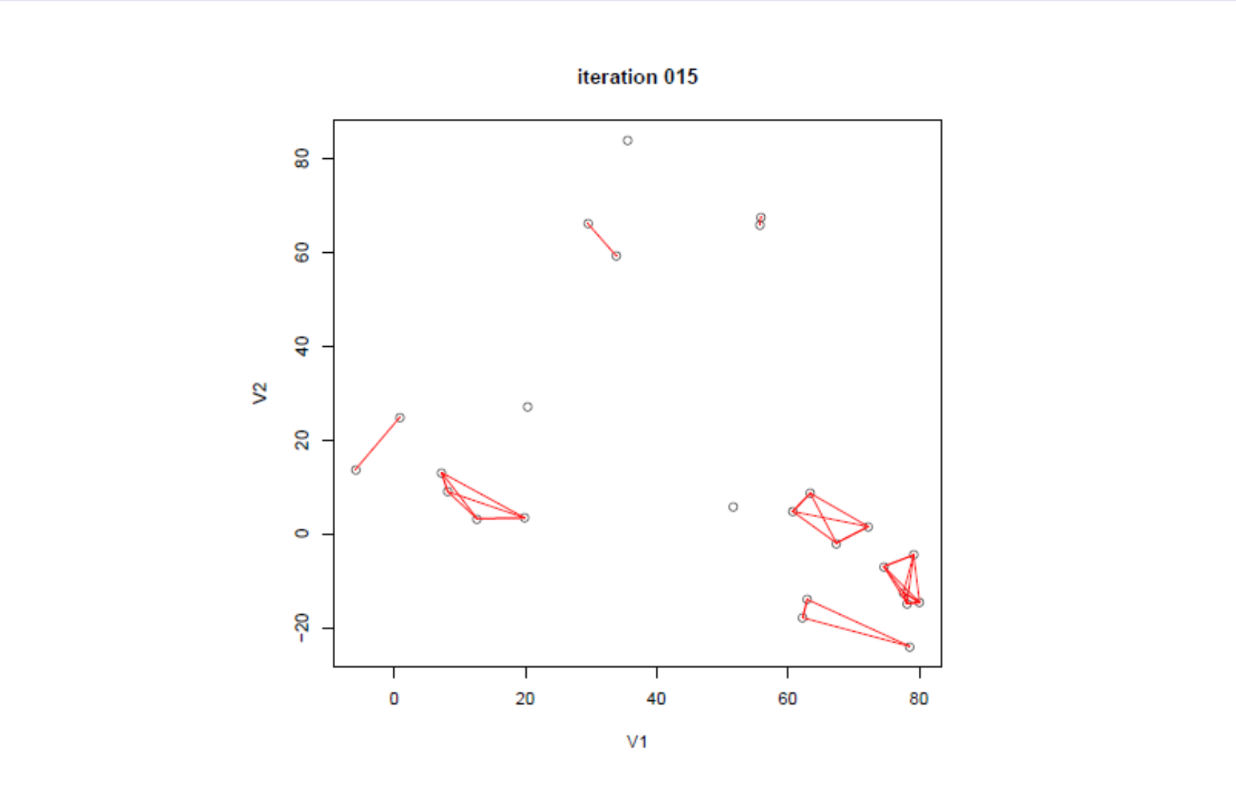
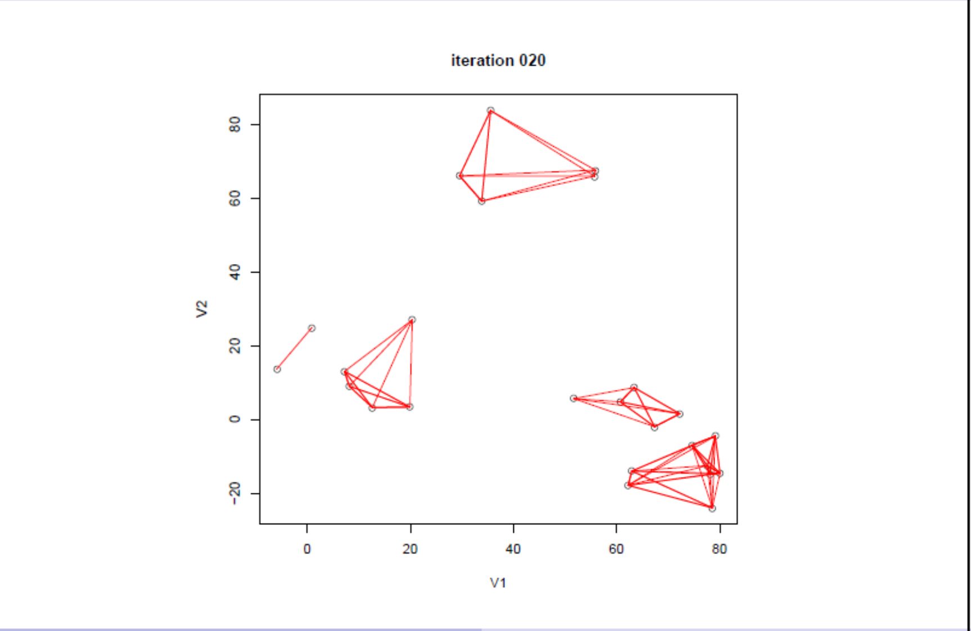
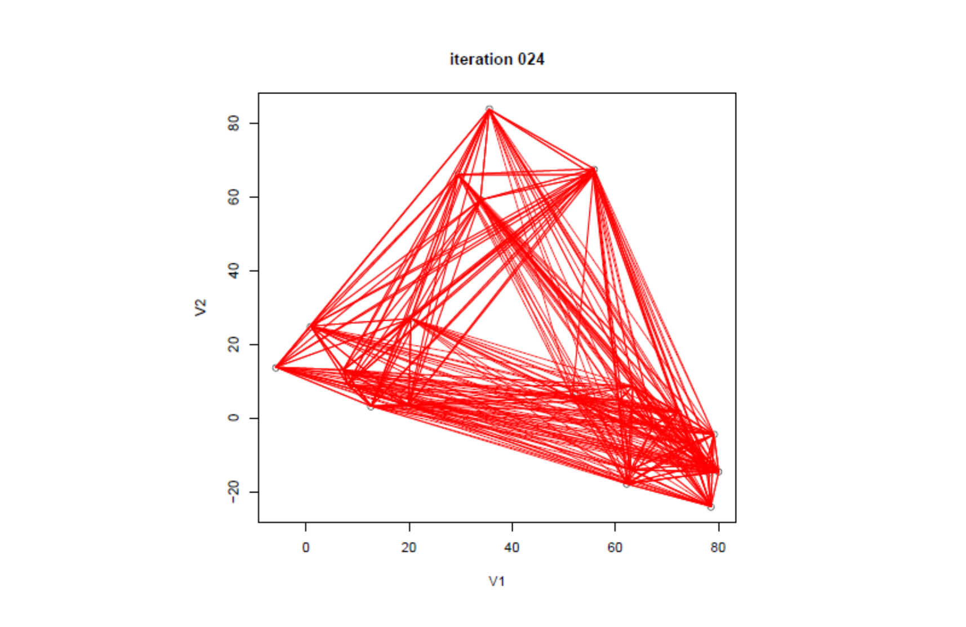
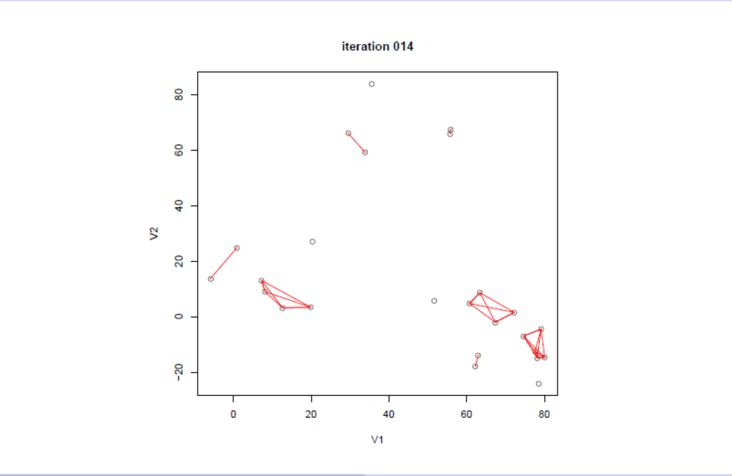





Slide 55
Dendrogram
• Agglomerative clustering is monotonic
• The similarity between merged clusters is monotone decreasing
with the level of the merge.
• Dendrogram: Plot each merge at the (negative) similarity between
the two merged groups
• Provides an interpretable visualization of the algorithm and data
• Useful summarization tool, part of why hierarchical clustering is
popular

Slide 56
Dendrogram of example data
Groups that merge at high values relative to the merger values of their
subgroups are candidates for natural clusters.

Slide 57
Properties of intergroup similarity
Single linkage can produce “chaining,” where a sequence of close
observations in different groups cause early merges of those groups.
• Complete linkage has the opposite problem. It might not merge
close groups because of outlier members that are far apart.
• Group average represents a natural compromise, but depends on the
scale of the similarities. Applying a monotone transformation to the
similarities can change the results.

Slide 58
Caveats
Hierarchical clustering should be treated with caution.
• Different decisions about group similarities can lead to vastly
different dendrograms.
• The algorithm imposes a hierarchical structure on the data, even
data for which such structure is not appropriate.

Slide 59
Where should we cut the tree of the hierarchy to get a good clustering?
The agglomerative hierarchical algorithm create a sequence of n different partitions on the set T.
The first partition in the sequence consist of n one-element set:
After the first merging, the second partition consist of n-1 subset, n-2 one-element sets and 1 two-element set
After i merging steps, we have n-i clusters:
After the (n-1)th merging step, finally we have only one cluster which coincide with the training set T.

Slide 60
Calculate the compactness function W at every step:

Slide 61
Sketch the polygon line diagram on the plane and select the breakpoints where the graph suddenly skips.
They are the good cutting places to the dendogram!

