Slide 1

Sketching Graphs

Slide 2
Vertical
Horizontal
Oblique

Slide 9
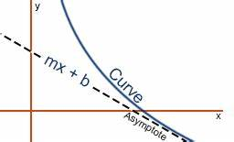

Slide 10
Determining intervals of monotonocity

Slide 11
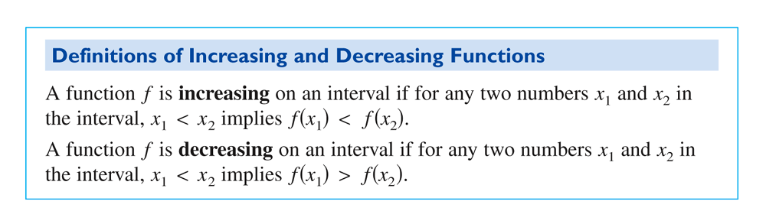
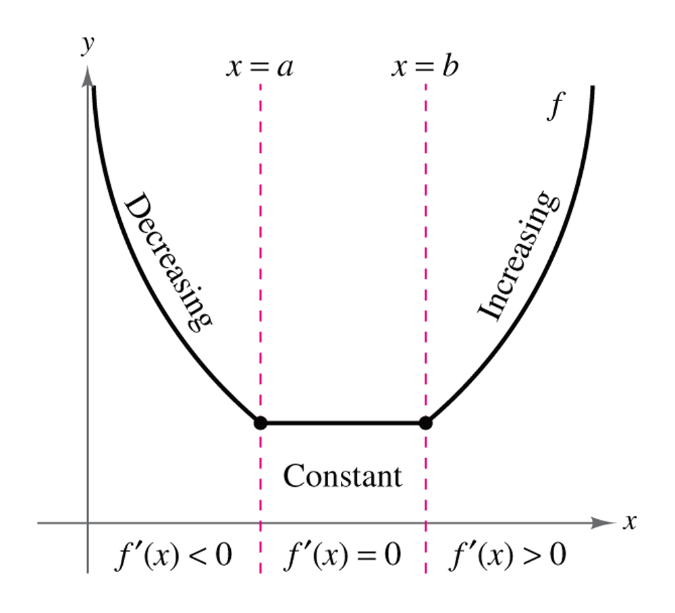
Definitions of Increasing and Decreasing Functions

Slide 12
A function is increasing when its graph rises as it goes from left to right. A function is decreasing when its graph falls as it goes from left to right.
dec
inc
inc

Slide 13
The inc\dec concept can be associated with the slope of the tangent line. The slope of the tan line is positive when the function is increasing and negative when decreasing

Slide 14
Test for Increasing and Decreasing Functions

Slide 15
Find the Open Intervals on which f is Increasing or Decreasing

Slide 16
Concavity & Inflection Points
 | Positive (increasing function) | Negative (decreasing function)
Positive (concave up) CONVEX
Negative (concave down)
f '(x)
f ''(x)

Slide 17
Objectives
To determine the intervals on which the graph of a function is concave up or concave down.
To find the inflection points of a graph of a function.

Slide 18
Concavity
The concavity of the graph of a function is the notion of curving upward or downward.

Slide 19
Concavity
curved upward
or
concave up
CONVEX

Slide 20
Concavity
curved downward
or
concave down
CONCAVE

Slide 21
Concavity
curved upward
or
concave up
CONVEX

Slide 22
Concavity
Question: Is the slope of the tangent line increasing or decreasing?

Slide 23
Concavity
What is the derivative doing?

Slide 24
Concavity
Question: Is the slope of the tangent line increasing or decreasing?
Answer: The slope is increasing.
The derivative must be increasing.

Slide 25
Concavity
Question: How do we determine where the derivative is increasing?

Slide 26
Concavity
Question: How do we determine where a function is increasing?
f (x) is increasing if f’ (x) > 0.

Slide 27
Concavity
Question: How do we determine where the derivative is increasing?
f’ (x) is increasing if f” (x) > 0.
Answer: We must find where the second derivative is positive.

Slide 28
Concavity
What is the derivative doing?

Slide 29
Concavity
The concavity of a graph can be determined by using the second derivative.
If the second derivative of a function is positive on a given interval, then the graph of the function is concave up (CONVEX) on that interval.
If the second derivative of a function is negative on a given interval, then the graph of the function is concave down (CONCAVE) on that interval.

Slide 30
The Second Derivative
If f” (x) > 0 , then f (x) is concave up or convex
If f” (x) < 0 , then f (x) is concave down or concave

Slide 31

Concavity
Concave down
Here the concavity changes.
Concave up
This is called an inflection point (or point of inflection).

Slide 32
Concavity
Concave up
Inflection point
Concave down

Slide 33
Inflection Points
Inflection points are points where the graph changes concavity.
The second derivative will either equal zero or be undefined at an inflection point.

Slide 34
Concavity
Find the intervals on which the function is concave up or concave down and the coordinates of any inflection points:

Slide 35
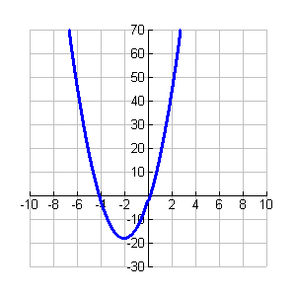
Concavity

Slide 36
Concavity
Find the intervals on which the function is concave up or concave down and the coordinates of any inflection points:

Slide 37

Concavity
0
$$x=1$$

Slide 38
Inflection Point

Slide 39
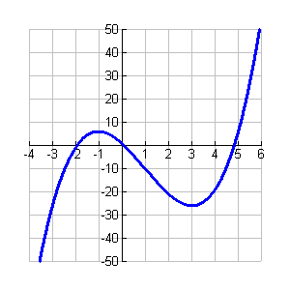
Concavity

Slide 40
Concavity
Find the intervals on which the function is concave up or concave down and the coordinates of any inflection points:

Slide 41
Concavity
UND.

Slide 42
Inflection Point

Slide 43
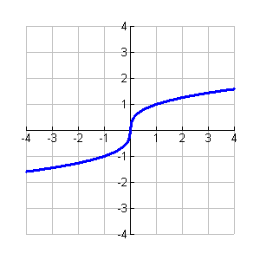
Concavity

Slide 44
Conclusion
The second derivative can be used to determine where the graph of a function is concave up or concave down and to find inflection points.
Knowing the critical points, increasing and decreasing intervals, relative extreme values, the concavity, and the inflection points of a function enables you to sketch accurate graphs of that function.

Slide 45
Strategy of sketching graph
Determine domain of function
Find y-intercepts, x-intercepts (zeros)
Check symmetry and periodicity
Check for vertical, horizontal and oblique asymptotes calculating limits
Determine values for f '(x) = 0, critical points
Determine f ''(x)
  Gives inflection points
  Test for intervals of concave up, down
Plot intercepts, critical points, inflection points, asymptotes
Connect points with smooth curve
Check sketch with graphing calculator

Slide 46
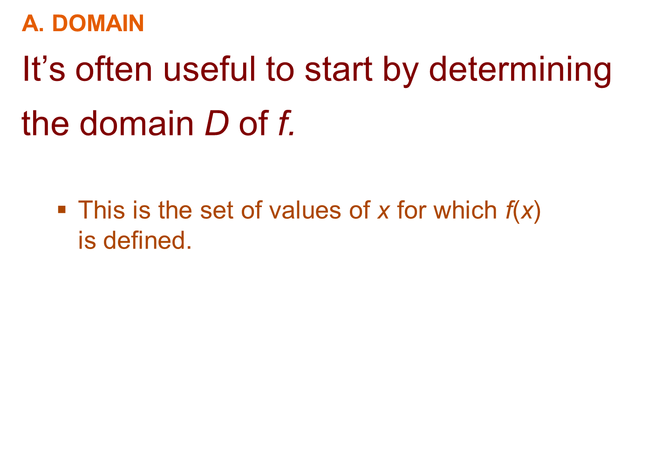

Slide 47
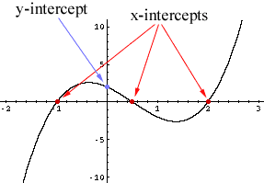
B. INTERCEPTS
The y-intercept is f(0) and this tells us
where the curve intersects the y-axis.
To find the x-intercepts, we set y = 0
and solve for x.
  You can omit this step if the equation is difficult
  to solve.

Slide 48
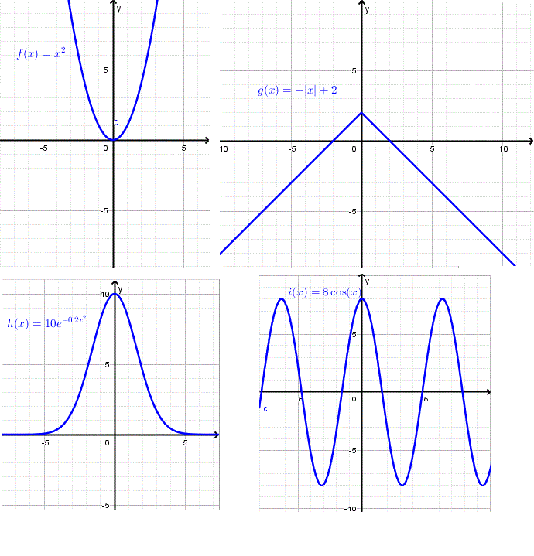
C. SYMMETRY—EVEN FUNCTION
If f(-x) = f(x) for all x in D, that is, the equation of the curve is unchanged when x is replaced by -x, then f is an even function and the curve is symmetric about the y-axis.
  This means that our work is cut in half.

Slide 49
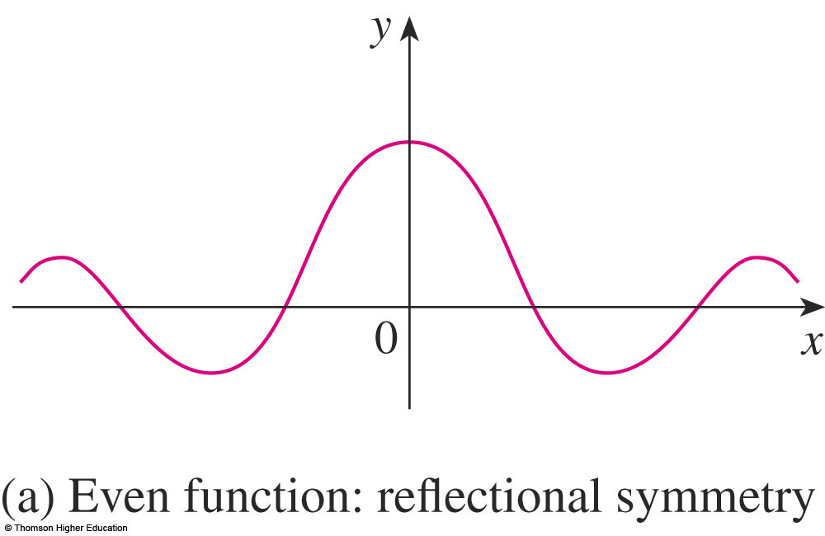
C. SYMMETRY—EVEN FUNCTION
If we know what the curve looks like for x ≥ 0, then we need only reflect about the y-axis to obtain the complete curve.

Slide 50
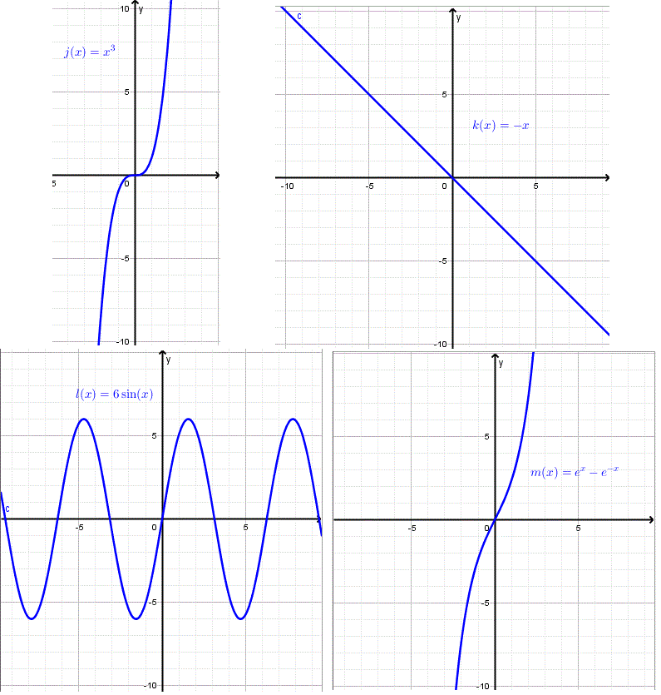
C. SYMMETRY—ODD FUNCTION
If f(-x) = -f(x) for all x in D, then f is an odd function and the curve is symmetric about the origin.

Slide 51
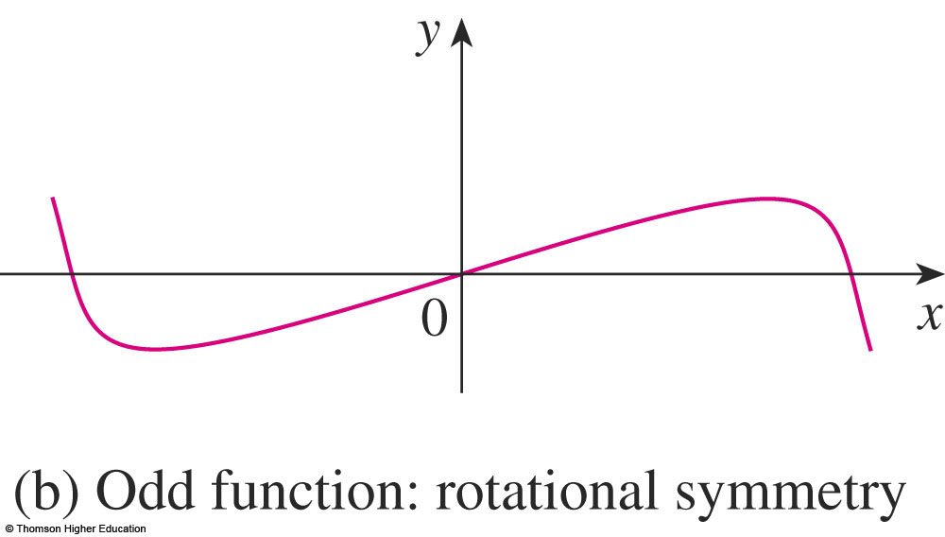
C. SYMMETRY—ODD FUNCTION
Again, we can obtain the complete curve
if we know what it looks like for x ≥ 0.
  Rotate 180°
  about the origin.

Slide 52
C. SYMMETRY—PERIODIC FUNCTION
If f(x + p) = f(x) for all x in D, where p
is a positive constant, then f is called
a periodic function.
The smallest such number p is called
the period.
  For instance, y = sin x has period 2π and y = tan x
  has period π.

Slide 53
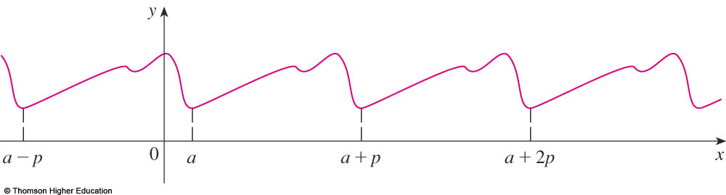
C. SYMMETRY—PERIODIC FUNCTION
If we know what the graph looks like in
an interval of length p, then we can use translation to sketch the entire graph.

Slide 54
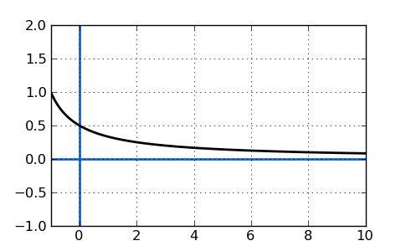
D. ASYMPTOTES—HORIZONTAL
Recall that, if either
or ,
then the line y = L is a horizontal asymptote
of the curve y = f (x).
  If it turns out that (or -∞), then
  we do not have an asymptote to the right.
  Nevertheless, that is still useful information
  for sketching the curve.

Slide 55
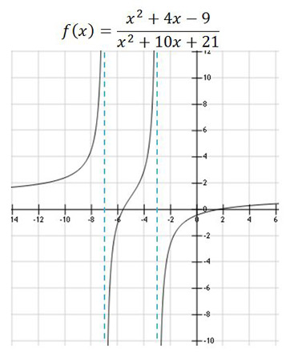
D. ASYMPTOTES—VERTICAL
For rational functions, you can locate
the vertical asymptotes by equating
the denominator to 0 after canceling any common factors.
  However, for other functions, this method
  does not apply.

Slide 56
D. ASYMPTOTES—VERTICAL
Furthermore, in sketching the curve, it is very useful to know exactly which of the statements is true.
  If f(a) is not defined but a is an endpoint of
  the domain of f, then you should compute
  or , whether or not this limit is infinite.

Slide 57
D. ASYMPTOTES—VERTICAL
Recall that the line x = a
is a vertical asymptote if at least one of
the following statements is true:

Slide 58
SLANT ASYMPTOTES
Some curves have asymptotes that
are oblique—that is, neither horizontal nor vertical.

Slide 59
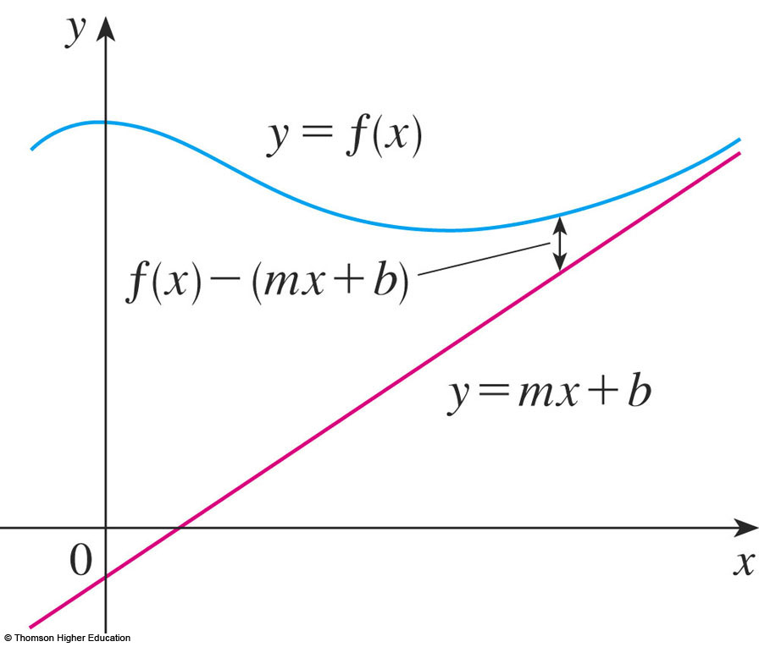
SLANT (OBLIQUE) ASYMPTOTES
If , then the line
y = mx + b is called a slant asymptote.
  This is because
  the vertical distance
  between the curve
  y = f(x) and the line
  y = mx + b approaches 0.
  A similar situation exists
  if we let x → -∞.

Slide 60
SLANT ASYMPTOTES
For rational functions, slant asymptotes occur when the degree of the numerator is one more than the degree of the denominator.
  In such a case, the equation of the slant
  asymptote can be found by long division—
  as in following example.

Slide 61
E. INTERVALS OF INCREASE OR DECREASE
Use the I /D Test.
Compute f’(x) and find the intervals
on which:
  f’(x) is positive (f is increasing).
  f’(x) is negative (f is decreasing).

Slide 62
F. LOCAL MAXIMUM AND MINIMUM VALUES
Find the critical numbers of f (the numbers c where f’(c) = 0 or f’(c) does not exist).
Then, use the First Derivative Test.
  If f’ changes from positive to negative at
  a critical number c, then f(c) is a local maximum.
  If f’ changes from negative to positive at c,
  then f(c) is a local minimum.

Slide 63
F. LOCAL MAXIMUM AND MINIMUM VALUES
Although it is usually preferable to use the First Derivative Test, you can use the Second Derivative Test if f’(c) = 0 and f’’(c) ≠ 0.
Then,
  f”(c) > 0 implies that f(c) is a local minimum.
  f’’(c) < 0 implies that f(c) is a local maximum.

Slide 64
G. CONCAVITY AND POINTS OF INFLECTION
Compute f’’(x) and use the Concavity Test.
The curve is:
  Concave upward where f’’(x) > 0
  Concave downward where f’’(x) < 0

Slide 65
G. CONCAVITY AND POINTS OF INFLECTION
Inflection points occur
where the direction of concavity changes.

Slide 66
H. SKETCH AND CURVE
Using the information in items A–G, draw the graph.
  Sketch the asymptotes as dashed lines.
  Plot the intercepts, maximum and minimum points,
  and inflection points.
  Then, make the curve pass through these points,
  rising and falling according to E, with concavity according to G, and approaching the asymptotes

Slide 67
H. SKETCH AND CURVE
If additional accuracy is desired near
any point, you can compute the value of
the derivative there.
  The tangent indicates the direction in which
  the curve proceeds.

Slide 68
A. DOMAIN
It’s often useful to start by determining
the domain D of f.
  This is the set of values of x for which f(x)
  is defined.

Slide 69
B. INTERCEPTS
The y-intercept is f(0) and this tells us
where the curve intersects the y-axis.
To find the x-intercepts, we set y = 0
and solve for x.
  You can omit this step if the equation is difficult
  to solve.

Slide 70
C. SYMMETRY—EVEN FUNCTION
If f(-x) = f(x) for all x in D, that is, the equation of the curve is unchanged when x is replaced by -x, then f is an even function and the curve is symmetric about the y-axis.
  This means that our work is cut in half.

Slide 71
C. SYMMETRY—EVEN FUNCTION
If we know what the curve looks like for x ≥ 0, then we need only reflect about the y-axis to obtain the complete curve.

Slide 72
C. SYMMETRY—EVEN FUNCTION
Here are some examples:
  y = x²
  y = x⁴
  y = |x|
  y = cos x

Slide 73
C. SYMMETRY—ODD FUNCTION
If f(-x) = -f(x) for all x in D, then f is an odd function and the curve is symmetric about the origin.

Slide 74
C. SYMMETRY—ODD FUNCTION
Again, we can obtain the complete curve
if we know what it looks like for x ≥ 0.
  Rotate 180°
  about the origin.

Slide 75
C. SYMMETRY—ODD FUNCTION
Some simple examples of odd functions are:
  y = x
  y = x³
  y = x⁵
  y = sin x

Slide 76
C. SYMMETRY—PERIODIC FUNCTION
If f(x + p) = f(x) for all x in D, where p is a positive constant, then f is called
a periodic function.
The smallest such number p is called the period.
  For instance, y = sin x has period 2π and y = tan x
  has period π.

Slide 77
C. SYMMETRY—PERIODIC FUNCTION
If we know what the graph looks like in
an interval of length p, then we can use translation to sketch the entire graph.

Slide 78
D. ASYMPTOTES—HORIZONTAL
Recall that, if either
or ,
then the line y = L is a horizontal asymptote
of the curve y = f (x).
  If it turns out that (or -∞), then
  we do not have an asymptote to the right.
  Nevertheless, that is still useful information
  for sketching the curve.

Slide 79
D. ASYMPTOTES—VERTICAL
Recall that the line x = a is a vertical asymptote if at least one of the following statements is true:

Slide 80
D. ASYMPTOTES—VERTICAL
For rational functions, you can locate the vertical asymptotes by equating the denominator to 0 after canceling any common factors.
  However, for other functions, this method
  does not apply.

Slide 81
D. ASYMPTOTES—VERTICAL
Furthermore, in sketching the curve, it is very useful to know exactly which of the statements is true.
  If f(a) is not defined but a is an endpoint of
  the domain of f, then you should compute
  or , whether or not this limit is infinite.

Slide 82
E. INTERVALS OF INCREASE OR DECREASE
Use the I /D Test.
Compute f’(x) and find the intervals
on which:
  f’(x) is positive (f is increasing).
  f’(x) is negative (f is decreasing).

Slide 83
F. LOCAL MAXIMUM AND MINIMUM VALUES
Find the critical numbers of f (the numbers c where f’(c) = 0 or f’(c) does not exist).
Then, use the First Derivative Test.
  If f’ changes from positive to negative at
  a critical number c, then f(c) is a local maximum.
  If f’ changes from negative to positive at c,
  then f(c) is a local minimum.

Slide 84
F. LOCAL MAXIMUM AND MINIMUM VALUES
Although it is usually preferable to use the First Derivative Test, you can use the Second Derivative Test if f’(c) = 0 and f’’(c) ≠ 0.
Then,
  f”(c) > 0 implies that f(c) is a local minimum.
  f’’(c) < 0 implies that f(c) is a local maximum.

Slide 85
G. CONCAVITY AND POINTS OF INFLECTION
Compute f’’(x) and use the Concavity Test.
The curve is:
  Concave upward where f’’(x) > 0
  Concave downward where f’’(x) < 0

Slide 86
G. CONCAVITY AND POINTS OF INFLECTION
Inflection points occur where the direction of concavity changes.

Slide 87
H. SKETCH AND CURVE
Using the information in items A–G, draw the graph.
  Sketch the asymptotes as dashed lines.
  Plot the intercepts, maximum and minimum points,
  and inflection points.
  Then, make the curve pass through these points,
  rising and falling according to E, with concavity according to G, and approaching the asymptotes

Slide 88
H. SKETCH AND CURVE
If additional accuracy is desired near any point, you can compute the value of the derivative there.
  The tangent indicates the direction in which
  the curve proceeds.

Slide 89
GUIDELINES
Example 1
Use the guidelines to sketch
the curve

Slide 90
GUIDELINES
Example 1
A. The domain is:
{x | x² – 1 ≠ 0} = {x | x ≠ ±1}
= (-∞, -1) U (-1, -1) U (1, ∞)
B. The x- and y-intercepts are both 0.

Slide 91
GUIDELINES
Example 1
C. Since f(-x) = f(x), the function
is even.
  The curve is symmetric about the y-axis.

Slide 92
GUIDELINES
Example 1
D.
Therefore, the line y = 2 is a horizontal asymptote.

Slide 93
GUIDELINES
Example 1
Since the denominator is 0 when x = ±1,
we compute the following limits:
  Thus, the lines x = 1 and x = -1 are vertical asymptotes.

Slide 94
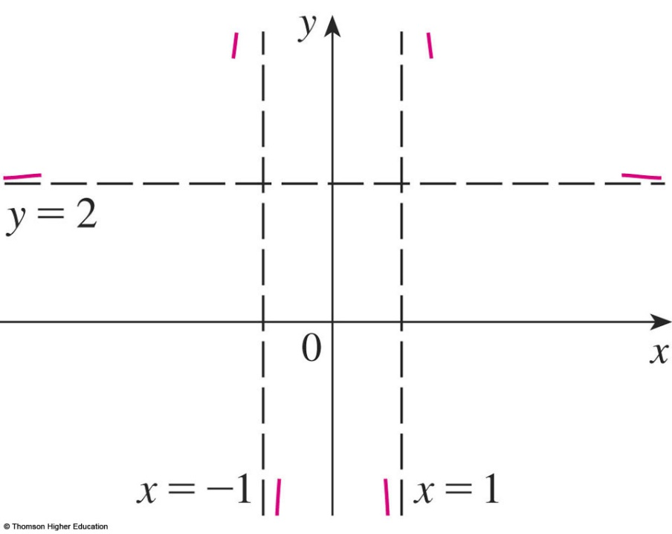
GUIDELINES
Example 1
This information about limits and asymptotes enables us to draw the preliminary sketch, showing the parts of the curve near the asymptotes.

Slide 95
GUIDELINES
Example 1
E.
Since f’(x) > 0 when x < 0 (x ≠ 1) and f’(x) < 0 when x > 0 (x ≠ 1), f is:
  Increasing on (-∞, -1) and (-1, 0)
  Decreasing on (0, 1) and (1, ∞)

Slide 96
GUIDELINES
Example 1
F. The only critical number is x = 0.
Since f’ changes from positive to negative
at 0, f(0) = 0 is a local maximum by the First Derivative Test.

Slide 97
GUIDELINES
Example 1
G.
Since 12x² + 4 > 0 for all x, we have
and

Slide 98
GUIDELINES
Example 1
Thus, the curve is concave upward on
the intervals (-∞, -1) and (1, ∞) and concave downward on (-1, -1).
It has no point of inflection since 1 and -1
are not in the domain of f.

Slide 99
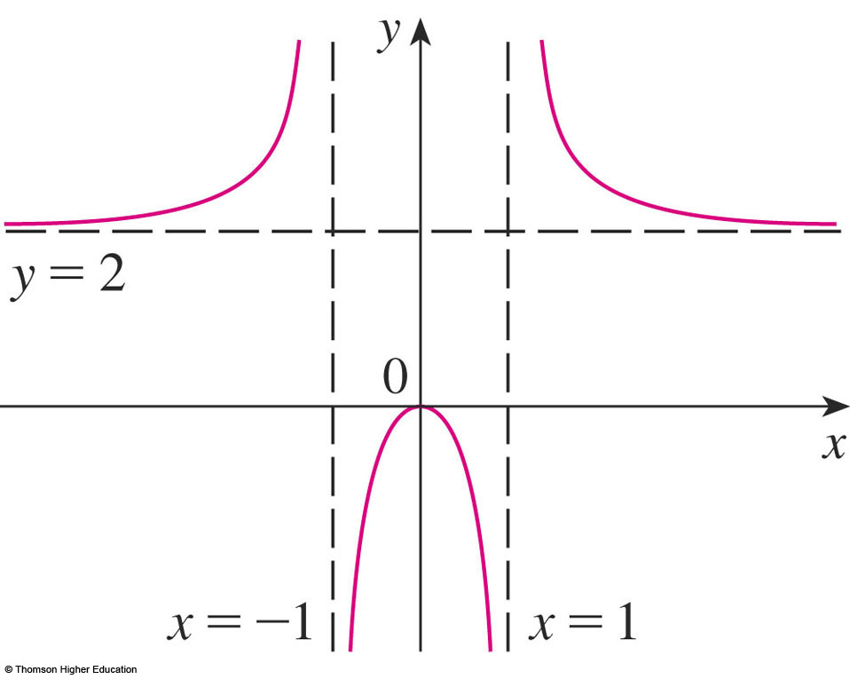
GUIDELINES
Example 1
H. Using the information in E–G, we finish the sketch.

Slide 100
GUIDELINES
Example 2
Sketch the graph of:

Slide 101
GUIDELINES
Example 2
A. Domain = {x | x + 1 > 0}
= {x | x > -1}
= (-1, ∞)
B. The x- and y-intercepts are both 0.
C. Symmetry: None

Slide 102
GUIDELINES
Example 2
D. Since , there is no horizontal asymptote.
Since as x → -1⁺ and f(x) is
always positive, we have ,
and so the line x = -1 is a vertical asymptote

Slide 103
GUIDELINES
Example 2
E.
We see that f’(x) = 0 when x = 0 (notice that
-4/3 is not in the domain of f).
  So, the only critical number is 0.

Slide 104
GUIDELINES
Example 2
As f’(x) < 0 when -1 < x < 0 and f’(x) > 0 when x > 0, f is:
  Decreasing on (-1, 0)
  Increasing on (0, ∞)

Slide 105
GUIDELINES
Example 2
F. Since f’(0) = 0 and f’ changes from negative to positive at 0, f(0) = 0 is
a local (and absolute) minimum by
the First Derivative Test.

Slide 106
GUIDELINES
Example 2
G.
  Note that the denominator is always positive.
  The numerator is the quadratic 3x² + 8x + 8,
  which is always positive because its discriminant
  is b² - 4ac = -32, which is negative, and the coefficient
  of x² is positive.

Slide 107
GUIDELINES
Example 2
So, f”(x) > 0 for all x in the domain of f.
This means that:
  f is concave upward on (-1, ∞).
  There is no point of inflection.

Slide 108
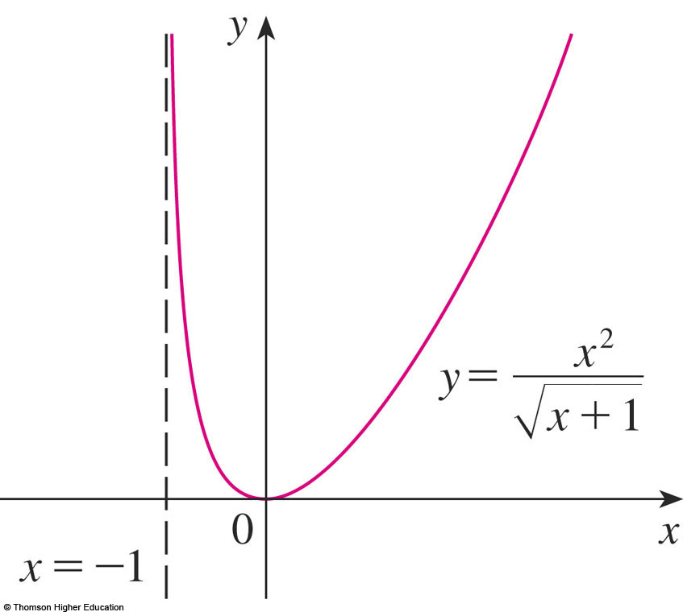
GUIDELINES
Example 2
H. The curve is sketched here.

Slide 109
GUIDELINES
Example 3
Sketch the graph of:
f(x) = xe^{x}

Slide 110
GUIDELINES
Example 3
A. The domain is IR
B. The x- and y-intercepts are both 0.
C. Symmetry: None

Slide 111
GUIDELINES
Example 3
D. As both x and e^{x} become large as
x → ∞, we have
However, as x → -∞, e^{x} → 0.

Slide 112
GUIDELINES
Example 3
So, we have an indeterminate product that requires the use of L’Hospital’s Rule:
  Thus, the x-axis is a horizontal asymptote.

Slide 113
GUIDELINES
Example 3
E. f’(x) = xe^{x} + e^{x} = (x + 1) e^{x}
As e^{x} is always positive, we see that f’(x) > 0 when x + 1 > 0, and f’(x) < 0 when x + 1 < 0.
So, f is:
  Increasing on (-1, ∞)
  Decreasing on (-∞, -1)

Slide 114
GUIDELINES
Example 3
F. Since f’(-1) = 0 and f’ changes from negative to positive at x = -1, f(-1) = -e⁻¹ is a local (and absolute) minimum.

Slide 115
GUIDELINES
Example 3
G. f’’(x) = (x + 1)e^{x} + e^{x} = (x + 2)e^{x}
  f”(x) = 0 if x > -2 and f’’(x) < 0 if x < -2.
  So, f is concave upward on (-2, ∞) and concave downward on (-∞, -2).
  The inflection point is (-2, -2e⁻²)

Slide 116
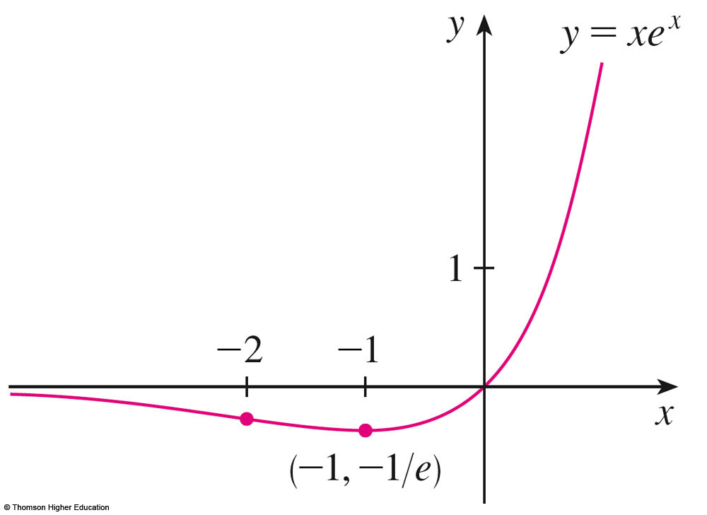
GUIDELINES
Example 3
H. We use this information to sketch
the curve.

Slide 117
GUIDELINES
Example 4
Sketch the graph of:

Slide 118
GUIDELINES
Example 4
A. The domain is IR
B. The y-intercept is f(0) = ½.
The x-intercepts occur when cos x =0,
that is, x = (2n + 1)π/2, where n is an integer.

Slide 119
GUIDELINES
Example 4
C. f is neither even nor odd.
  However, f(x + 2π) = f(x) for all x.
  Thus, f is periodic and has period 2π.
  So, in what follows, we need to consider only 0 ≤ x ≤ 2π and then extend the curve by translation in part H.
D. Asymptotes: None

Slide 120
GUIDELINES
Example 4
E.
Thus, f’(x) > 0 when 2 sin x + 1 < 0 sin x < -½ 7π/6 < x < 11π/6

Slide 121
GUIDELINES
Example 4
Thus, f is:
  Increasing on (7π/6, 11π/6)
  Decreasing on (0, 7π/6) and (11π/6, 2π)

Slide 122
GUIDELINES
Example 4
F. From part E and the First Derivative Test, we see that:
  The local minimum value is f(7π/6) = -1/
  The local maximum value is f(11π/6) = +1/

Slide 123
GUIDELINES
Example 4
G. If we use the Quotient Rule again
and simplify, we get:
(2 + sin x)³ > 0 and 1 – sin x ≥ 0 for all x.
So, we know that f’’(x) > 0 when cos x < 0, that is, π/2 < x < 3π/2.

Slide 124
GUIDELINES
Example 4
Thus, f is concave upward on (π/2, 3π/2)
and concave downward on (0, π/2) and (3π/2, 2π).
The inflection points are (π/2, 0) and
(3π/2, 0).

Slide 125
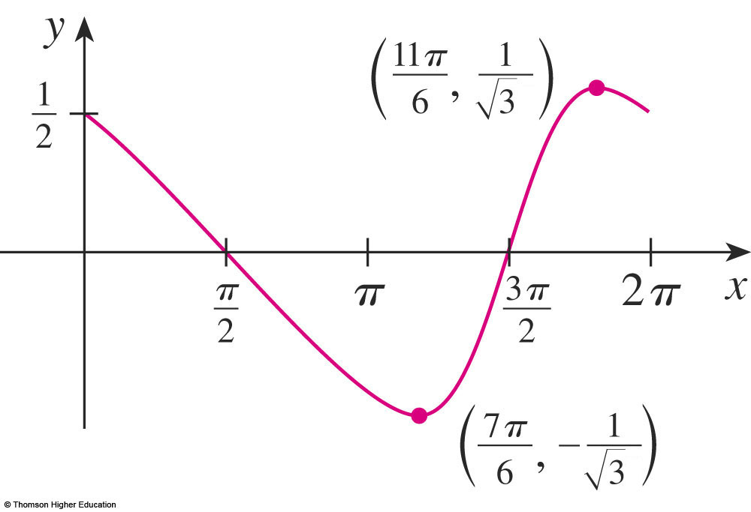
GUIDELINES
Example 4
H. The graph of the function restricted
to 0 ≤ x ≤ 2π is shown here.

Slide 126
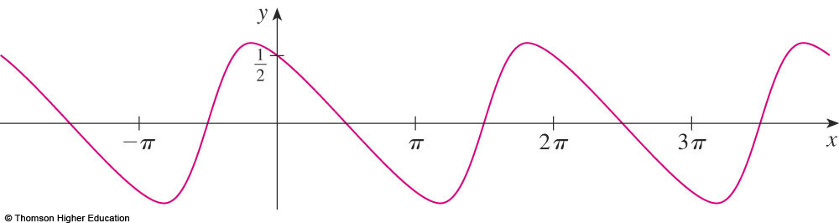
GUIDELINES
Example 4
Then, we extend it, using periodicity,
to the complete graph here.

Slide 127
GUIDELINES
Example 5
Sketch the graph of:
y = ln(4 - x²)

Slide 128
GUIDELINES
Example 5
A. The domain is:
{x | 4 − x² > 0} = {x | x² < 4}
= {x | |x| < 2}
= (−2, 2)

Slide 129
GUIDELINES
Example 5
B. The y-intercept is: f(0) = ln 4
To find the x-intercept, we set:
y = ln(4 – x²) = 0
  We know that ln 1 = 0.
  So, we have 4 – x² = 1 x² = 3
  Therefore, the x-intercepts are:

Slide 130
GUIDELINES
Example 5
C. f(-x) = f(x)
Thus,
  f is even.
  The curve is symmetric about the y-axis.

Slide 131
GUIDELINES
Example 5
D. We look for vertical asymptotes
at the endpoints of the domain.
  Since 4 − x² → 0⁺ as x → 2⁻ and as x → 2⁺,
  we have:
  Thus, the lines x = 2 and x = -2
  are vertical asymptotes.

Slide 132
GUIDELINES
Example 5
E.
f’(x) > 0 when -2 < x < 0 and f’(x) < 0 when
0 < x < 2.
So, f is:
  Increasing on (-2, 0)
  Decreasing on (0, 2)

Slide 133
GUIDELINES
Example 5
F. The only critical number is x = 0.
As f’ changes from positive to negative at 0, f(0) = ln 4 is a local maximum by the First Derivative Test.

Slide 134
GUIDELINES
Example 5
G.
Since f”(x) < 0 for all x, the curve is
concave downward on (-2, 2) and has
no inflection point.

Slide 135
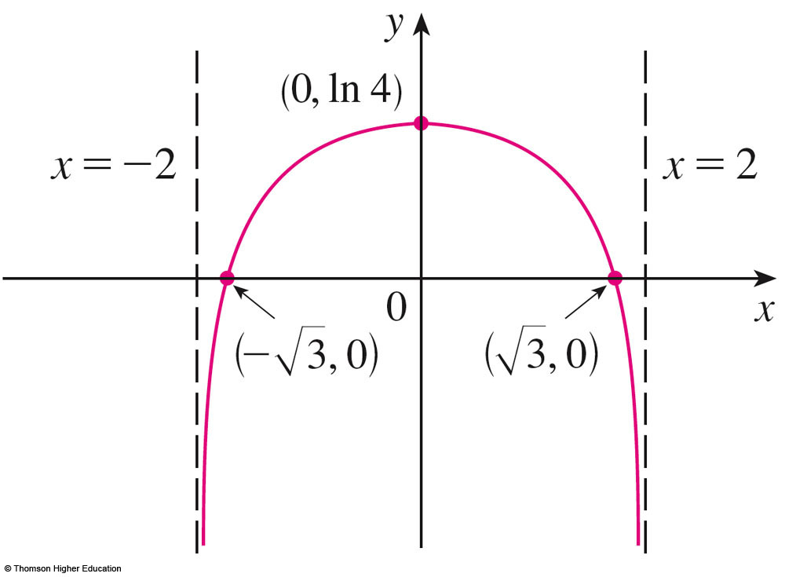
GUIDELINES
Example 5
H. Using this information, we sketch
the curve.

Slide 136
SLANT ASYMPTOTES
Some curves have asymptotes that
are oblique—that is, neither horizontal nor vertical.

Slide 137
SLANT ASYMPTOTES
If , then the line
y = mx + b is called a slant asymptote.
  This is because
  the vertical distance
  between the curve
  y = f(x) and the line
  y = mx + b approaches 0.
  A similar situation exists
  if we let x → -∞.

Slide 138
SLANT ASYMPTOTES
For rational functions, slant asymptotes occur when the degree of the numerator is one more than the degree of the denominator.
  In such a case, the equation of the slant
  asymptote can be found by long division—
  as in following example.

Slide 139
SLANT ASYMPTOTES
Example 6
Sketch the graph of:

Slide 140
SLANT ASYMPTOTES
Example 6
A. The domain is: R = (-∞, ∞)
B. The x- and y-intercepts are both 0.
C. As f(-x) = -f(x), f is odd and its graph is symmetric about the origin.

Slide 141
SLANT ASYMPTOTES
Example 6
Since x² + 1 is never 0, there is no vertical asymptote.
Since f(x) → ∞ as x → ∞ and f(x) → -∞ as
x → - ∞, there is no horizontal asymptote.

Slide 142
SLANT ASYMPTOTES
Example 6
However, long division gives:
  So, the line y = x is a slant asymptote.

Slide 143
SLANT ASYMPTOTES
Example 6
E.
Since f’(x) > 0 for all x (except 0), f is increasing on (- ∞, ∞).

Slide 144
SLANT ASYMPTOTES
Example 6
F. Although f’(0) = 0, f’ does not change sign at 0.
  So, there is no local maximum or minimum.

Slide 145
SLANT ASYMPTOTES
Example 6
G.
  Since f’’(x) = 0 when x = 0 or x = ± ,
  we set up the following chart.

Slide 146
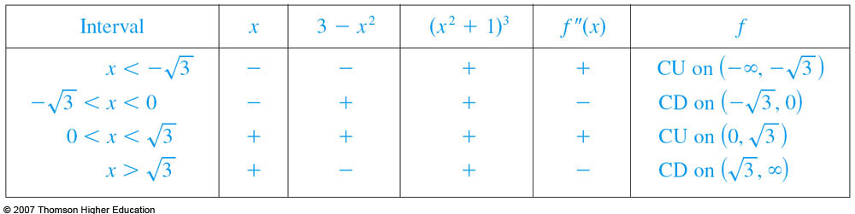
SLANT ASYMPTOTES
Example 6
The points of inflection are:
  (− , −¾ )
  (0, 0)
  ( , ¾ )

Slide 147
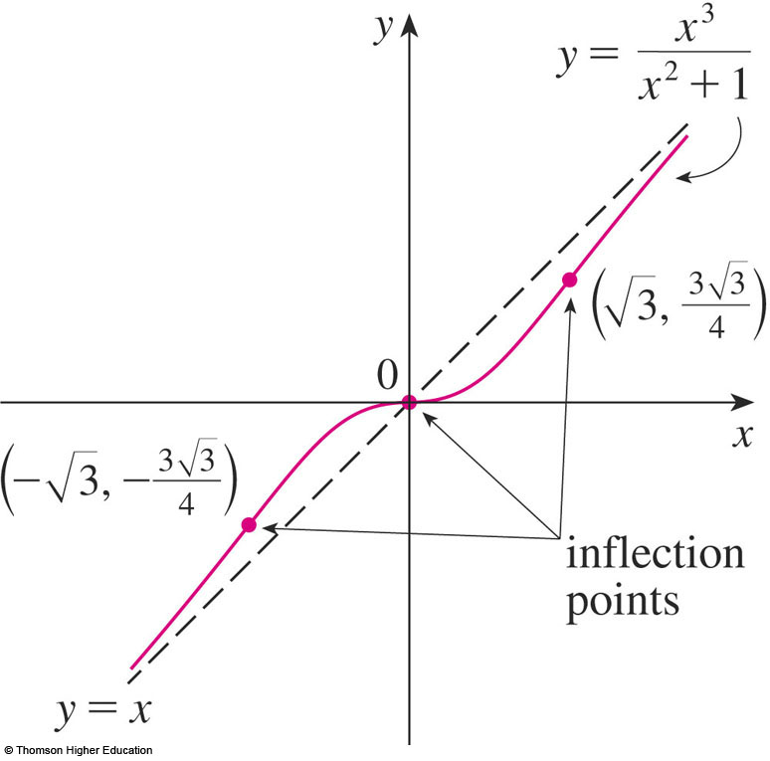
SLANT ASYMPTOTES
Example 6
H. The graph of f is sketched.

