Slide 1
Hypothesis Theory
examples

Slide 2

An automatic cutter machine must cut steel strips of 1200 mm length. From preliminary data we checked that the lengths of the pieces produced by the machine can be considered as normal random variables with a 3 mm standard deviation. We want to make sure that the machine is set correctly. Therefore 16 pieces of the products are randomly selected and weighed. The figures were in mm:
1193,1196,1198,1195,1198,1199,1204,1193,1203,1201,1196,1200,1191,1196,1198,1191.
Examine whether there is any significant deviation from the required size.

Slide 3
As we know the standard deviation of the sample, we can decide on the null hypothesis with the one sample u-test.
The calculated value of T test statistic
Since in absolute terms this is greater than the critical value, at this significance level, null hypothesis is rejected, i.e. the length of the strips is significantly different from the etalon value, the cutters have to be calibrated again.

Slide 4
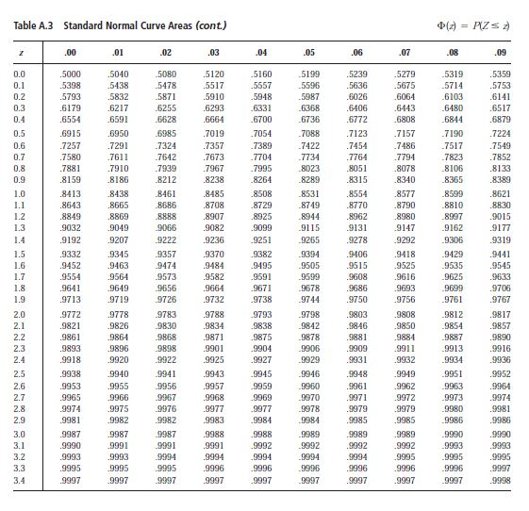

Slide 5

The length of a certain product is 1000 mm. We know that the fluctuation of the length is normal distribution around the prescribed value. Consider the following 10-element pattern:
983,1002,998,996,1002,983,994,991,1005,986.
Is the null hypothesis acceptable, that the expected length of the length is 1000?

Slide 7
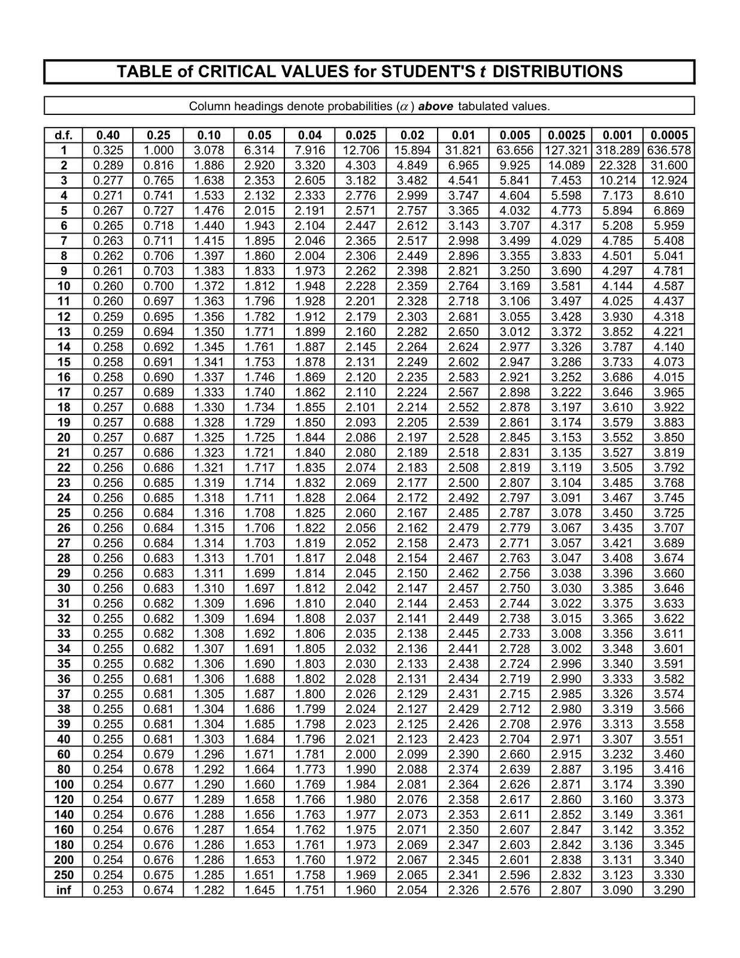

Slide 8



Slide 10


Slide 12
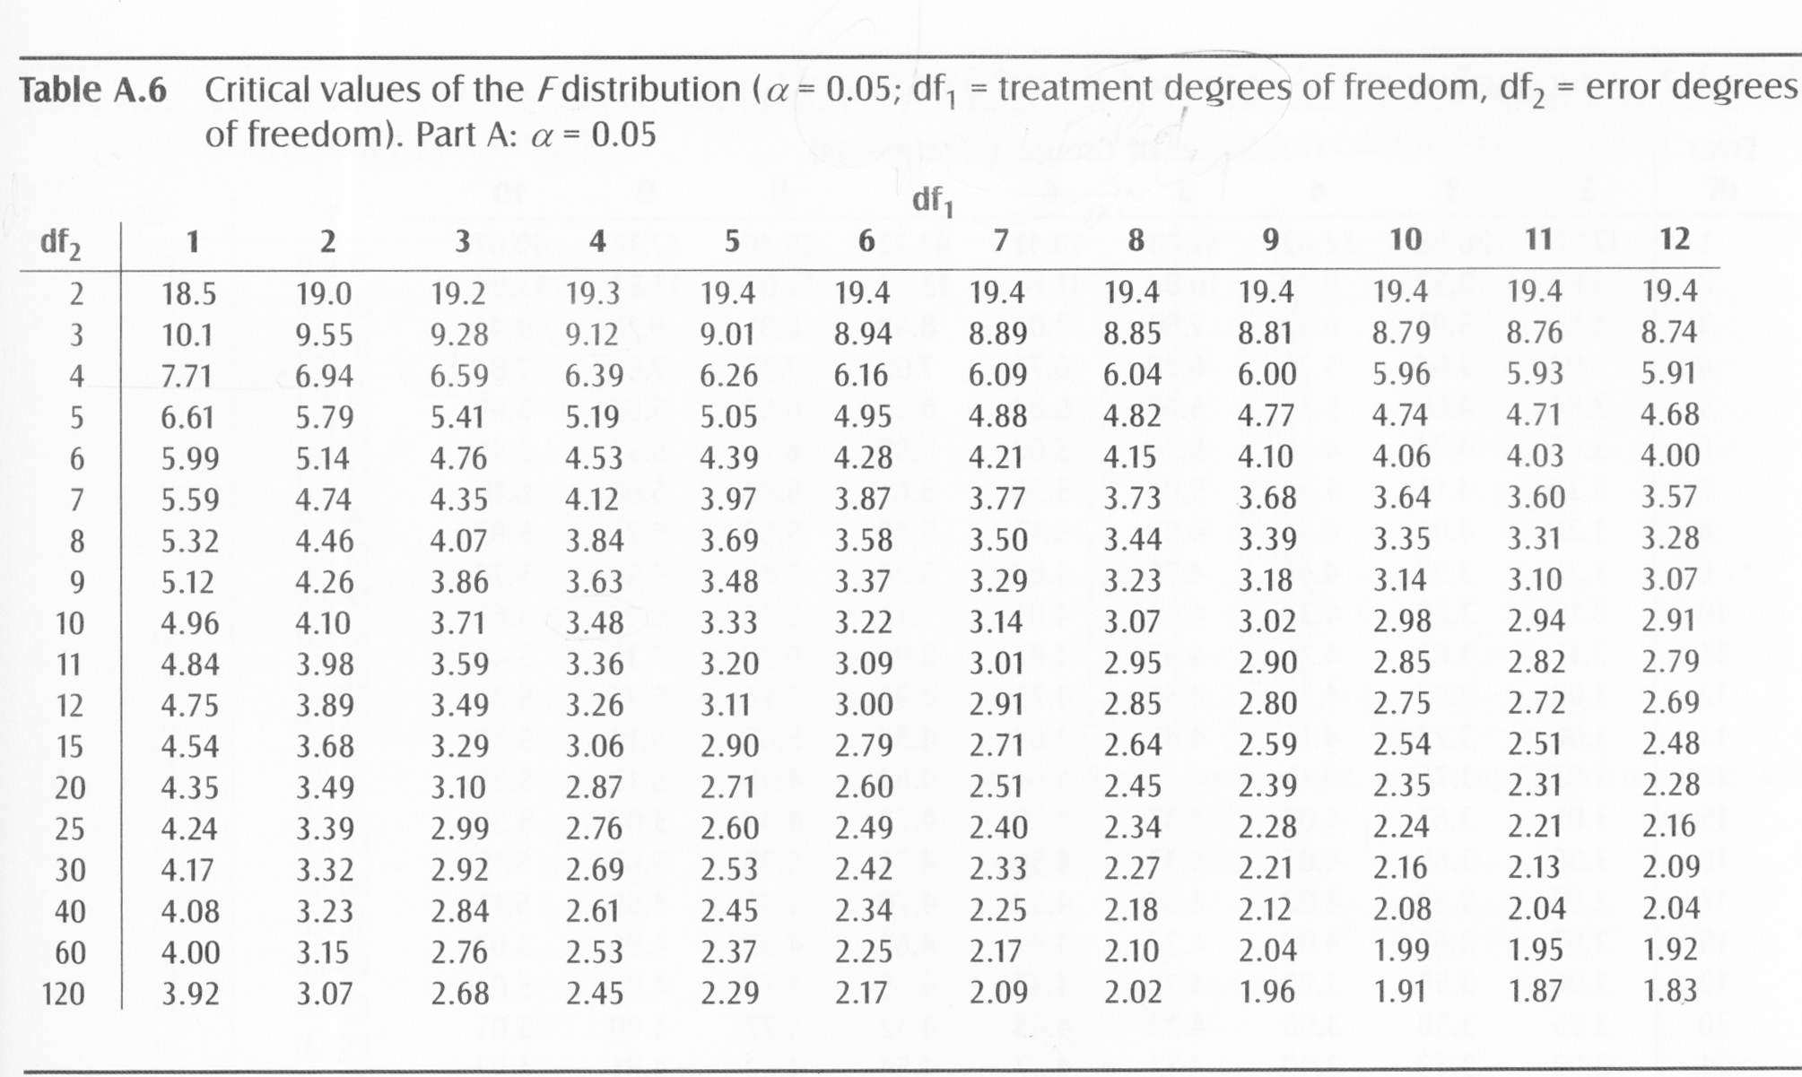

Slide 14


Slide 16


Slide 20
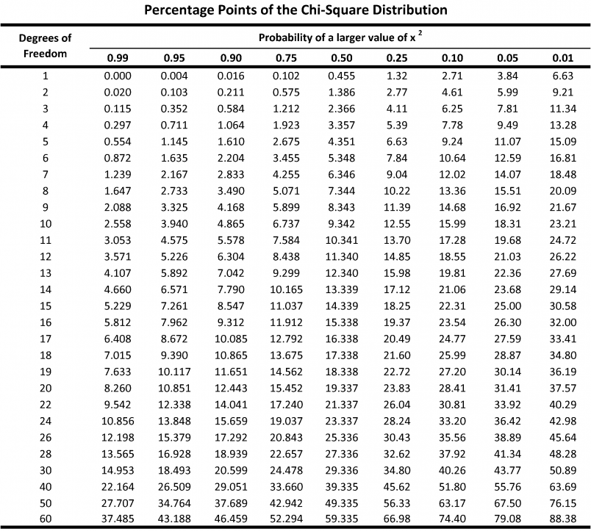

Slide 24
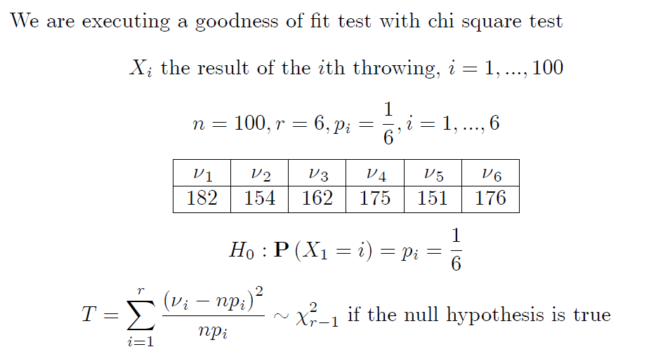

Slide 26

Earlier experience in a textile plant showed that the number of yarn tearing in a particular machine type and yarn followed Poisson distribution with lambda = 8. Let's check the null hypothesis that the nowadays measured data also follows this Poisson distribution.

Slide 27
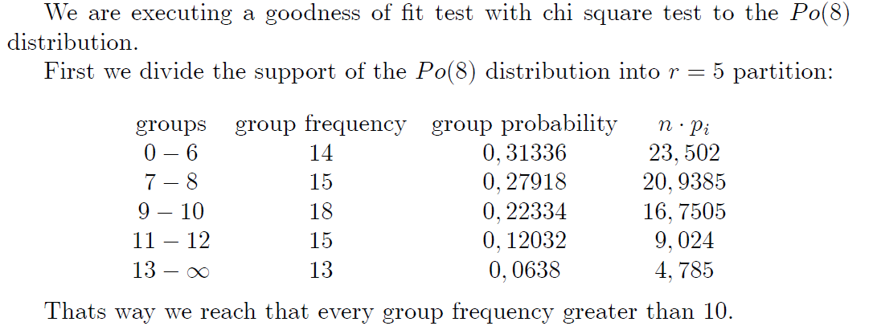

Slide 31
Using the following given hundred-year sample, decide on the null hypothesis that the distribution of the average temperature of Budapest's air in January is normal. Make the decision with Kolmogorov-Smirnov test. Perform the test with a chi square test, too.

Slide 32
First we estimate the expectation with the sample mean and the deviation with the sample standard deviation:
With these data we can give the theoretical pdf as
After sorting the data, we create the empirical distribution function. Calculate the substitute values of the theoretical distribution in the jumping points using the normal distribution table. Then we determine the maximum absolute value of the differences.

Slide 33
The critical value of the Kolmogorov-Smirnov test can be found in the table below
At the 0.05 significance level, the null hypothesis is accepted

Slide 34
First we prepare the ordered sample with frequencies

Slide 35
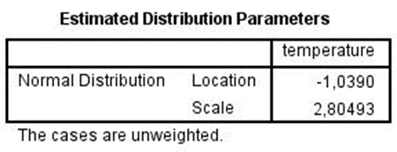
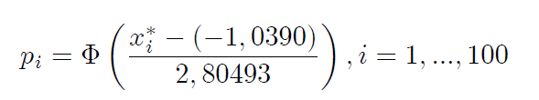
Then we calculate the estimations
With this estimations we calculate

Slide 36
We calculate the differencies between the Φ values and the percentiles:

Slide 37

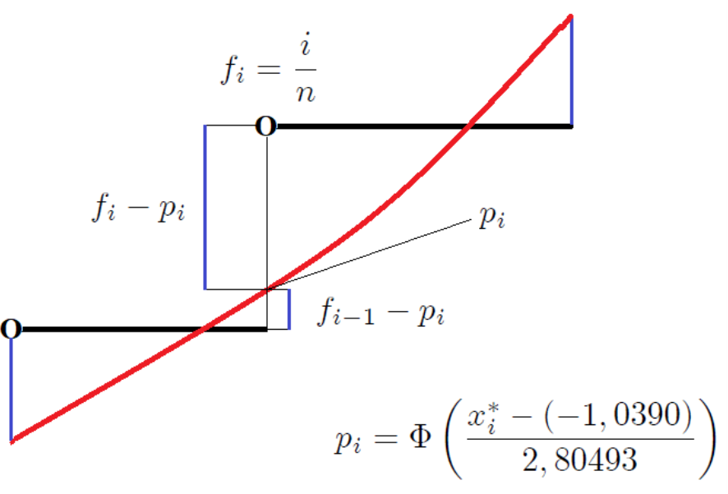
… then we determine the greatest and smallest differences :
0,027366 and -0,06446

Slide 38
Performing goodness of fit chi square test
We have to perform estimated goodness of fit chi square test. The first step is the estimating the expected value with the mean and the theoretical deviation with sample standard deviation. After this we can define the hypothetical distribution function. Because we execute two parameter estimating, so finally we have to draw 2 from the degree of freedom.

Slide 39
We create 8 groups (r=8). The probabilities of the groups are calculated with the hypothetical distribution function using the normal distribution table:

Slide 40
From these data the test statistics can be calculated
The signicance level: 0.05
The degree of fredom: r-1-k=8-1-2=5
The critical value: 11.07
We accept the goodness fit to the normal distribution.

Slide 41

Examine with chi square test that the distributions the average temperatures of January in Budapest are the same between 1861-1910 and 1911-1960.

Slide 42
The sample sizes are equal:
We create 5 groups. The data can be summarize in the next table.
From this table the test statistics is calculable

Slide 43
The significance level: 0.05
The degree of fredom: r-1=5-1=4
The critical value from the chi square table: 7.81
Because the calculated value of the test statistics is greater than the critical value, we reject the null hypothesis, ie the average temperature is changed significantly in 50 years in Budapest. We have probably experienced a change in climate. (Global warming…)

Slide 44



Slide 47
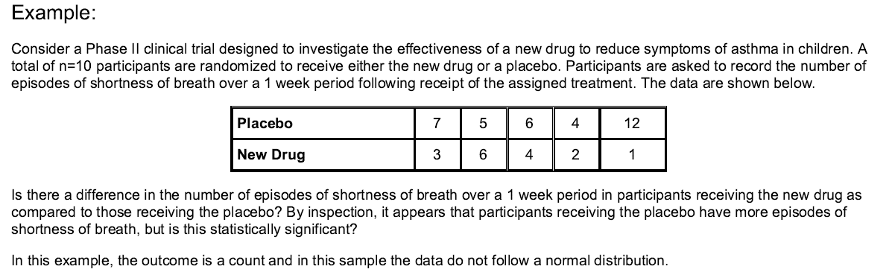



Slide 48

We will decide with Mann Whitney U Test. n₁=n₂=5.

Slide 49
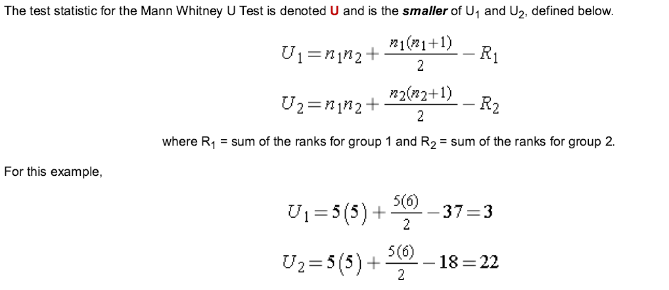

Slide 50
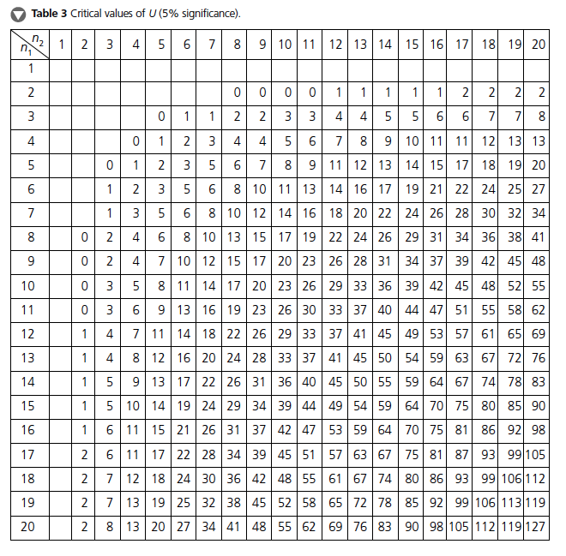
The critical value of U can be found in the table below. To determine the appropriate critical value we need sample sizes (for Example: n₁=n₂=5) and our two-sided level of significance (α=0.05). For our Example the critical value is 2, and the decision rule is to reject H₀ if U < 2. We do not reject H₀ because 3 > 2. We do not have statistically significant evidence at α =0.05, to show that the two populations of numbers of episodes of shortness of breath are not equal. However, in this example, the failure to reach statistical significance may be due to low power. The sample data suggest a difference, but the sample sizes are too small to conclude that there is a statistically significant difference.

Slide 51
Consider a clinical investigation to assess the effectiveness of a new drug designed to reduce repetitive behaviors in children affected with autism. If the drug is effective, children will exhibit fewer repetitive behaviors on treatment as compared to when they are untreated. A total of 8 children with autism enroll in the study. Each child is observed by the study psychologist for a period of 3 hours both before treatment and then again after taking the new drug for 1 week. The time that each child is engaged in repetitive behavior during each 3 hour observation period is measured. Repetitive behavior is scored on a scale of 0 to 100 and scores represent the percent of the observation time in which the child is engaged in repetitive behavior. For example, a score of 0 indicates that during the entire observation period the child did not engage in repetitive behavior while a score of 100 indicates that the child was constantly engaged in repetitive behavior. The data are shown below.
Looking at the data, it appears that some children improve (e.g., Child 5 scored 80 before treatment and 20 after treatment), but some got worse (e.g., Child 3 scored 40 before treatment and 50 after treatment). Is there statistically significant improvement in repetitive behavior after 1 week of treatment?

Slide 52
Solution with Wilcoxon Signed Rank Test
First, we compute difference scores for each child.

Slide 53
The next step is to rank the difference scores. We first order the absolute values of the difference scores and assign rank from 1 through n to the smallest through largest absolute values of the difference scores, and assign the mean rank when there are ties in the absolute values of the difference scores.

Slide 54
The final step is to attach the signs ("+" or "-") of the observed differences to each rank as shown below.

Slide 55
The Wilcoxon Signed Rank Test concern the population median of the difference scores. The research hypothesis can be one- or two-sided. Here we consider a two-sided test.
H₀: The median difference is zero versus
H₁: The median difference is positive α=0.05
The test statistic for the Wilcoxon Signed Rank Test is W, defined as the smaller of W+ (sum of the positive ranks) and W- (sum of the negative ranks). If the null hypothesis is true, we expect to see similar numbers of lower and higher ranks that are both positive and negative (i.e., W+ and W- would be similar). If the research hypothesis is true we expect to see more higher and positive ranks (in this example, more children with substantial improvement in repetitive behavior after treatment as compared to before, i.e., W+ much larger than W-).
In this example, W+ = 32 and W- = 4. Recall that the sum of the ranks (ignoring the signs) will always equal n(n+1)/2. As a check on our assignment of ranks, we have n(n+1)/2 = 8(9)/2 = 36 which is equal to 32+4. The test statistic is W = 4.
Next we must determine whether the observed test statistic W supports the null or research hypothesis. This is done following the same approach used in parametric testing. Specifically, we determine a critical value of W such that if the observed value of W is less than or equal to the critical value, we reject H₀ in favor of H₁, and if the observed value of W exceeds the critical value, we do not reject H₀.

Slide 56
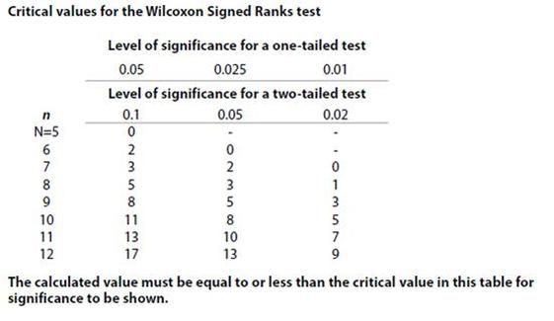
To determine the appropriate two-sided critical value we need sample size (n=8) and our two-sided level of significance (α=0.05). For this example, the critical value of W is 3 and the decision rule is to reject H₀ if W >3. Thus, we reject H₀, because 4 >3. We have statistically significant evidence at α =0.05, to show that the median difference is non-zero (i.e., that repetitive behavior changes.)

