Slide 1
Hypothesis Theory
PhD course

Slide 2
Confidence Interval
Point estimation
Interval estimation

Slide 3
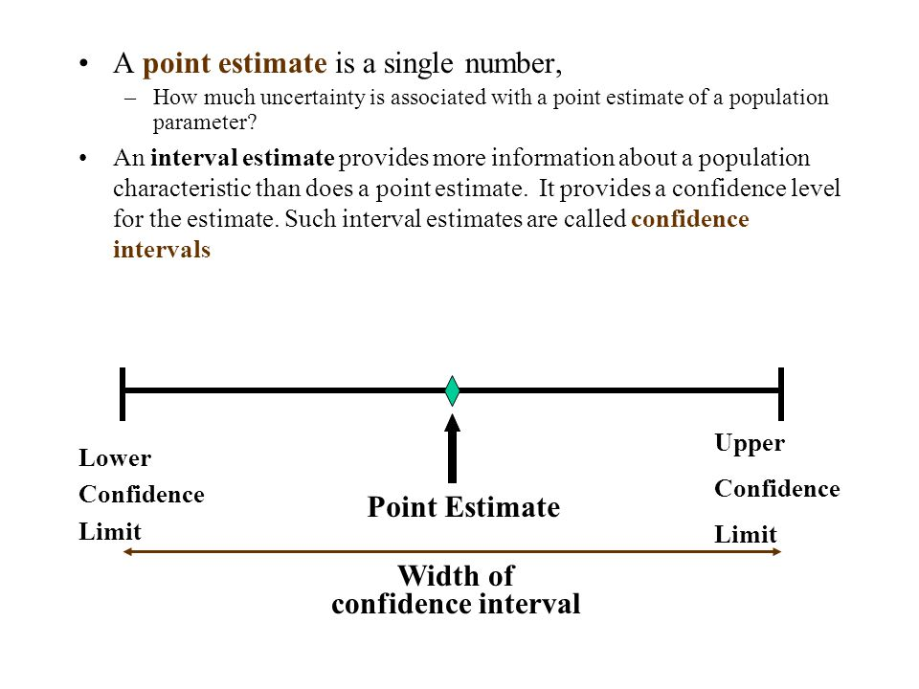

Slide 4


Slide 5
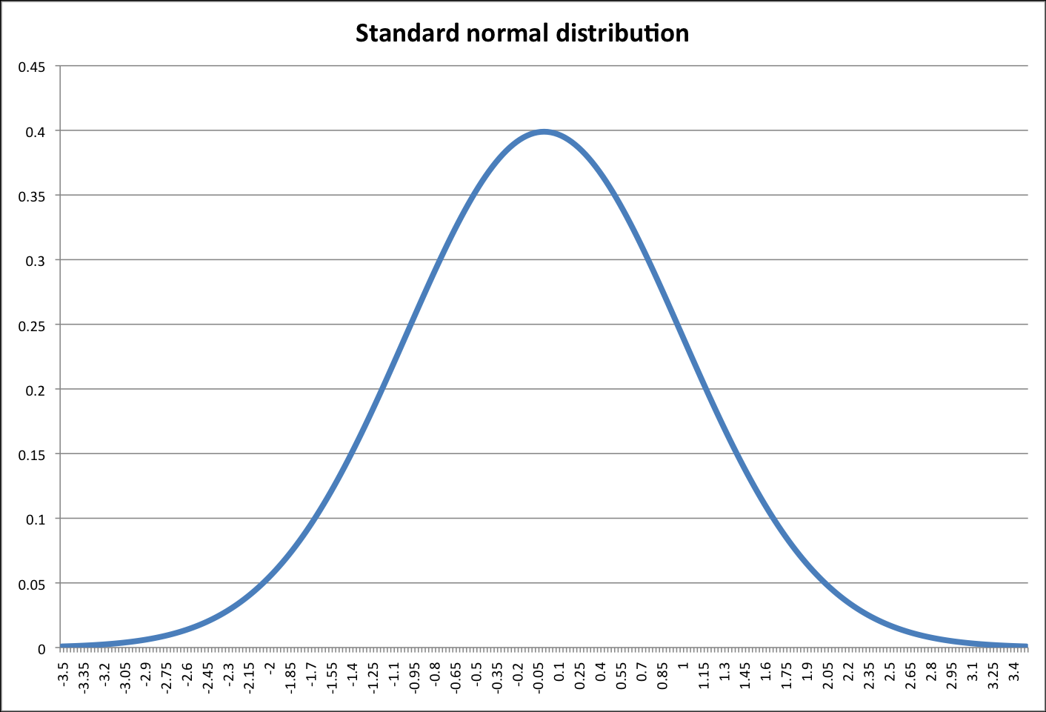
Editing confidence interval to the expected value when the deviation is known in normal case

Slide 6
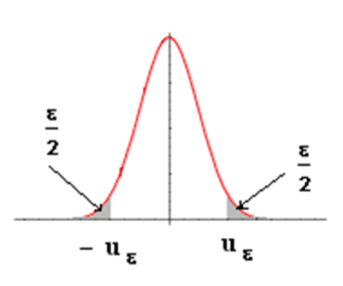
Editing confidence interval to the expected value when the deviation is known in normal case

Slide 7
Editing confidence interval to the expected value when the deviation is known in normal case

Slide 8
Editing confidence interval to the expected value when the deviation is unknown in normal case

Slide 9
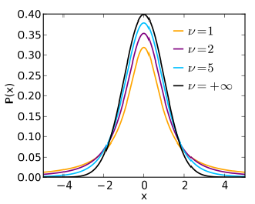
Editing confidence interval to the expected value when the deviation is unknown in normal case

Slide 10
Editing confidence interval to the expected value when the deviation is unknown in normal case

Slide 11
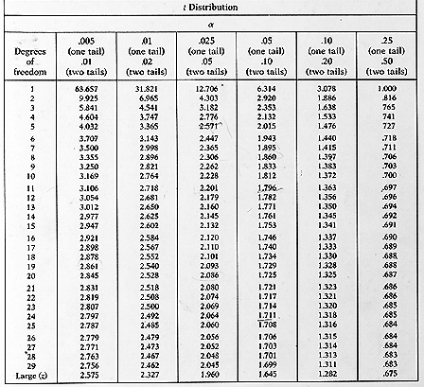

Slide 12
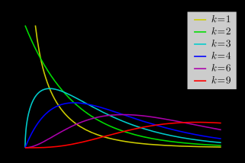
Editing Confidence Interval for Unknown Deviation in Case of Normal Distribution

Slide 13
Editing Confidence Interval for Unknown Deviation in Case of Normal Distribution

Slide 14
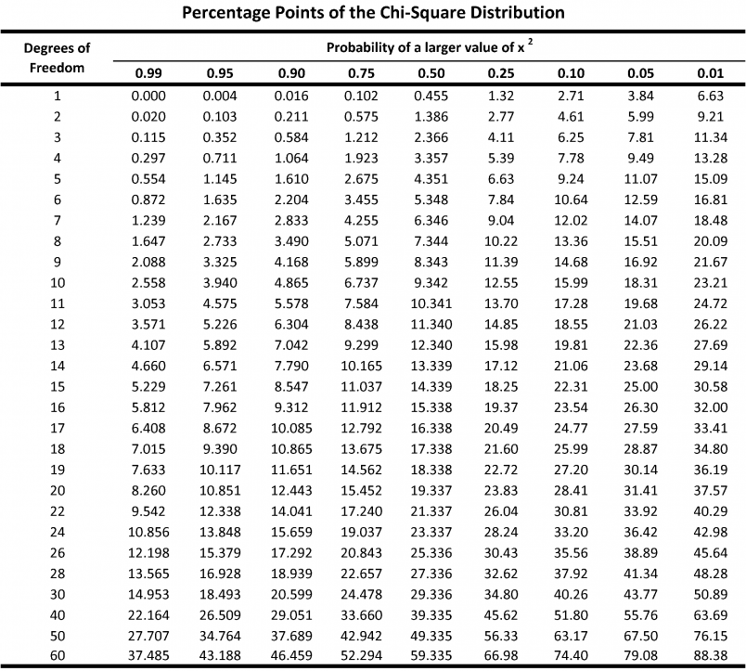

Slide 15
Hypothesis Theory

Slide 16
Basic Model

Slide 20
A Type I error occurs if we reject the null hypothesis H₀
(in favor of the alternative hypothesis H₁) when the null hypothesis H₀ is true.
A Type II error occurs if we fail to reject the null hypothesis H₀
when the alternative hypothesis H₁ is true.

Slide 21
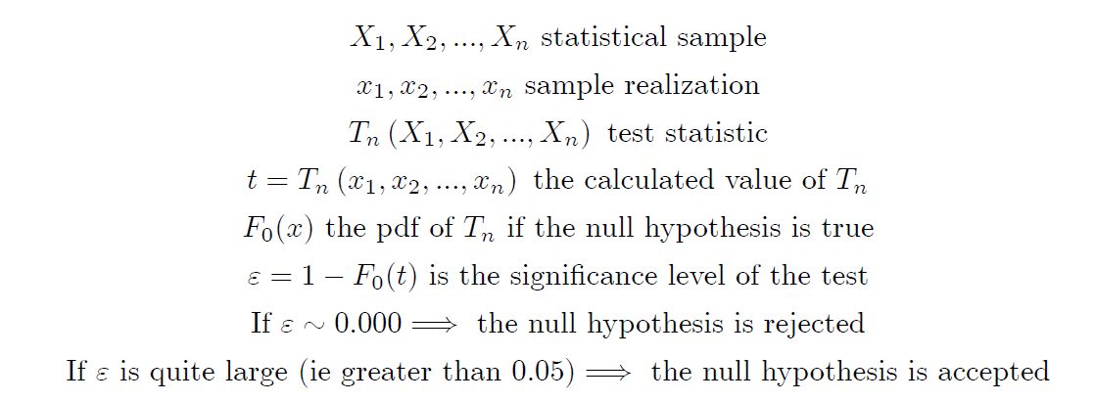
Principle of Significance Tests
(An alternative implementation of the decision on the null hypothesis)

Slide 23
Parametrical tests
One sample u-test
Two independent samples u-test
One sample t-test
Two independent samples t-test
F-test
Welch-test
Two paired sample t-test
Oneway ANOVA
Bartlett-test

Slide 24
One sample u-test

Slide 25


Slide 28
One sample u-test
One sample u-test

Slide 29
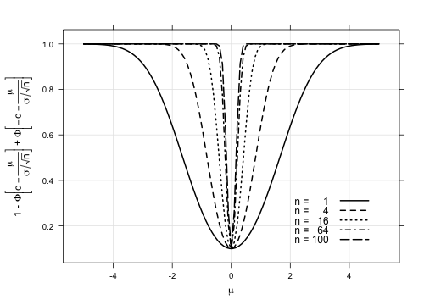
One sample u-test: power function
How depends the power function on n

Slide 30
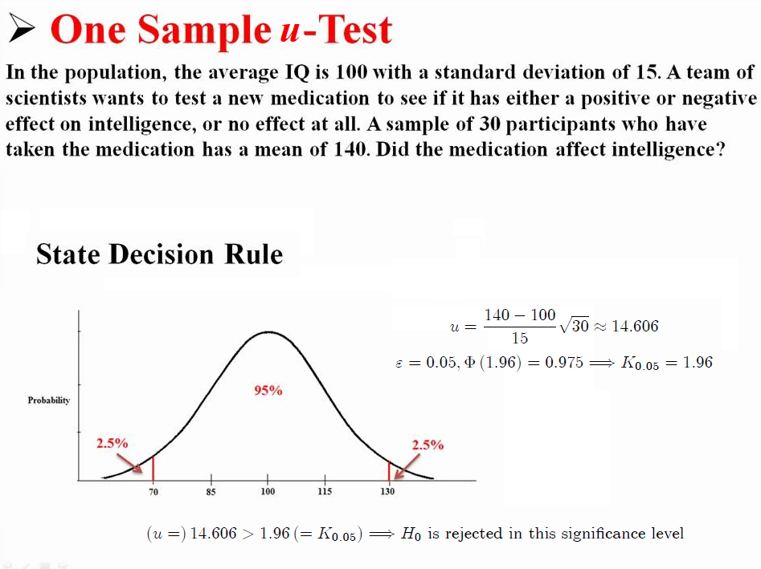

Slide 31
Two independent samples u-test

Slide 32


Slide 34
One sample t-test

Slide 35


Slide 37


Slide 39
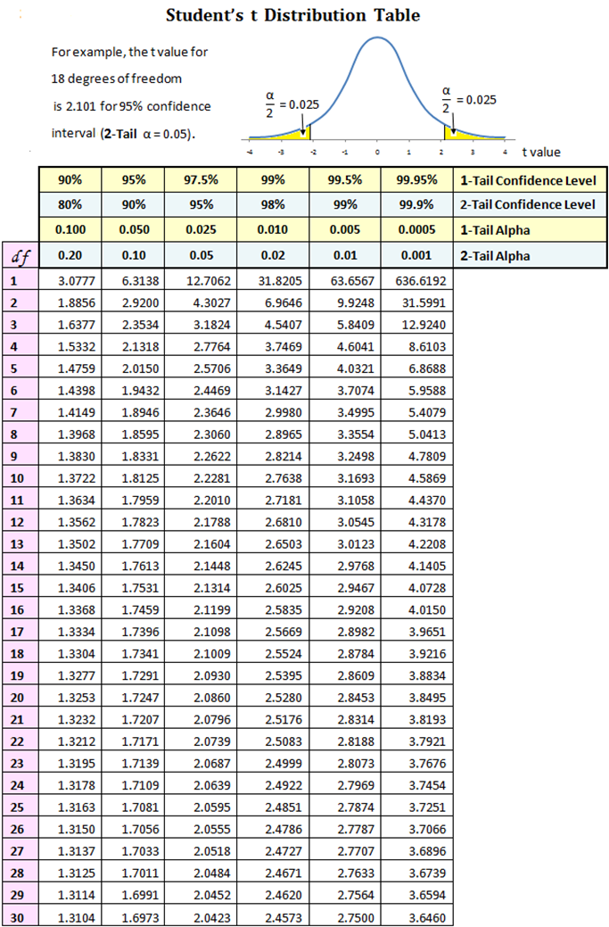
The critical value is 2.1328.
So the null hypotheses is accepted at this level.
The group mean doesn’t differ significantly from 70 with 90%
probability.

Slide 40
Two independent samples t-test

Slide 41
Two independent samples t-test

Slide 42
Two independent samples t-test

Slide 43
Two independent samples t-test

Slide 44
Two independent samples t-test

Slide 45
F- or Fisher-test

Slide 46
F- or Fisher-test

Slide 47
F- or Fisher-test

Slide 48

An example
Example: Comparing Packing Machines
In a packing plant, a machine packs cartons with jars. It is supposed that a new machine will pack faster on the average than the machine currently used. To test that hypothesis, the times it takes each machine to pack ten cartons are recorded. The results (machine.txt), in seconds, are shown in the following table.
New machine Old machine
42.1 42.7
41 43.6
41.3 43.8
41.8 43.3
42.4 42.5
42.8 43.5
43.2 43.1
42.3 41.7
41.8 44
42.7 44.1
x_mean = 42.14, s₁ = 0.683
y_mean = 43.23, s₂ = 0.750
Do the data provide sufficient evidence to conclude that, on the average, the new machine packs faster? Perform the required hypothesis test at the 5% level of significance.

Slide 49
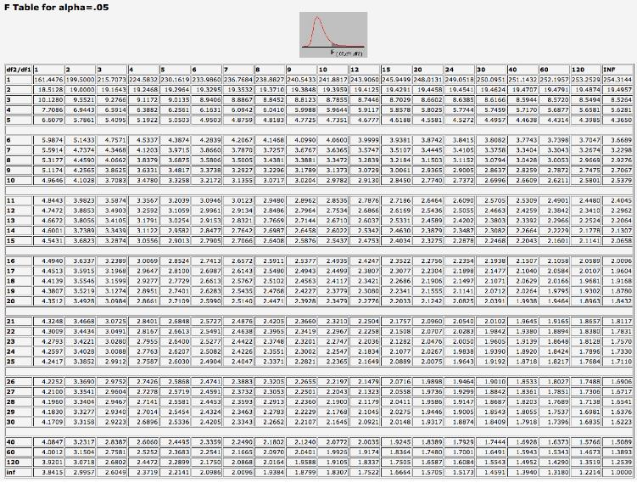
First we execute the F-test to check the equality of the sample variations.

Slide 53
Example

Slide 56


Slide 57


Slide 58
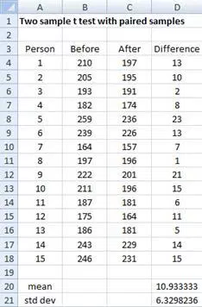


Slide 60


Slide 63
One-way ANOVA
The one-way analysis of variance (ANOVA) is used to determine whether there are any statistically significant differences between the means of two or more independent (unrelated) groups (although you tend to only see it used when there are a minimum of three, rather than two groups).

Slide 64
One-way ANOVA

Slide 65
One-way ANOVA

Slide 66


Slide 70


Slide 72


Slide 74


Slide 76


