Slide 1
HOMEWORK 6
PhD Course

Slide 2
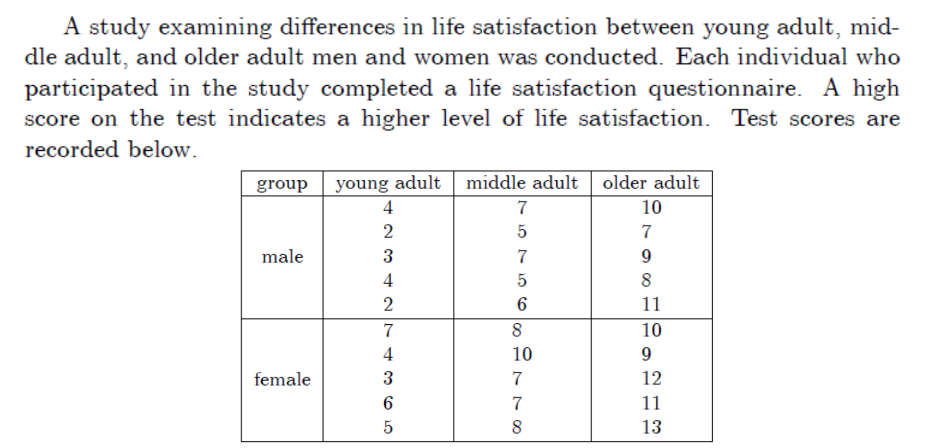
Check with Bartlett’s Test, that the variances of the six treatment groups are equal!

