Slide 1
Data Matrix
PhD Course

Slide 2
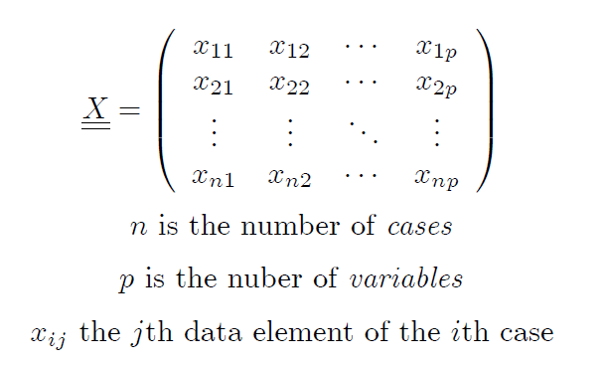

Slide 4


Slide 5

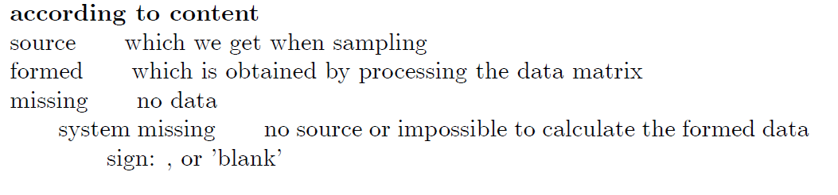

Slide 6
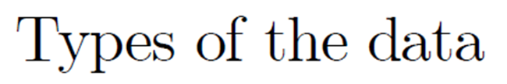

Slide 7
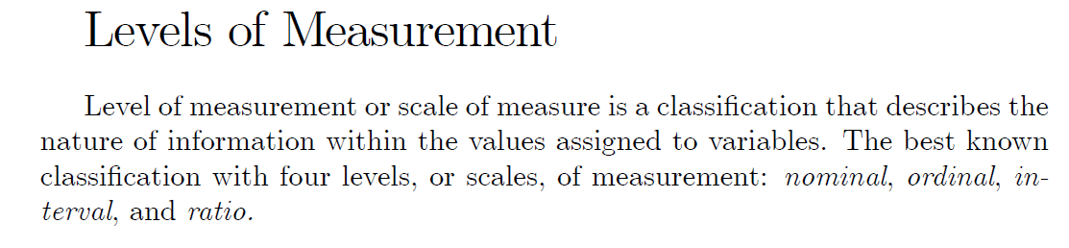
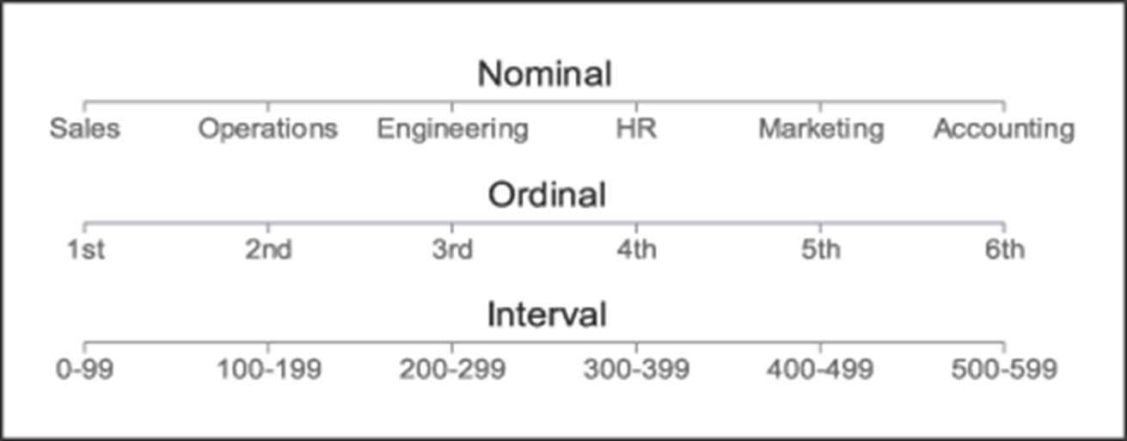

Slide 9
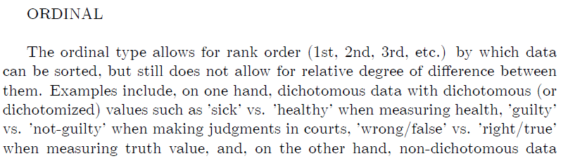

Slide 14




Slide 17
Graphs for categorical or discrete variables
Bar diagrams

Slide 18

Pie Charts

Slide 19
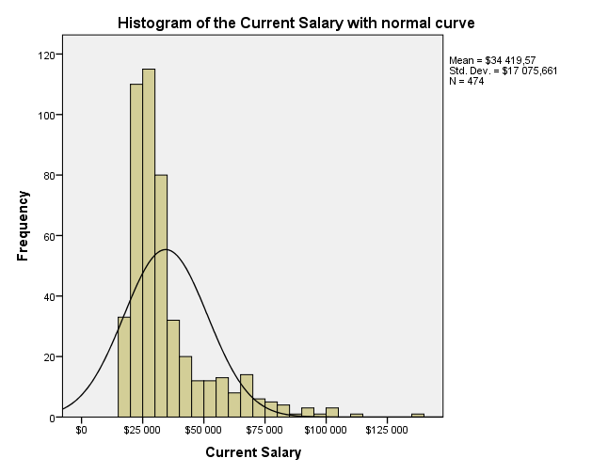
Graps for continuous variables
Histogram

Slide 20
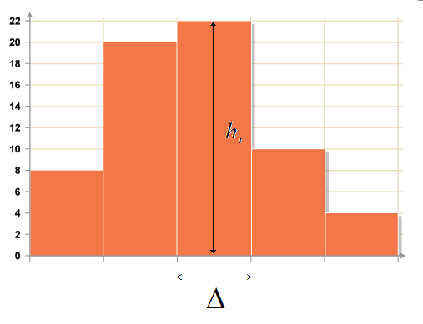

Slide 24
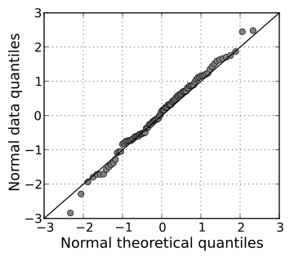
Q-Q PLOT

Slide 25
BOX PLOT
A simple version

Slide 26
BOX PLOT
Enhanced Version

Slide 27
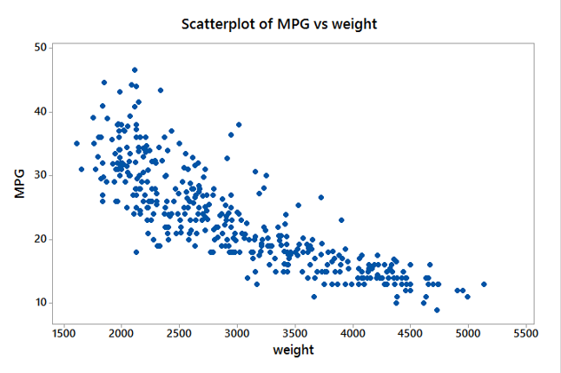
Scatter Plot
Representation of the data pairs (x_{i}, y_{i})

Slide 28
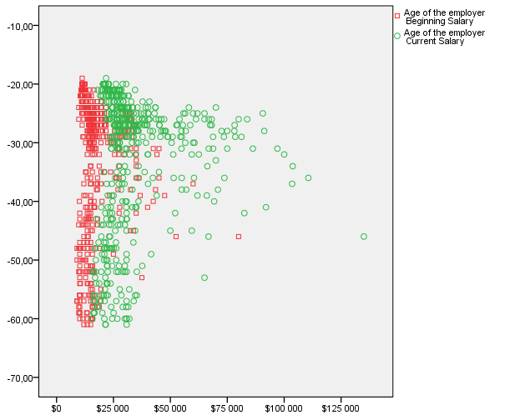
Scatter Plot
Overlay Scatter together (x_{i}, y_{i}), (x_{i}, z_{i})

Slide 29
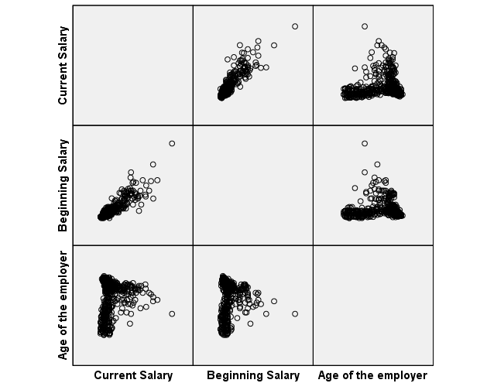
Scatter Plot
Matrix Scatter

