Slide 1
Basic Concepts
PhD Course

Slide 5
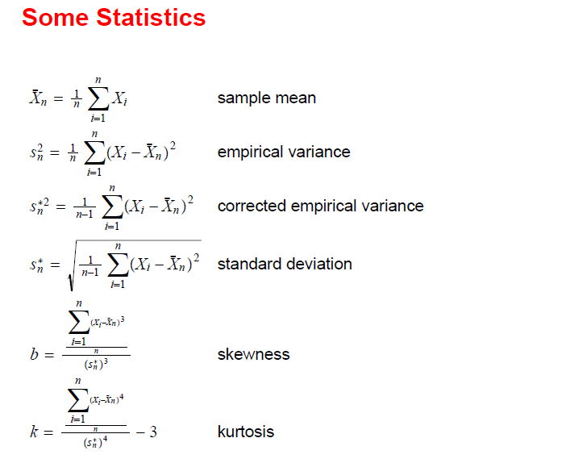

Slide 6
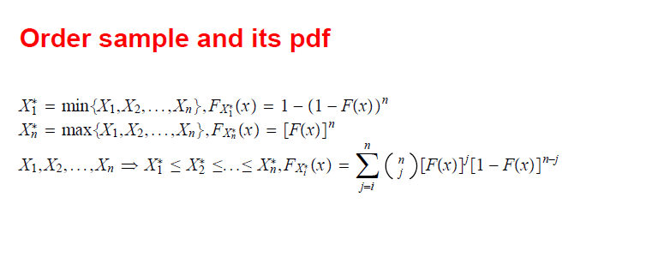

Slide 7
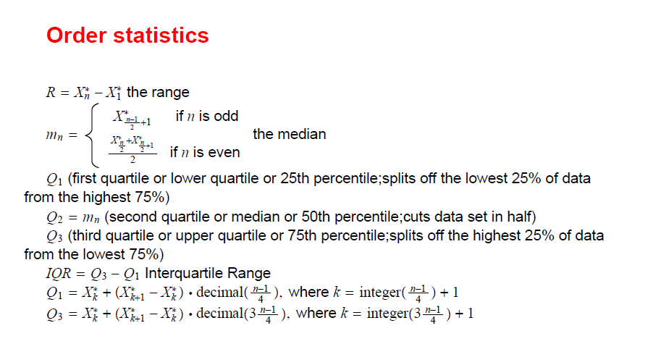

Slide 8



The sample is

Slide 9
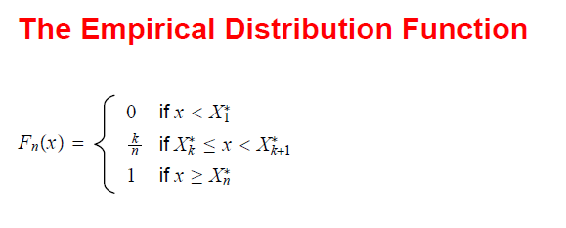
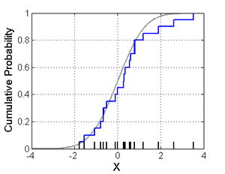

Slide 10
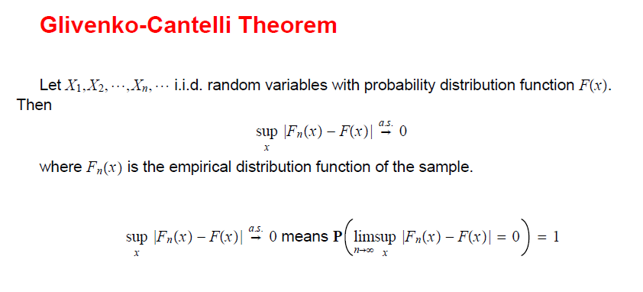

Slide 11
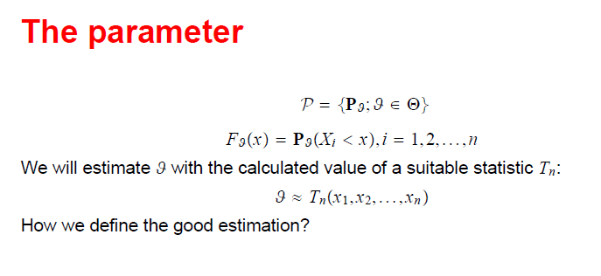

Slide 12

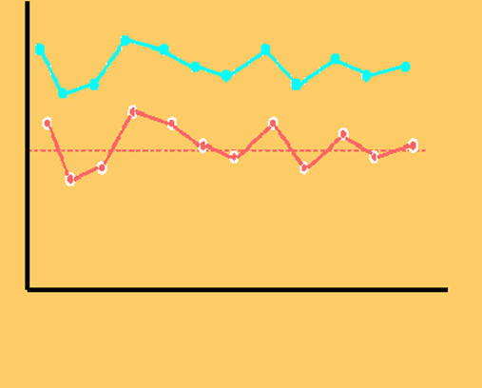
The parameter ϑ
A baised estimator
An unbaised estimator

Slide 13

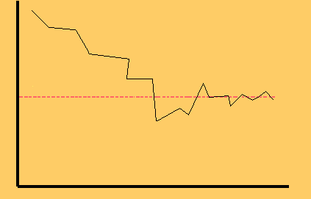
The parameter ϑ

Slide 14

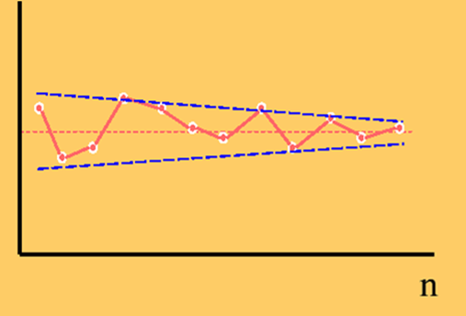
The parameter ϑ
The estimation error decreases as the sample size increases.

Slide 15
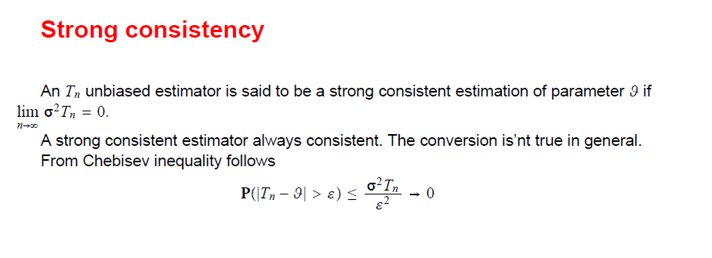

Slide 16

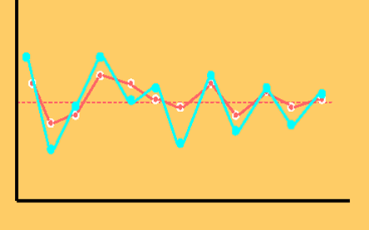
The efficient estimator

Slide 17
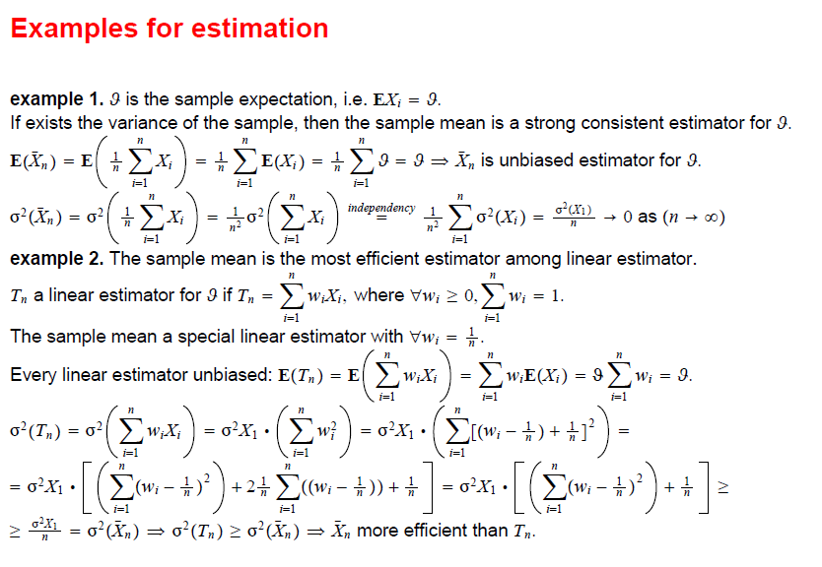

Slide 18
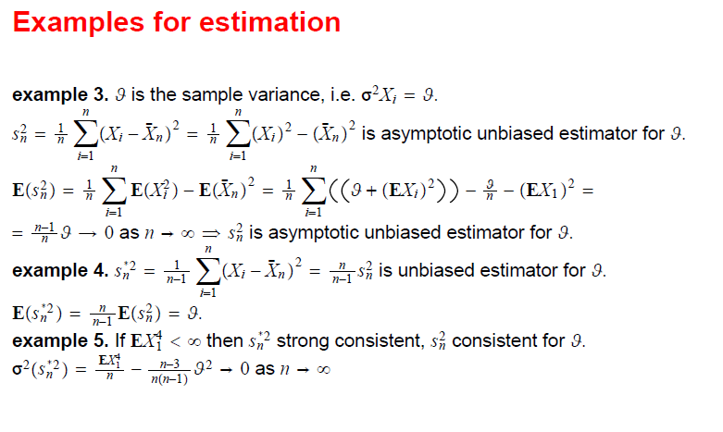

Slide 24

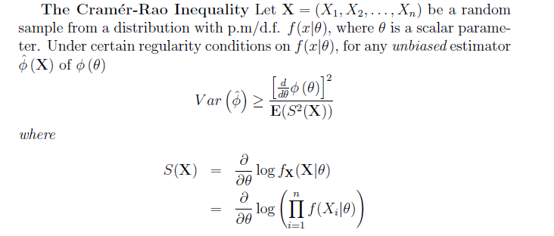

Slide 25


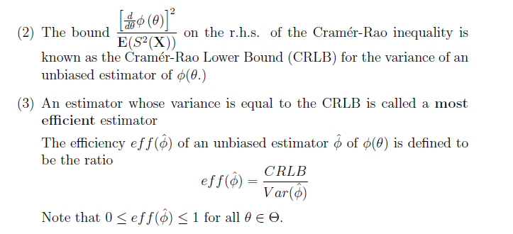

Slide 32
Distributions derived from normal distribution
Chi-square
Student or t
Fisher or F

Slide 33
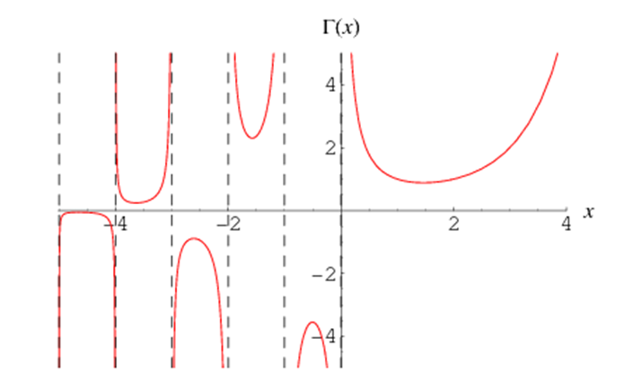

Slide 35
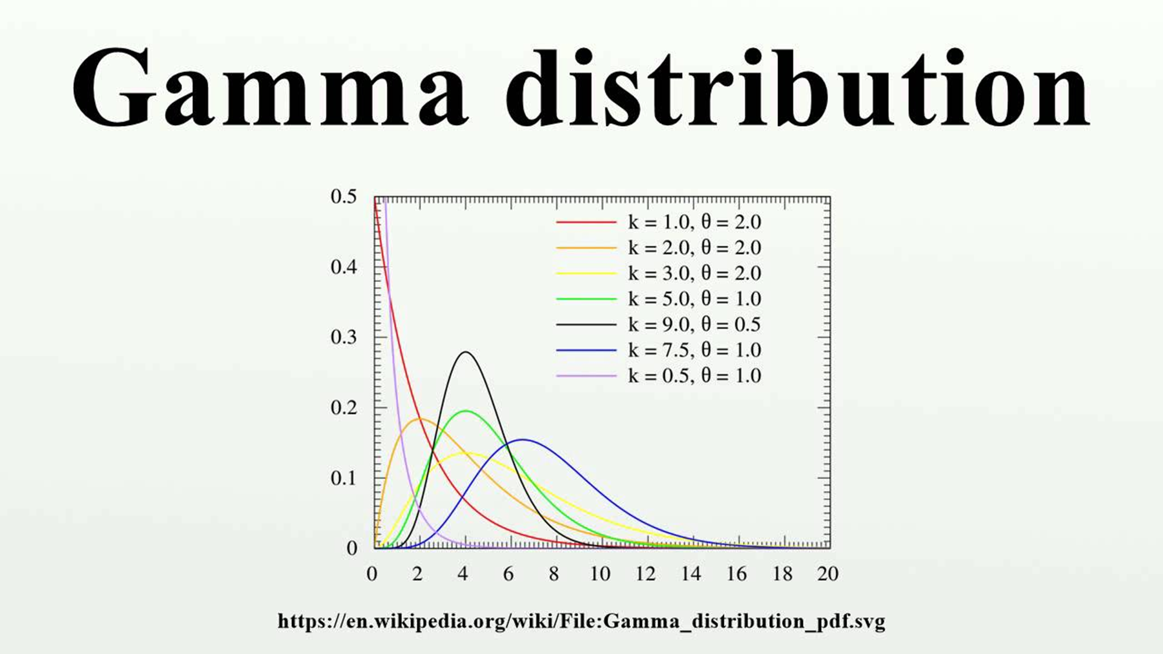

Slide 37
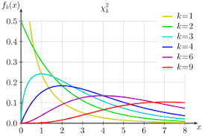
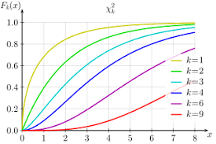
density function:
distribution function:

Slide 39




Slide 40
Relationship between polynomial distribution and chi square distribution

Slide 41
t or Student distribution

Slide 42

are independents

Slide 43
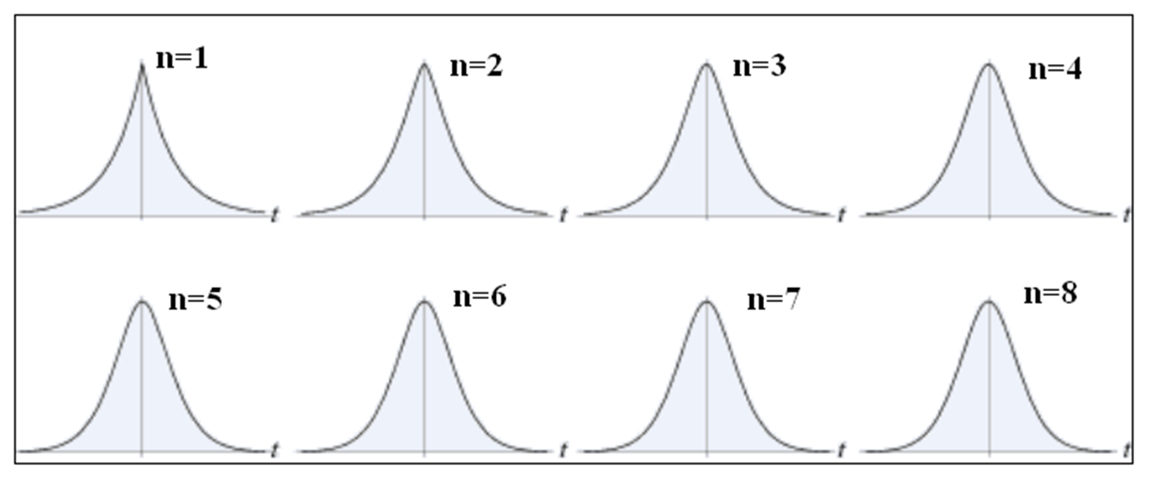
Density functions of the t distributions

Slide 44
F- or Fisher distribution

Slide 45
Density function of the F distribution

Slide 51
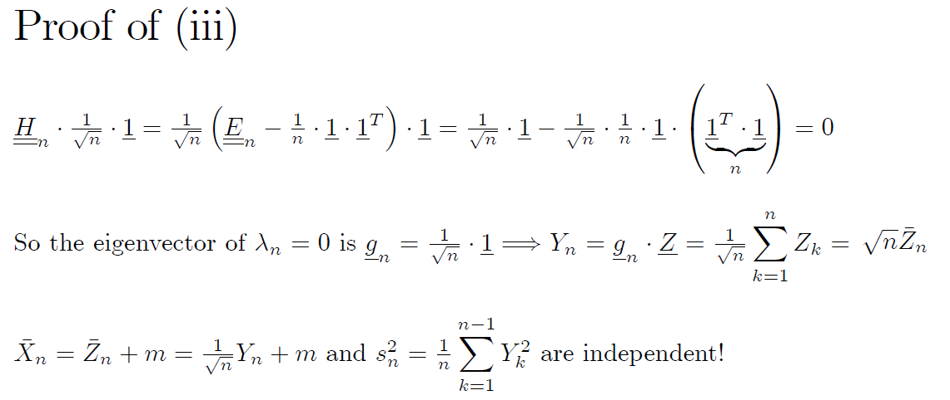

Slide 58


Slide 60


Slide 62


Slide 67


Slide 69

