Slide 1
Recent Advances in
Parameterized Complexity
The Strong Exponential-Time Hypothesis
Insert
«Academic unit»
on every page:
1 Go to the menu «Insert»
2 Choose: Date and time
3 Write the name of your faculty or department in the field «Footer»
4 Choose «Apply to all"
Dániel Marx
(slides by Daniel Lokshtanov)
Tel Aviv, Israel
December 4, 2017

Slide 2
Tight lower bounds
Have seen that ETH can give tight lower bounds
How tight? ETH «ignores» constants in exponent
How to distinguish 1.85^{n} from 1.0001^{n}?

Slide 3
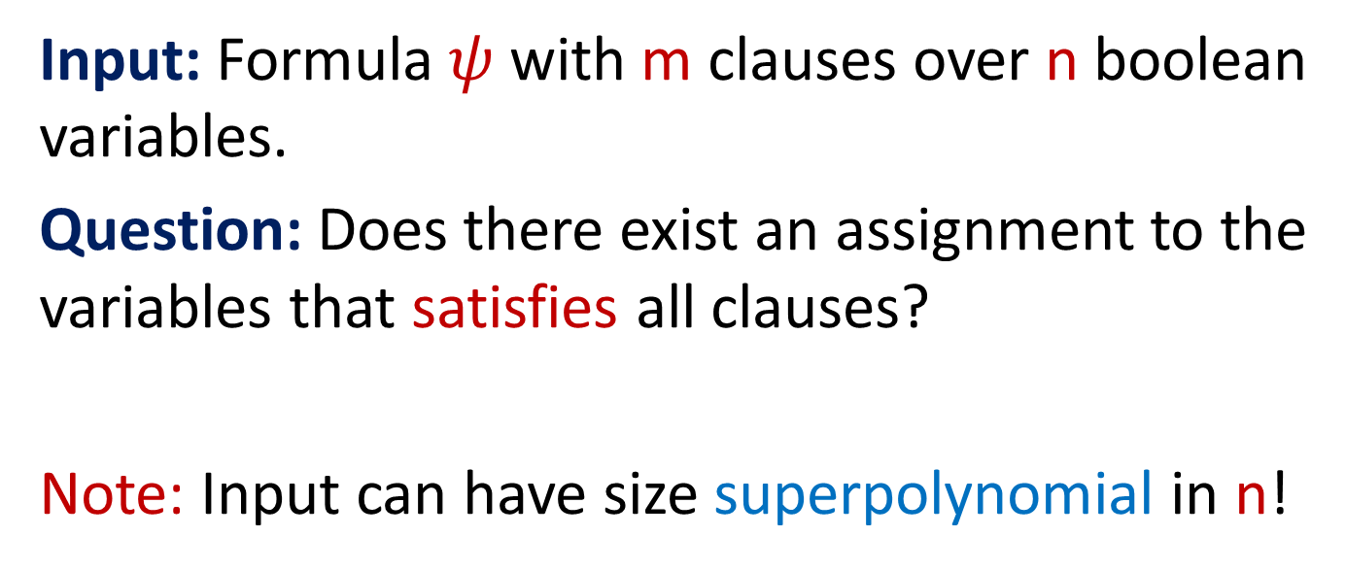
SAT
Input: Formula $ψ$ with m clauses over n boolean variables.
Question: Does there exist an assignment to the variables that satisfies all clauses?
Note: Input can have size superpolynomial in n!
Fastest algorithm for SAT: 2^{n}poly(m)

Slide 4


d-SAT
Here all clauses have size $≤$ d
Input size $≤$ n^{d}
Fastest algorithm for 2-SAT: n+m
Fastest algorithm for 3-SAT: 1.31^{n}
Fastest algorithm for 4-SAT: 1.47^{n}
…
Fastest algorithm for d-SAT: $2^{\left(1−c/d\right)n}$
Fastest algorithm for SAT: $2^{n}$

Slide 5
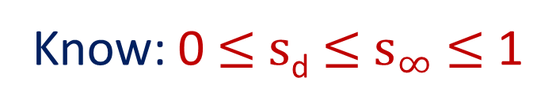


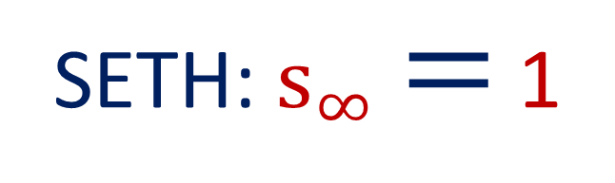

Strong ETH
Let $s_{d}=inf⁡\{c :$ d-SAT has a $2^{cn}$ algorithm$\}$
Let $s_{∞}= \lim_{d→∞}{s_{d}}$
Know: 0 $≤$ $s$_{d} $≤$ $s_{∞}$ $≤$ 1
ETH: s₃ $>$ 0
SETH: $s_{∞}=$ 1

Slide 6

Showing Lower Bounds under SETH
d-SAT
Your Problem
$${1.99999}^{n}$$
Too fast algorithm?
The number of 9’s MUST
be independent of d

Slide 7
Dominating Set
Input: n vertices, integer k
Question: Is there a set S of at most k vertices such that N[S] = V(G)?
Naive: n^{k+1}
Smarter: n^{k+o(1)}
Assuming ETH: no f(k)n^{o(k)}
n^{k/10}?
n^{k-1}?

Slide 8
SAT → k-Dominating Set
Variables
SAT-formula
k groups, each on
n/k variables.
One vertex for each of the 2^{n/k}
assignments to the variables
in the group.

Slide 9
Variables
SAT-formula
k groups, each on
n/k variables.
Selecting one vertex from each
cloud corrsponds to selecting
an assignment to the variables.
Cliques

Slide 10
Variables
SAT-formula
k groups, each on
n/k variables.
Edge if the partial assignment
satisfies the clause
One vertex per clause in the formula

Slide 11
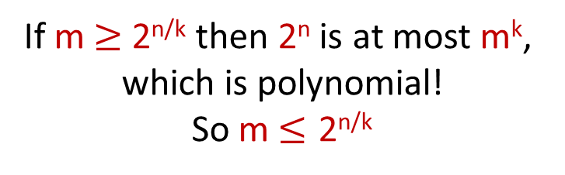
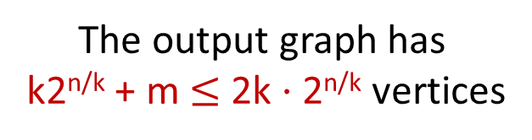

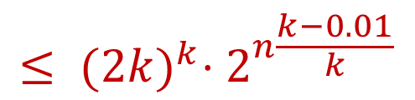

SAT → k-Dominating Set analysis
Too fast algorithm for k-Dominating Set: n^{k-0.01}
For any fixed k (like k=3)
If m $≥$ 2^{n/k} then 2^{n} is at most m^{k},
which is polynomial!
So m $≤\text{2}\text{n}\text{/}\text{k}$
The output graph has
k2^{n/k} + m $≤$ 2k $⋅$ 2^{n/k} vertices
$$≤ {(2k)}^{k}⋅2^{n\frac{k−0.01}{k}}$$
${({2k⋅2}^{n/k})}^{k−0.01}$
$$=O({1.999}^{n})$$

Slide 12
Dominating Set, wrapping up
A O(n^{2.99}) algorithm for 3-Dominating Set, or
a O(n^{3.99}) algorithm for 4-Dominating Set, or a
a O(n^{4.99}) algorithm for 5-Dominating Set, or a …
… would violate SETH.

Slide 13
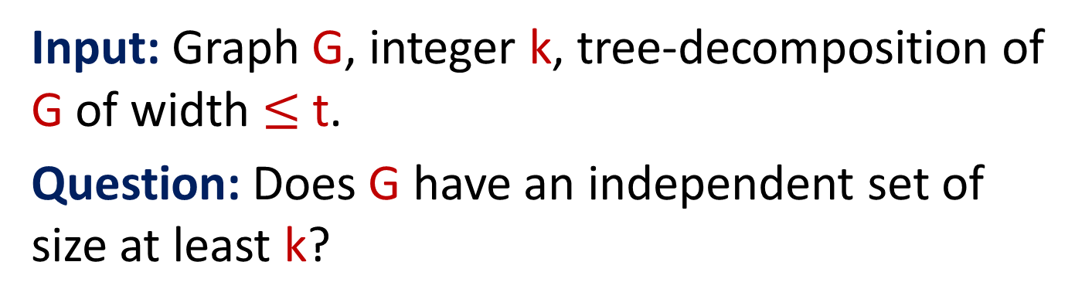
Independent Set / Treewidth
Input: Graph G, integer k, tree-decomposition of G of width $≤$ t.
Question: Does G have an independent set of size at least k?
DP: O(2^{t}n) time algorithm
Can we do it in 1.99^{t} poly(n) time?
Next: If yes, then SETH fails!

Slide 14
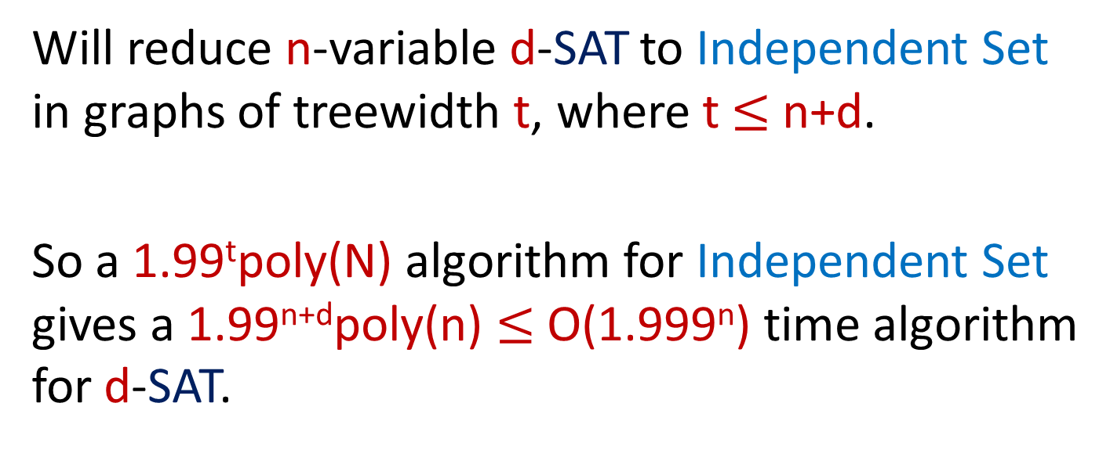
Independent Set / Treewidth
Will reduce n-variable d-SAT to Independent Set in graphs of treewidth t, where t $≤$n+d.
So a 1.99^{t}poly(N) algorithm for Independent Set gives a 1.99^{n+d}poly(n) $≤$ O(1.999^{n}) time algorithm for d-SAT.

Slide 15
Independent Sets on an Even Path
In independent set:
Not in solution:
t
f
t
f
t
f
t
f
t
f
True
False
first
True
then
False

Slide 16
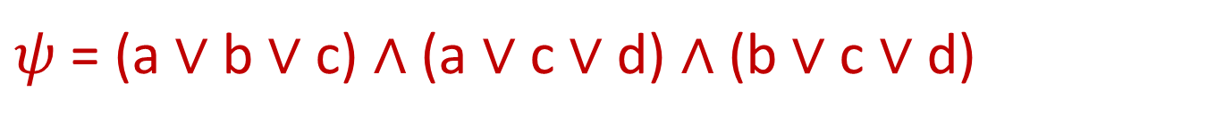

d-SAT $≤$ Independent Set proof by example
$ψ$ = (a $∨$ b $∨$ c) $∧$ (a $∨$ c $∨$ d) $∧$ (b $∨$ c $∨$ d)
b
c
c
a
c
a
d
b
d
a
t
f
t
f
t
f
b
t
f
t
f
t
f
c
t
f
t
f
t
f
d
t
f
t
f
t
f

Slide 17
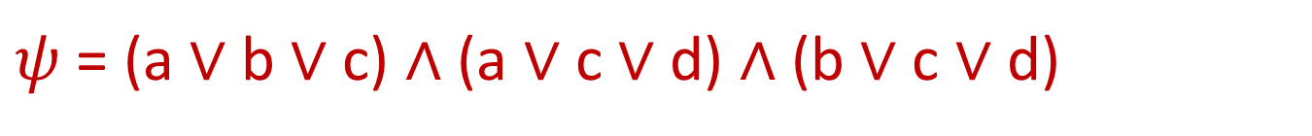

Independent Sets $↔$ Assignments
$ψ$ = (a $∨$ b $∨$ c) $∧$ (a $∨$ c $∨$ d) $∧$ (b $∨$ c $∨$ d)
b
c
c
But what about the
first true then false independent sets?
a
c
a
d
b
d
True
a
t
f
t
f
t
f
False
b
t
f
t
f
t
f
True
c
t
f
t
f
t
f
False
d
t
f
t
f
t
f

Slide 18
Dealing with true→false
Clause
gadgets
1
2
3
1
2
3
1
2
3
1
2
3
1
2
3
a
b
c
d
Every variable flips true→false at most once!

Slide 19
Treewidth Bound by picture
d
b
c
c
a
c
a
d
b
d
a
…
t
f
t
f
t
f
b
…
t
f
t
f
t
f
n
c
…
t
f
t
f
t
f
d
…
t
f
t
f
t
f
Formal proof - exercise

Slide 20
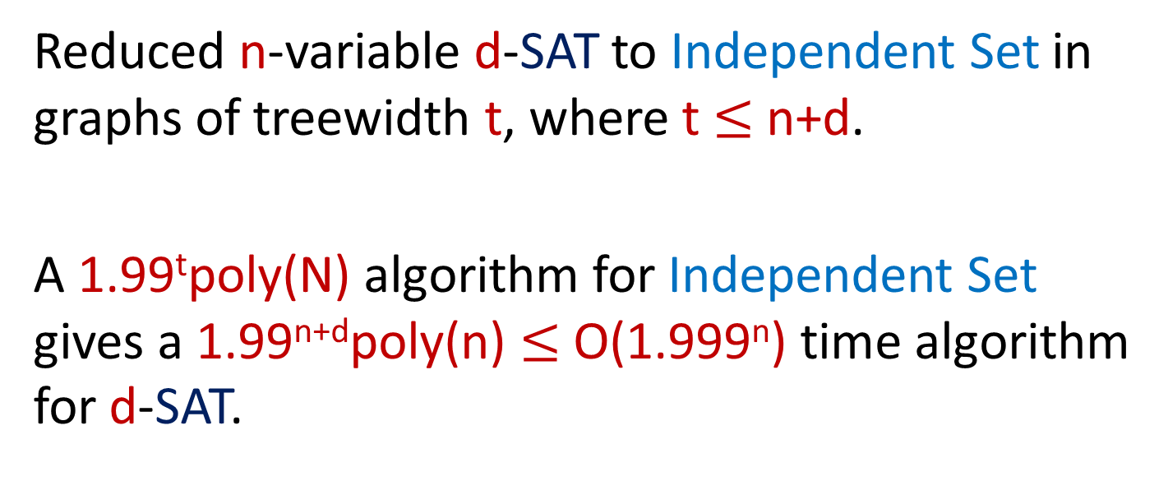
Independent Set / Treewidth wrap up
Reduced n-variable d-SAT to Independent Set in graphs of treewidth t, where t $≤$n+d.
A 1.99^{t}poly(N) algorithm for Independent Set gives a 1.99^{n+d}poly(n) $≤$ O(1.999^{n}) time algorithm for d-SAT.
Thus, no 1.99^{t} algorithm for
Independent Set assuming SETH

Slide 21
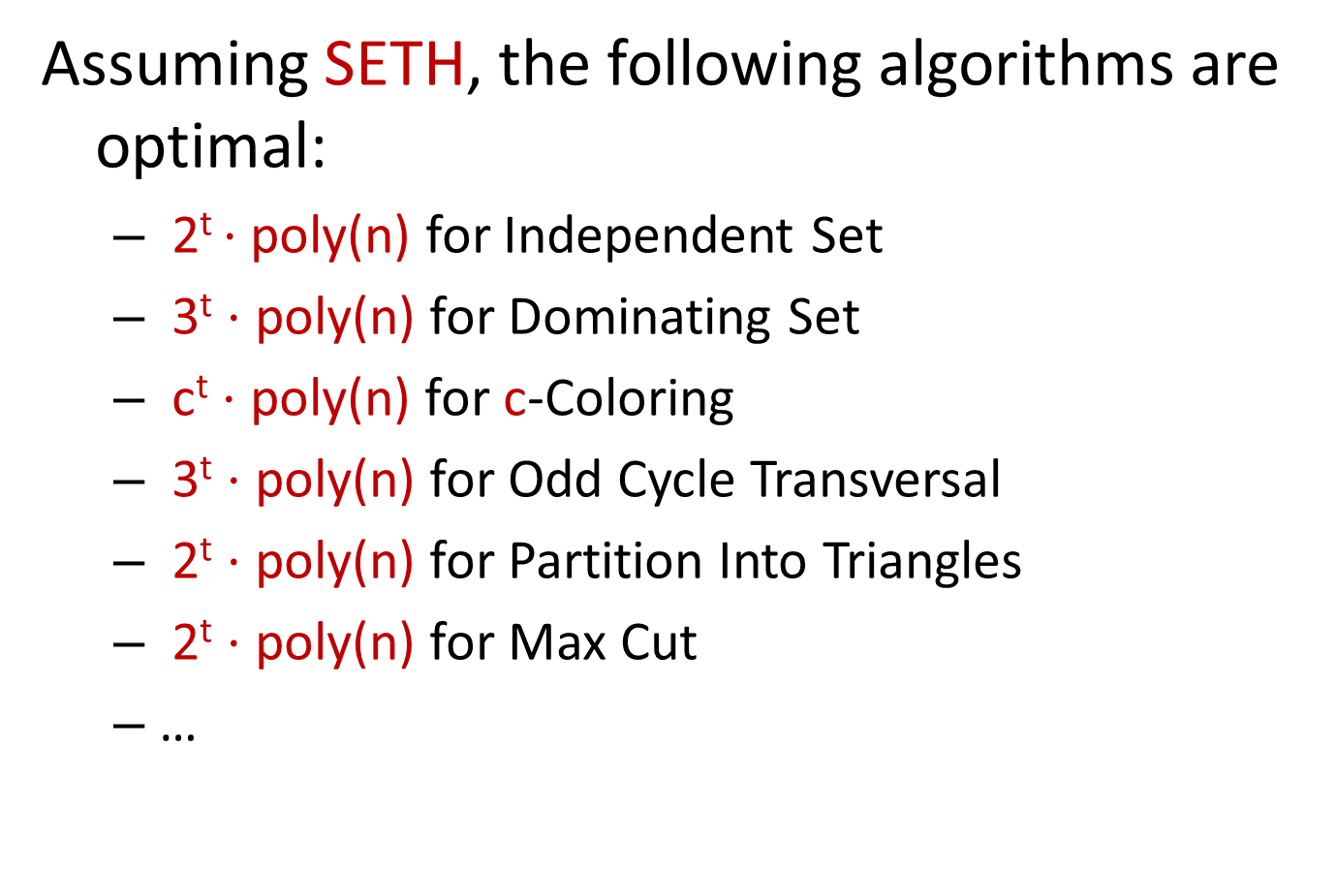
Assuming SETH, the following algorithms are optimal:
  2^{t} $⋅$ poly(n) for Independent Set
  3^{t} $⋅$ poly(n) for Dominating Set
  c^{t} $⋅$ poly(n) for c-Coloring
  3^{t} $⋅$ poly(n) for Odd Cycle Transversal
  2^{t} $⋅$ poly(n) for Partition Into Triangles
  2^{t} $⋅$ poly(n) for Max Cut
  …

Slide 22
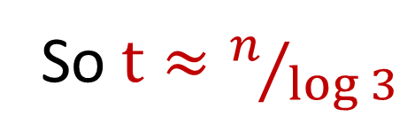
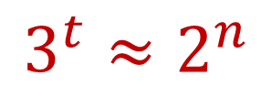
3^{t} lower bound for Dominating Set?
Need to reduce k-SAT formulas on n-variables to Dominating Set in graphs of treewidth t, where
$$3^{t}≈2^{n}$$
So $t≈n/{\log{3}}$

Slide 23
Conclusions
SETH can be used to give very tight running time bounds.
SETH recently has been used to give lower bounds for polynomial time solvable problems, and for running time of approximation algorithms.

Slide 24

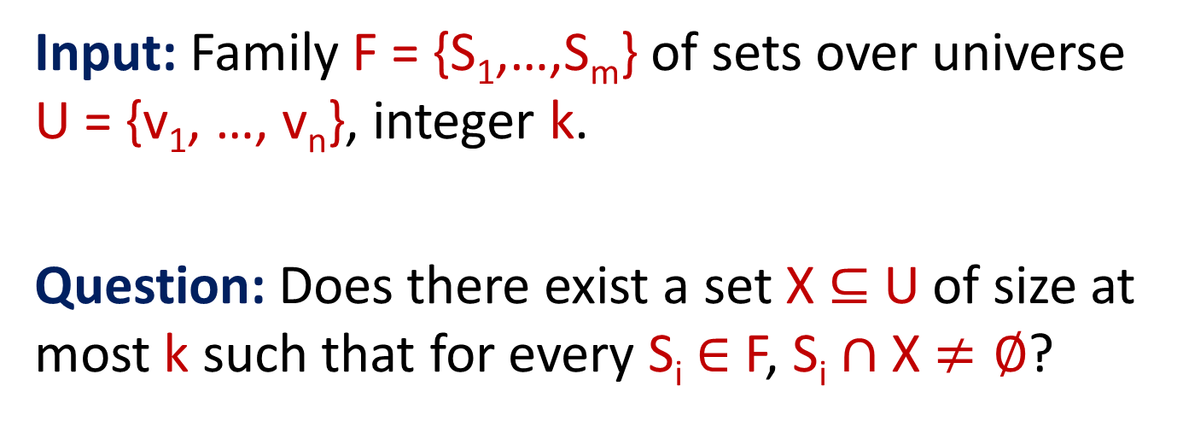

Hitting Set / n
Input: Family F = {S₁,…,S_{m}} of sets over universe U = {v₁, …, v_{n}}, integer k.
Question: Does there exist a set X $⊆$ U of size at most k such that for every S_{i} $∈$ F, S_{i} $∩$X $≠∅$?
Naive algorithm runs in ${O(2}^{n}nm)$ time.
Next: ${1.41}^{n}poly(n,m)$ implies that SETH fails

Slide 25










d-SAT $≤$ Hitting Set
$ψ$ = (a $∨$ b $∨$ c) $∧$ (a $∨$ c $∨$ d) $∧$ (b $∨$ c $∨$ d)
$$a$$
$$b$$
$$c$$
$$d$$
Budget = 4
$$\overline{a}$$
$$\overline{b}$$
$$\overline{c}$$
$$\overline{d}$$

Slide 26
d-SAT vs Hitting Set
A c^{n} algorithm for Hitting Set makes a c^{2n} algorithm for d-SAT.
Since 1.41^{2n} < 1.9999^{n}, a 1.41^{n} algorithm for Hitting Set violates the SETH.
Have a 2^{n} algorithm and a 1.41^{n} lower bound.
Next: 2^{n} lower bound

Slide 27
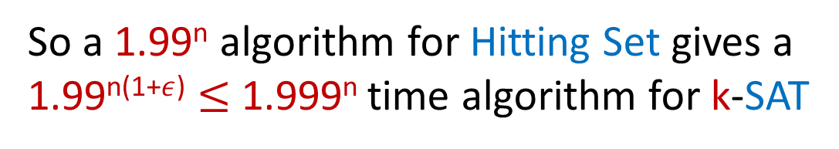
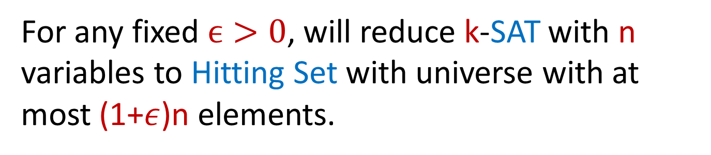
Hitting Set
For any fixed $ϵ>0$, will reduce k-SAT with n variables to Hitting Set with universe with at most (1+$ε$)n elements.
So a 1.99^{n} algorithm for Hitting Set gives a
1.99^{n(1+}$ε$⁾ $≤$ 1.999^{n} time algorithm for k-SAT

Slide 28
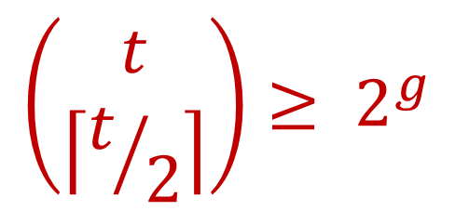
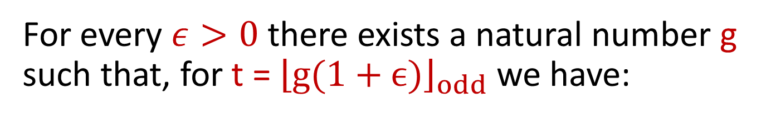
Some deep math
For every $ε>0$ there exists a natural number g such that, for t = ${\left\lfloor g(1+ϵ)\right\rfloor }_{odd}$ we have:
$$\left({t \atop \left\lceil t/2\right\rceil }\right)≥ 2^{g}$$
Why is this relevant?

Slide 29
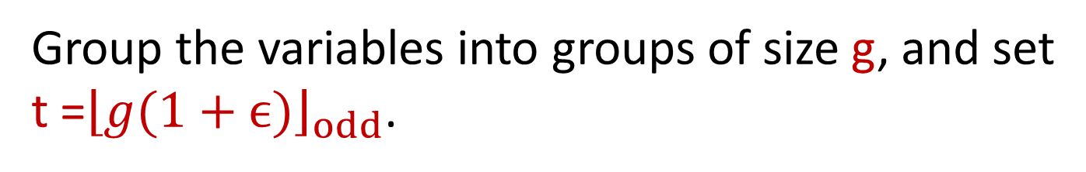

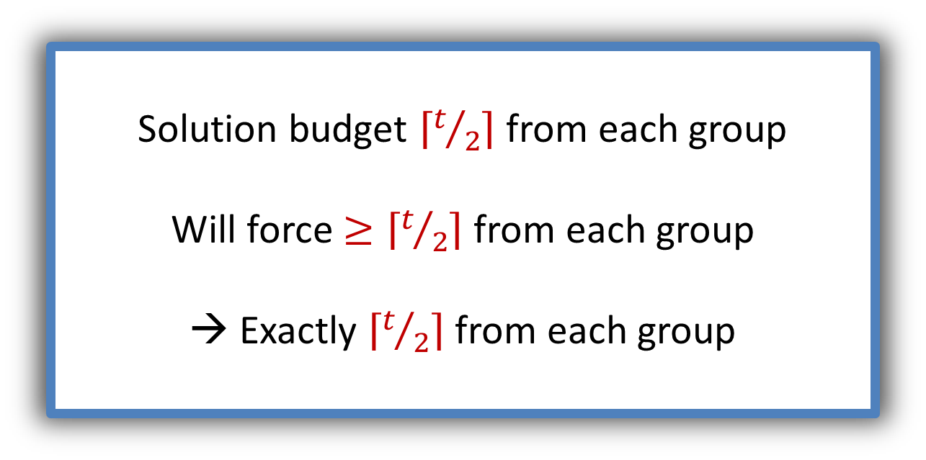

d-SAT $≤$ Hitting Set
Group the variables into groups of size g, and set t =${\left\lfloor g(1+ϵ)\right\rfloor }_{odd}$.
Solution budget $\left\lceil t/2\right\rceil$ from each group
Will force $≥\left\lceil t/2\right\rceil$ from each group
→ Exactly $\left\lceil t/2\right\rceil$ from each group
Variables:
g
g
g
g
g
t
t
t
t
t
Elements:
Elements $≤$ (1 + $ϵ$) $⋅$ variables

Slide 30
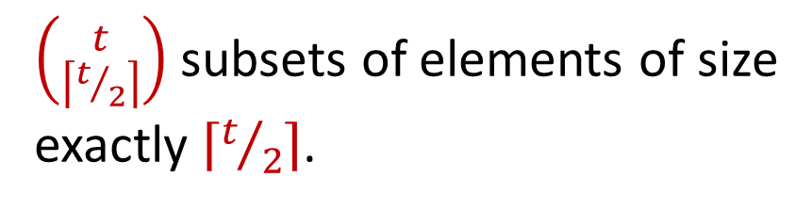
Analyzing a group
Group of g variables
2^{g} assignments to variables
Injection
$\left({t \atop \left\lceil t/2\right\rceil }\right)$ subsets of elements of size
exactly $\left\lceil t/2\right\rceil$.
Group of t elements

Slide 31
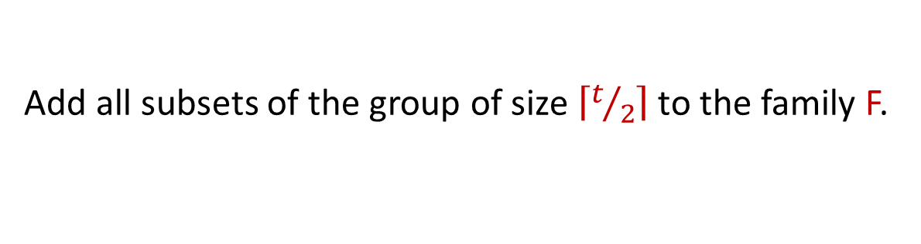

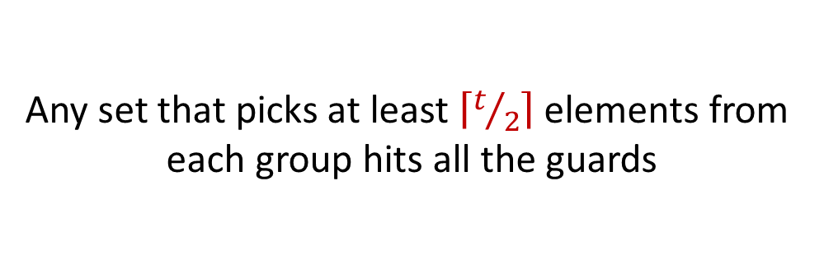
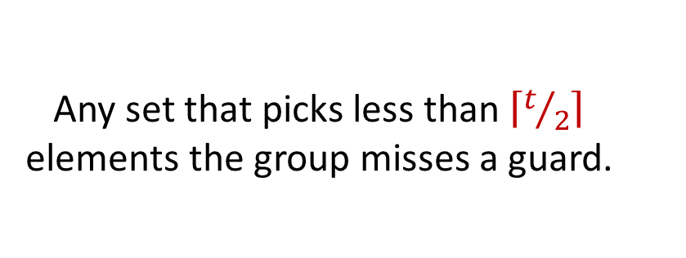
Forcing solution $\left\lceil t/2\right\rceil$ vertices in a group?
Add all subsets of the group of size $\left\lceil t/2\right\rceil$ to the family F.
Lets call these sets guards
Any set that picks less than $\left\lceil t/2\right\rceil$
elements the group misses a guard.
Any set that picks at least $\left\lceil t/2\right\rceil$ elements from
each group hits all the guards

Slide 32
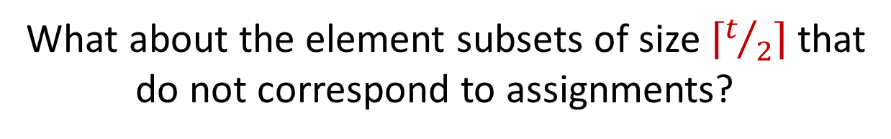
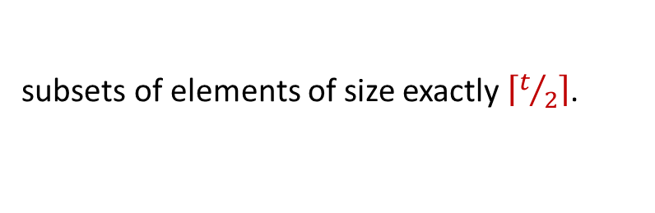
Analyzing a group
Group of g variables
assignments to variables
Injection
subsets of elements of size exactly $\left\lceil t/2\right\rceil$.
Group of t elements
What about the element subsets of size $\left\lceil t/2\right\rceil$ that
do not correspond to assignments?

Slide 33
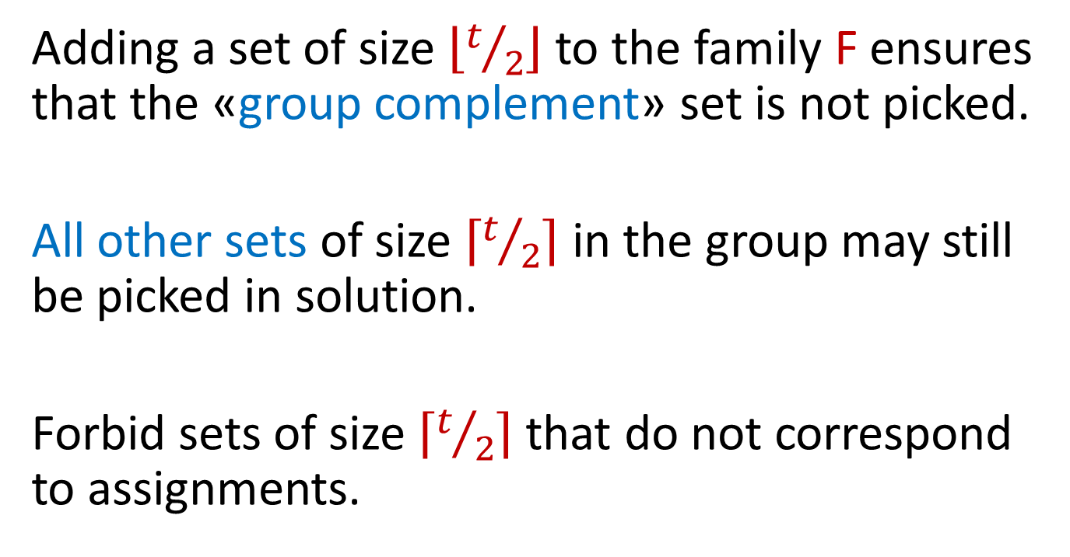

Sets of size $\left\lfloor t/2\right\rfloor$
Adding a set of size $\left\lfloor t/2\right\rfloor$ to the family F ensures that the «group complement» set is not picked.
All other sets of size $\left\lceil t/2\right\rceil$ in the group may still be picked in solution.
Forbid sets of size $\left\lceil t/2\right\rceil$ that do not correspond to assignments.

Slide 34

d-SAT $≤$ Hitting Set
Variables:
g
g
g
g
g
assignments
potential
solutions
t
t
t
t
t
Elements:
Want:
Solutions $↔$ Satisfying assignments

Slide 35
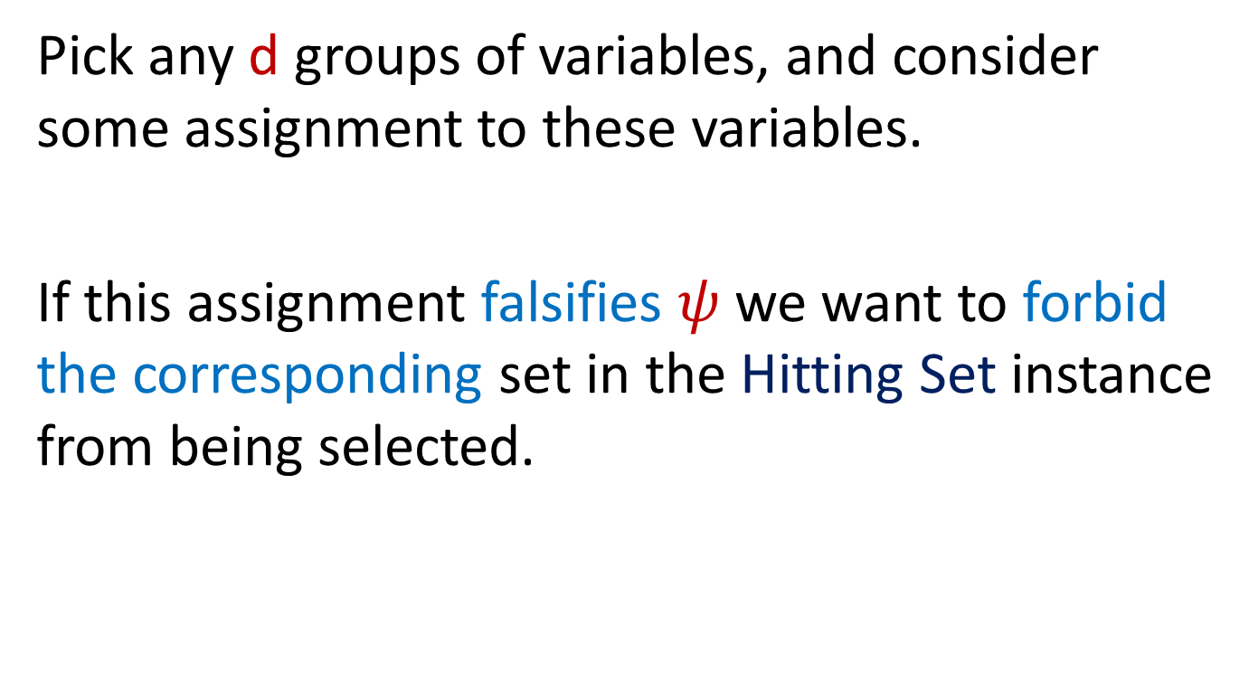
Forbidding partial assignments
Pick any d groups of variables, and consider some assignment to these variables.
If this assignment falsifies $ψ$ we want to forbid the corresponding set in the Hitting Set instance from being selected.

Slide 36
Forbidding partial assignments
Bad assignment
…
Variables
…
Set added to F to forbid the bad assignment

Slide 37
Forbidding partial assignments
For each bad assignment to at most d groups, forbid it by adding a «bad assignment guard»
This adds O(n^{d}2^{gd}) = O(n^{d}) sets to F.

Slide 38
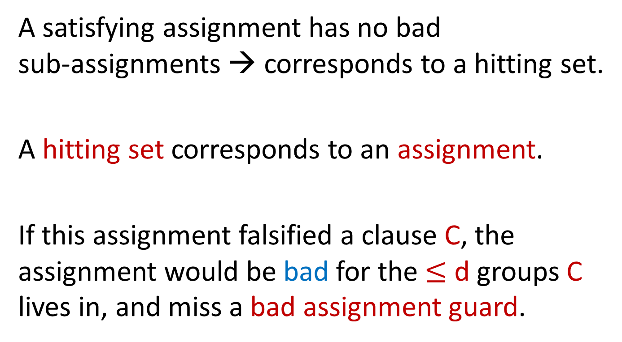

Satisfying Assignments $↔$ Hitting Sets
A satisfying assignment has no bad
sub-assignments → corresponds to a hitting set.
A hitting set corresponds to an assignment.
If this assignment falsified a clause C, the assignment would be bad for the $≤$ d groups C lives in, and miss a bad assignment guard.

Slide 39
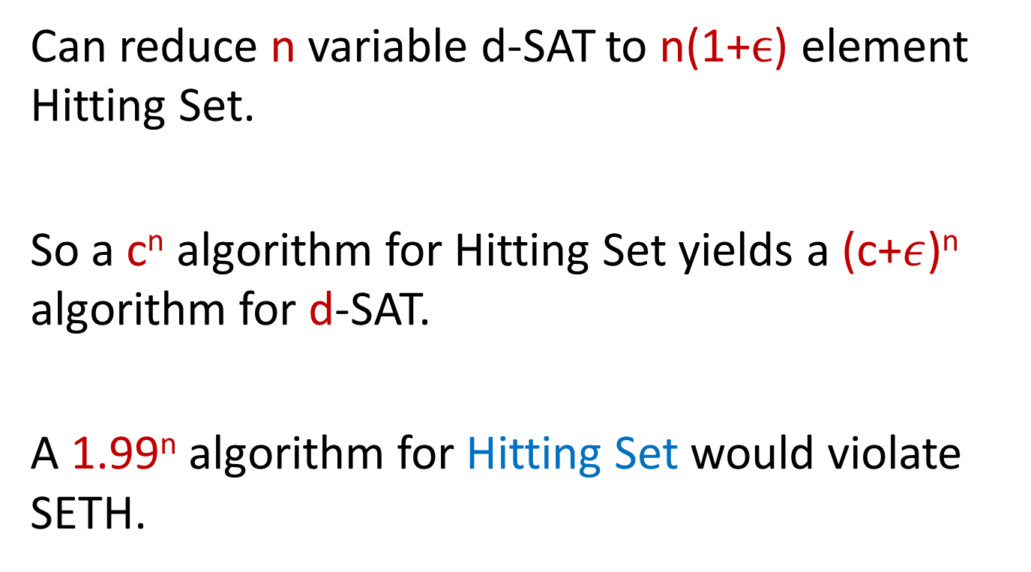
Hitting Set wrap up
Can reduce n variable d-SAT to n(1+$ϵ$) element Hitting Set.
So a c^{n} algorithm for Hitting Set yields a (c+$ε$)^{n} algorithm for d-SAT.
A 1.99^{n} algorithm for Hitting Set would violate SETH.

Slide 40
Hitting Set / n
Input: Family F = {S₁,…,S_{m}} of sets over universe U = {v₁, …, v_{n}}, integer k.
Question: Does there exist a set X $⊆$ U of size at most k such that for every S_{i} $∈$ F, S_{i} $∩$X $≠∅$?
Naive algorithm runs in ${O(2}^{n}nm)$ time.
Next: ${1.41}^{n}poly(n,m)$ implies that SETH fails

Slide 41
d-SAT $≤$ Hitting Set
$ψ$ = (a $∨$ b $∨$ c) $∧$ (a $∨$ c $∨$ d) $∧$ (b $∨$ c $∨$ d)
$$a$$
$$b$$
$$c$$
$$d$$
Budget = 4
$$\overline{a}$$
$$\overline{b}$$
$$\overline{c}$$
$$\overline{d}$$

Slide 42
d-SAT vs Hitting Set
A c^{n} algorithm for Hitting Set makes a c^{2n} algorithm for d-SAT.
Since 1.41^{2n} < 1.9999^{n}, a 1.41^{n} algorithm for Hitting Set violates the SETH.
Have a 2^{n} algorithm and a 1.41^{n} lower bound.
Next: 2^{n} lower bound

Slide 43
Hitting Set
For any fixed $ϵ>0$, will reduce k-SAT with n variables to Hitting Set with universe with at most (1+$ε$)n elements.
So a 1.99^{n} algorithm for Hitting Set gives a
1.99^{n(1+}$ε$⁾ $≤$ 1.999^{n} time algorithm for k-SAT

Slide 44
Some deep math
For every $ε>0$ there exists a natural number g such that, for t = ${\left\lfloor g(1+ϵ)\right\rfloor }_{odd}$ we have:
$$\left({t \atop \left\lceil t/2\right\rceil }\right)≥ 2^{g}$$
Why is this relevant?

Slide 45
d-SAT $≤$ Hitting Set
Group the variables into groups of size g, and set t =${\left\lfloor g(1+ϵ)\right\rfloor }_{odd}$.
Solution budget $\left\lceil t/2\right\rceil$ from each group
Will force $≥\left\lceil t/2\right\rceil$ from each group
→ Exactly $\left\lceil t/2\right\rceil$ from each group
Variables:
g
g
g
g
g
t
t
t
t
t
Elements:
Elements $≤$ (1 + $ϵ$) $⋅$ variables

Slide 46
Analyzing a group
Group of g variables
2^{g} assignments to variables
Injection
$\left({t \atop \left\lceil t/2\right\rceil }\right)$ subsets of elements of size
exactly $\left\lceil t/2\right\rceil$.
Group of t elements

Slide 47
Forcing solution $\left\lceil t/2\right\rceil$ vertices in a group?
Add all subsets of the group of size $\left\lceil t/2\right\rceil$ to the family F.
Lets call these sets guards
Any set that picks less than $\left\lceil t/2\right\rceil$
elements the group misses a guard.
Any set that picks at least $\left\lceil t/2\right\rceil$ elements from
each group hits all the guards

Slide 48
Analyzing a group
Group of g variables
assignments to variables
Injection
subsets of elements of size exactly $\left\lceil t/2\right\rceil$.
Group of t elements
What about the element subsets of size $\left\lceil t/2\right\rceil$ that
do not correspond to assignments?

Slide 49
Sets of size $\left\lfloor t/2\right\rfloor$
Adding a set of size $\left\lfloor t/2\right\rfloor$ to the family F ensures that the «group complement» set is not picked.
All other sets of size $\left\lceil t/2\right\rceil$ in the group may still be picked in solution.
Forbid sets of size $\left\lceil t/2\right\rceil$ that do not correspond to assignments.

Slide 50
d-SAT $≤$ Hitting Set
Variables:
g
g
g
g
g
assignments
potential
solutions
t
t
t
t
t
Elements:
Want:
Solutions $↔$ Satisfying assignments

Slide 51
Forbidding partial assignments
Pick any d groups of variables, and consider some assignment to these variables.
If this assignment falsifies $ψ$ we want to forbid the corresponding set in the Hitting Set instance from being selected.

Slide 52
Forbidding partial assignments
Bad assignment
…
Variables
…
Set added to F to forbid the bad assignment

Slide 53
Forbidding partial assignments
For each bad assignment to at most d groups, forbid it by adding a «bad assignment guard»
This adds O(n^{d}2^{gd}) = O(n^{d}) sets to F.

Slide 54
Satisfying Assignments $↔$ Hitting Sets
A satisfying assignment has no bad
sub-assignments → corresponds to a hitting set.
A hitting set corresponds to an assignment.
If this assignment falsified a clause C, the assignment would be bad for the $≤$ d groups C lives in, and miss a bad assignment guard.

Slide 55
Hitting Set wrap up
Can reduce n variable d-SAT to n(1+$ϵ$) element Hitting Set.
So a c^{n} algorithm for Hitting Set yields a (c+$ε$)^{n} algorithm for d-SAT.
A 1.99^{n} algorithm for Hitting Set would violate SETH.

Slide 56
Important Open Problems
Can we show a 2^{n} lower bound for Set Cover assuming SETH?
Can we show a 1.00001 lower bound for 3-SAT assuming SETH?

