Slide 1
Parameterized Complexity of Even Set (and others)
Dániel Marx
Hungarian Academy of Sciences
Dagstuhl Seminar 19041
January 25, 2019
L
BELM
BGKM
$→$BBEGKLMM
[1] Bingkai Lin, SODA 2015, JACM 2018
[2] Bonnet, Egri, Lin, M. , unpublished
[3] Bhattacharyya, Ghoshal, Kartik C.S., Manurangsi, ICALP 2018

Slide 2
Hitting Set and Variants
{
}
HITTING
UNIQUE HITTING
ODD
EVEN
ODD/EVEN
{
}
$$×$$
$$×$$
{
}
MINIMUM
EXACT
SET
All of them are known to be W[1]-hard, except MINIMUM EVEN SET (note: solution is required to be nonempty).
Dual form: SET COVER and friends.

Slide 3
Even Set definitions
Hypergraphs (Even Hitting Set)
Bipartite Graphs (Red-Blue Dominating Set)
Linear Algebra (Minimum Dependent Set)
Find a nonempty vector $x∈𝔽_{2}^{n}$ with Hamming weight at most $k$ such that $Ax=0$.
Matroid Theory (Shortest Circuit):
Find a circuit of size at most $k$ in a binary matroid
Coding Theory (Minimum Distance):
Find a nonempty codeword of Hamming weight at most $k$.

Slide 4
Coding theory
Generating matrix:
$$A∈𝔽_{2}^{h×m}$$
Codewords:
$𝒞=\left\{Ax \right| x∈𝔽_{2}^{m}$}
Fact:
$y∈𝒞⇔A^{⊥}y=0$
distance, systematic code, Sphere packing bound,…

Slide 5
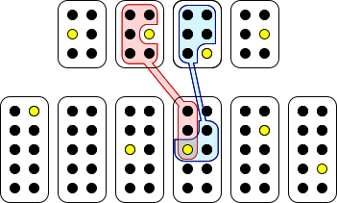
W[1]-hardness of Odd Set
$$V_{1}$$
$$V_{2}$$
$$V_{3}$$
$$V_{4}$$
$$E_{1,2}$$
$$E_{1,3}$$
$$E_{1,4}$$
$$E_{2,3}$$
$$E_{2,4}$$
$$E_{3,4}$$

Slide 6
?
Odd Set
Even Set

Slide 7
?
Odd Set
Even Set
Gap Odd Set
Gap Even Set

Slide 8
?
Clique
Odd Set
Even Set
x
Gap Biclique*
Gap Linear Dep. Set
Gap Odd Set
Gap Even Set
*Actually, gap version of One Sided Biclique. Subject to approval. Additional fees may apply. Not suitable for children under the age of 99. Not responsible for damages or personal injuries. Not to be used in nuclear facilities or on the Northern hemisphere. Tobacco Smoke Increases The Risk Of Lung Cancer And Heart Disease, Even In Nonsmokers. This Product Contains/Produces Chemicals Known To The State Of California To Cause Cancer, And Birth Defects Or Other Reproductive Harm.

Slide 9
Biclique
Given a bipartite graph $G$ and integer $k$, find two sets $X$ and $Y$ of size $k$that are fully adjacent to each other.
Should have been on the Downey-Fellows list.
Easy to give an incorrect proof (which works only for Partitioned Biclique)
Theorem: Biclique is W[1]-hard [Bingkai Lin, SODA’15, JACM’18]

Slide 10
Template graph
$\left(n,k,l,h\right)$-threshold property for a bipartite graph on $A=(V_{1},…,V_{n})$ and $B$:
For any $k+1$ vertices in $A$ have at most $l$ common neighbors.
For any choice of $k$ sets $V_{i_{1}},…,V_{i_{k}}$, we can find one vertex in each set such that these $k$ vertices have at least $h$ common neighbors.
There are randomized constructions for such graphs with $l=O(k^{2})$ and $h=n^{Ω(\frac{1}{k})}$ (deterministic construction is worse).

Slide 11
The reduction
$k$ clique
$\left({k \atop 2}\right)$ vertices with $h$ common neighbors
no $k$ clique
Any $\left({k \atop 2}\right)$ vertices has $≤l$ common neighbors

Slide 12
Hardness of Biclique
We reduced $k$-Clique to $\left({k \atop 2}\right)$-Biclique.
Theorem: Biclique is W[1]-hard and no $f\left(k\right)n^{o(\sqrt{k})}$ algorithm assuming randomized ETH.
Approximation version:
One Sided Biclique Find $k$ vertices maximizing the common intersection
Hard to distinguish between optimum of $k^{2}$ and $n^{Ω(\frac{1}{k})}$

Slide 13
Randomized construction
Random graph on $n^{2}+n^{2}$ vertices with edge probability
$p=n^{−\frac{2\left(k+1+l+1\right)+2}{(k+1)(l+1)}}$
Claim 1: probability of $∃k+1$ vertices with $l+1$ common vertices is at most $n^{−2}$.
Claim 2: probability of a given set of $k$vertices do not have $h$ common neighbors is less than $n^{−\frac{1}{4k}}$.

Slide 14
Linear Dependent Set
Given vectors ${v_{1},…, v_{n}∈𝔽}_{q}^{d}$, find $k$ vectors that are linearly dependent.
$$Ax=0$$
s.t. $x$ has Hamming weight at most $k$
Hard to approximate for any constant: proof by reduction from One Sided Biclique.

Slide 15
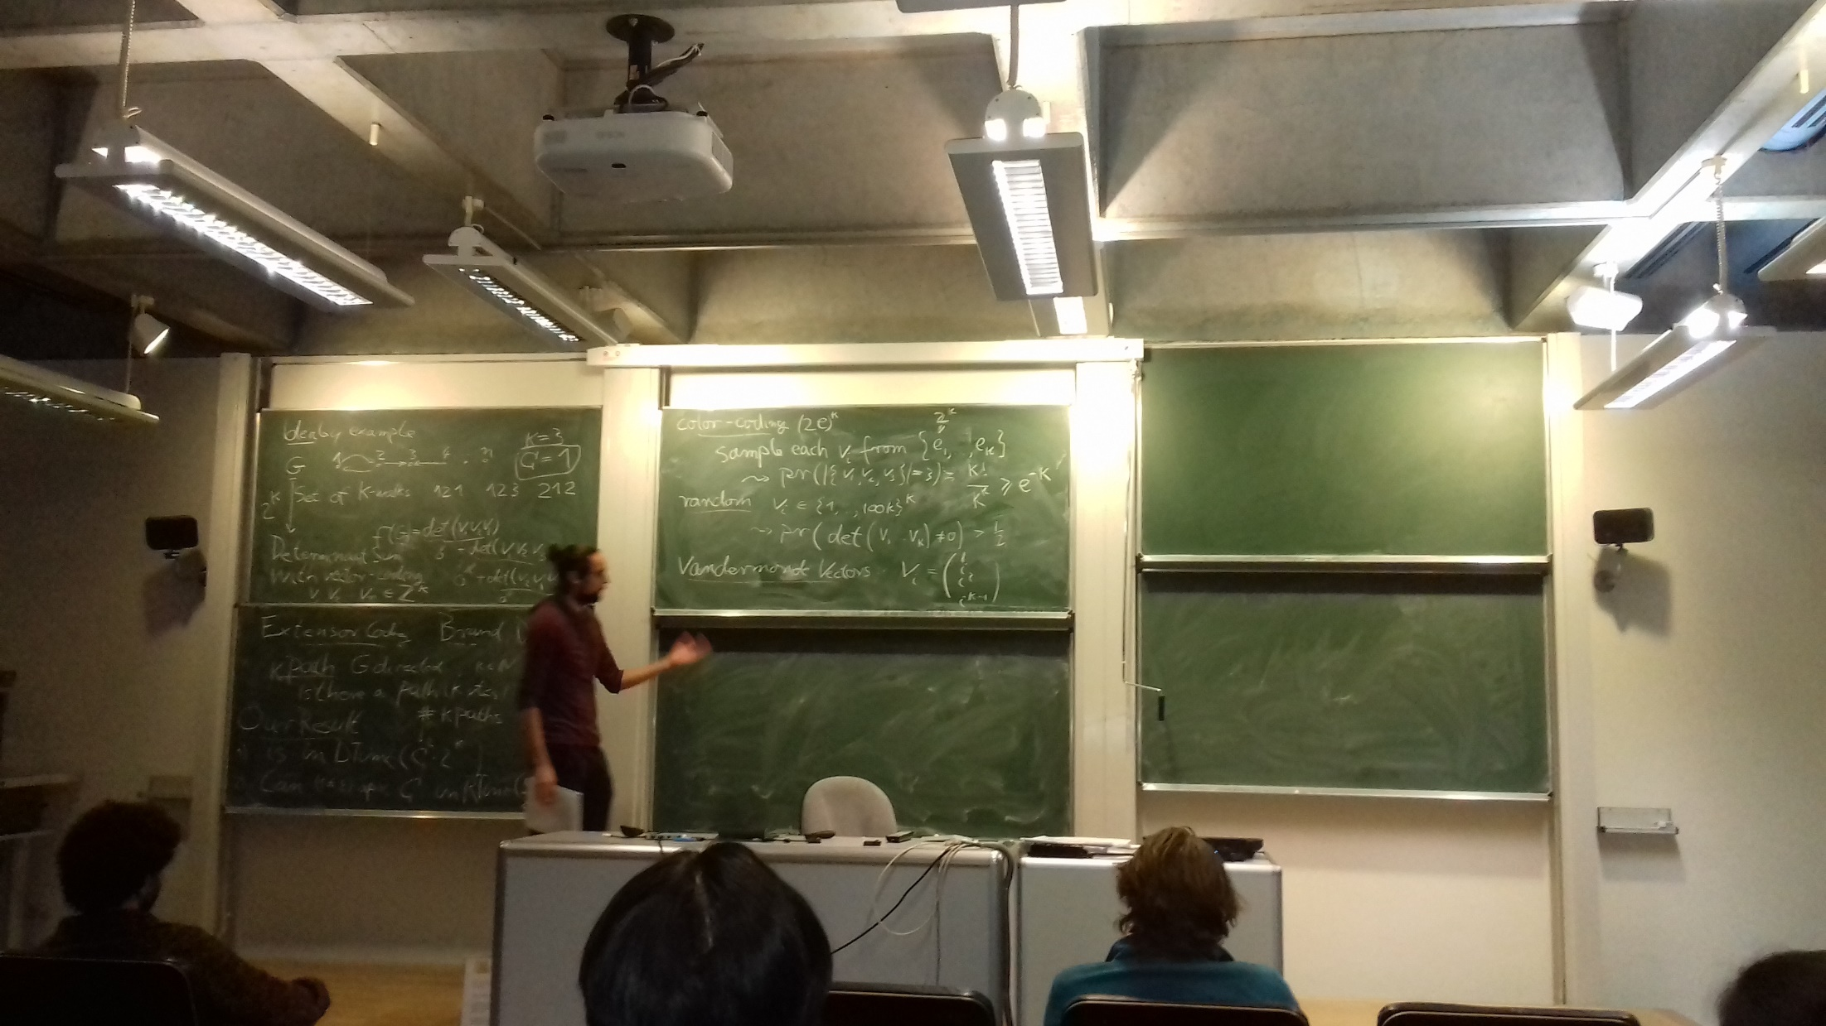
Encoding vertices
Vertex set $A=\left\{a_{1},…,a_{n}\right\}$
$→$ vectors in ${F(a}_{1}),…,{F(a}_{n})∈𝔽_{q}^{s−1}$ such that
any $s−1$ are linearly independent
any $s$ are linearly dependent
Vertex set B$=\left\{b_{1},…,b_{n}\right\}$
$→$ vectors in ${F(b}_{1}),…,{F(b}_{n})∈𝔽_{q}^{h−1}$ such that
any $h−1$ are linearly independent
any $h$ are linearly dependent
(Vandermonde matrices)

Slide 16
Reduction
edge $e=\{a_{x},b_{y}\}$
F(e)
block $x$
block $y$
$$F(b_{y})$$
$$F(a_{x})$$
REALLY!
REALLY!

Slide 17
Reduction
$s×h$ biclique
$sh$ linearly dependent sets
no $s×l$ biclique
no $γsh$ linearly dependent sets
(if $h$ is sufficiently large)

Slide 18
Colored Linear Dependent Set
Vectors partitioned into $k$ color classes, distinguish between
exists dependent set of $k$vectors, one from each color,
no dependent set of $γk$ vectors (or arbitrary colors!)
Simple reduction from the uncolored version using Color Coding (Turing or not)

Slide 19
Maximum Likelihood Decoding
Given $A∈𝔽_{2}^{n×m}$ and $y∈𝔽_{2}^{n}$, find $x∈𝔽_{2}^{m}$ of Hamming weight at most $k$ such that $Ax=y$.
= Odd/Even Set
Reduction from Colored Linear Dependent Set.
Tool: $𝔽_{2^{q}}$ as $q$-bit vectors.

Slide 20
Reduction
Colored $k$ dependent set
MLD solution of weight $k$
no dependent set of size $3k$
No MLD solution of weight $3k$

Slide 21
Nearest Codeword
Given $A∈𝔽_{2}^{n×m}$ and $y∈𝔽_{2}^{n},$find $x∈𝔽_{2}^{m}$ such that $Ax−y$ has Hamming weight at most $k.$
Sparse version: in a YES instance, exists solution $x$ of Hamming weight at most $k$.
Inapproximability by an easy reduction from Maximum Likelihood Decoding.

Slide 22
Minimum Distance (finally!)
Sparse Nearest Codeword
Given $A∈𝔽_{2}^{n×m}$, find $x∈𝔽_{2}^{m}$ such that $Ax−y$ has Hamming weight at most $k.$
Minimum Distance
Given $A∈𝔽_{2}^{n×m}$ and $y∈𝔽_{2}^{n}$, find $x∈𝔽_{2}^{m}$ of such that $Ax$ has Hamming weight at most $k$.

Slide 23
Reduction
codeword at distance $k$
Distance is at most $t$
no codeword at distance $5k$
Distance is at least $1.25t$

Slide 24
Increasing the gap
Codes $𝒞_{1},𝒞_{2}$with matrices $A_{1},A_{2}∈F_{2}^{h×m}$, the tensor product is the code
$𝒞_{1}⨂𝒞_{2}=\left\{A_{1}XA_{2}^{T} \right| X∈F_{2}^{m×m}$}
Fact: $dist\left(𝒞_{1}⨂𝒞_{2}\right)={dist(𝒞}_{1})dist\left(𝒞_{2}\right)$
Any $γ>1$ inapproximability for Minimum Distance can be boosted to $γ^{2}$ and hence to any constant.
Theorem: Minimum Distance (Even Set etc.) is randomized W[1]-hard to approximate for any $γ>1$.

Slide 25
Integer Lattice problems
Shortest Vector
Given a matrix $A∈ℤ^{n×m}$ and integer $k$, find a vector $x∈ℤ^{m}∖\{0\}$ with ${\left\|Ax\right\|}_{p}^{p}≤k$.
Nearest Vector
Given a matrix $A∈ℤ^{n×m}$ , vector $y∈ℤ^{n}$ and integer $k$, find an $x∈ℤ^{m}∖\{0\}$ with ${\left\|Ax−y\right\|}_{p}^{p}≤k$.
Theorem: Shortest Vector for any $p>1$ and Nearest Vector for any $p≥1$is randomized W[1]-hard to approximate for any constant $γ>1$.

Slide 26
Summary
Clique
$$⇓$$
One Sided Biclique
$$⇓$$
Linear Dependent Set
$$⇓$$
Maximum Likelihood Decoding
$$⇓$$
(Sparse) Nearest Codeword
$$⇓$$
Minimum Distance
Transferring inapproximability results can be easier than transferring exact hardness!

