Slide 1
Minicourse on parameterized algorithms and complexity
Part 8: The Strong Exponential-Time Hypothesis
Insert
«Academic unit»
on every page:
1 Go to the menu «Insert»
2 Choose: Date and time
3 Write the name of your faculty or department in the field «Footer»
4 Choose «Apply to all"
Dániel Marx
(slides by Daniel Lokshtanov)
Jagiellonian University in Kraków
April 21-23, 2015

Slide 2
Tight lower bounds
Have seen that ETH can give tight lower bounds
How tight? ETH «ignores» constants in exponent
How to distinguish 1.85^{n} from 1.0001^{n}?

Slide 3
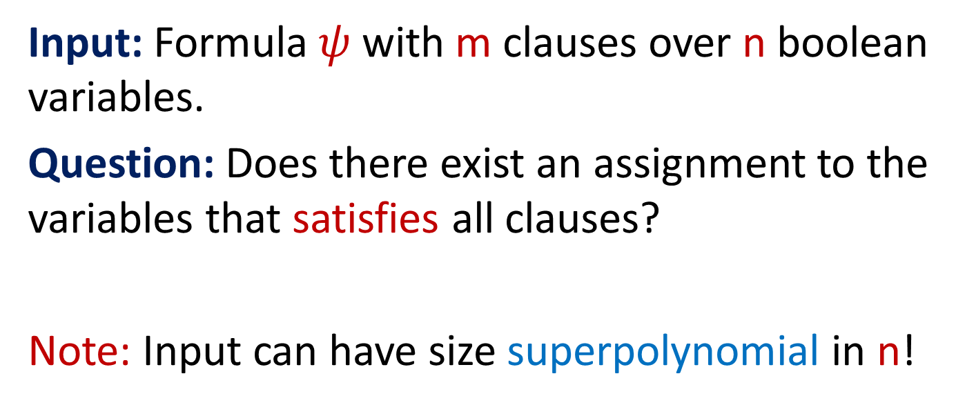
SAT
Input: Formula $ψ$ with m clauses over n boolean variables.
Question: Does there exist an assignment to the variables that satisfies all clauses?
Note: Input can have size superpolynomial in n!
Fastest algorithm for SAT: 2^{n}poly(m)

Slide 4


d-SAT
Here all clauses have size $≤$ d
Input size $≤$ n^{d}
Fastest algorithm for 2-SAT: n+m
Fastest algorithm for 3-SAT: 1.31^{n}
Fastest algorithm for 4-SAT: 1.47^{n}
…
Fastest algorithm for d-SAT: $2^{\left(1−c/d\right)n}$
Fastest algorithm for SAT: $2^{n}$

Slide 5
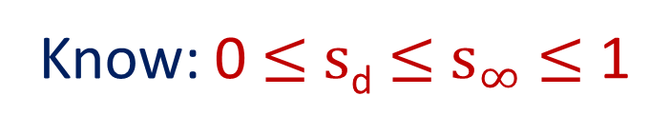


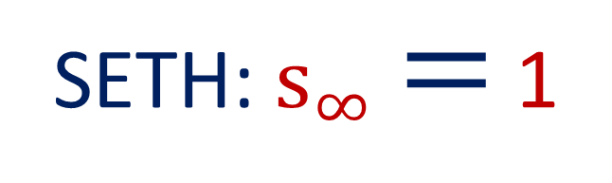
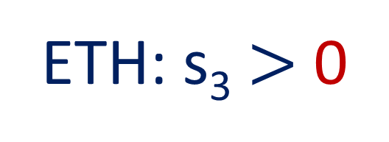
Strong ETH
Let $s_{d}=inf⁡\{c :$ d-SAT has a $2^{cn}$ algorithm$\}$
Let $s_{∞}= \lim_{d→∞}{s_{d}}$
Know: 0 $≤$ $s$_{d} $≤$ $s_{∞}$ $≤$ 1
ETH: s₃ $>$ 0
SETH: $s_{∞}=$ 1

Slide 6

Showing Lower Bounds under SETH
d-SAT
Your Problem
$${1.99999}^{n}$$
Too fast algorithm?
The number of 9’s MUST
be independent of d

Slide 7
Dominating Set
Input: n vertices, integer k
Question: Is there a set S of at most k vertices such that N[S] = V(G)?
Naive: n^{k+1}
Smarter: n^{k+o(1)}
Assuming ETH: no f(k)n^{o(k)}
n^{k/10}?
n^{k-1}?

Slide 8
SAT → k-Dominating Set
Variables
SAT-formula
k groups, each on
n/k variables.
One vertex for each of the 2^{n/k}
assignments to the variables
in the group.

Slide 9
Variables
SAT-formula
k groups, each on
n/k variables.
x
y
x
y
x
y
x
y
x
y
Selecting one vertex from each
cloud corrsponds to selecting
an assignment to the variables.
Cliques

Slide 10
Variables
SAT-formula
k groups, each on
n/k variables.
x
y
x
y
x
y
x
y
x
y
Edge if the partial assignment
satisfies the clause
One vertex per clause in the formula

Slide 11
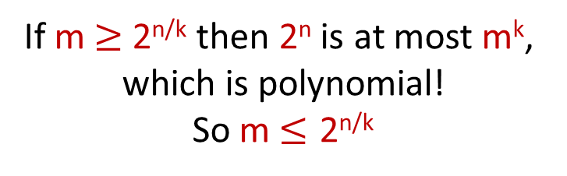
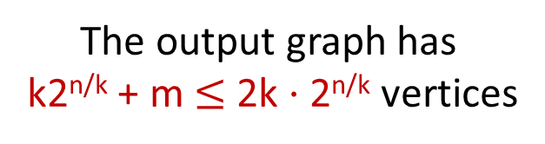

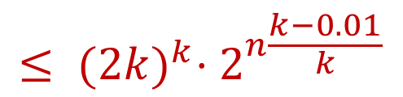

SAT → k-Dominating Set analysis
Too fast algorithm for k-Dominating Set: n^{k-0.01}
For any fixed k (like k=3)
If m $≥$ 2^{n/k} then 2^{n} is at most m^{k},
which is polynomial!
So m $≤\text{2}\text{n}\text{/}\text{k}$
The output graph has
k2^{n/k} + m $≤$ 2k $⋅$ 2^{n/k} vertices
$$≤ {(2k)}^{k}⋅2^{n\frac{k−0.01}{k}}$$
${({2k⋅2}^{n/k})}^{k−0.01}$
$$=O({1.999}^{n})$$

Slide 12
Dominating Set, wrapping up
A O(n^{2.99}) algorithm for 3-Dominating Set, or
a O(n^{3.99}) algorithm for 4-Dominating Set, or a
a O(n^{4.99}) algorithm for 5-Dominating Set, or a …
… would violate SETH.

Slide 13
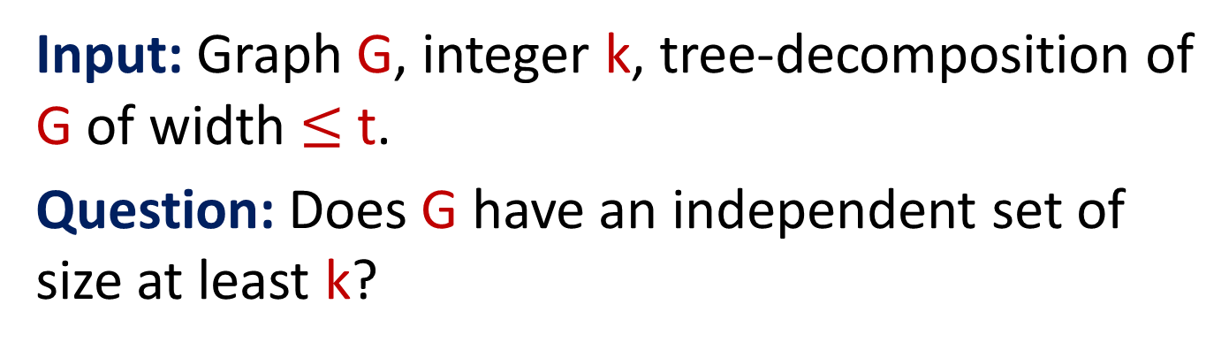
Independent Set / Treewidth
Input: Graph G, integer k, tree-decomposition of G of width $≤$ t.
Question: Does G have an independent set of size at least k?
DP: O(2^{t}n) time algorithm
Can we do it in 1.99^{t} poly(n) time?
Next: If yes, then SETH fails!

Slide 14
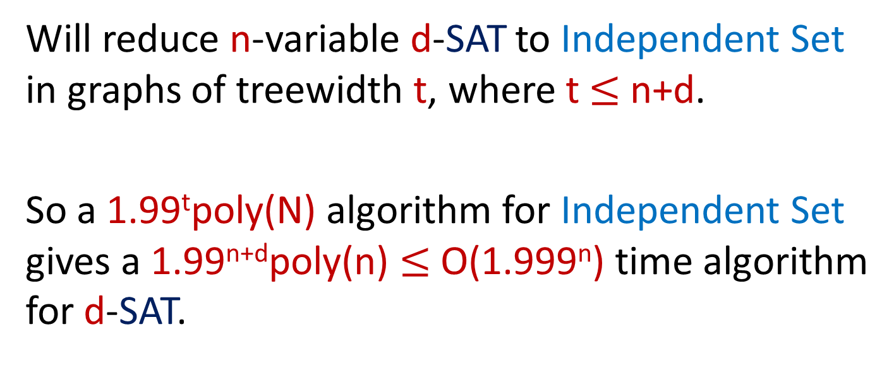
Independent Set / Treewidth
Will reduce n-variable d-SAT to Independent Set in graphs of treewidth t, where t $≤$n+d.
So a 1.99^{t}poly(N) algorithm for Independent Set gives a 1.99^{n+d}poly(n) $≤$ O(1.999^{n}) time algorithm for d-SAT.

Slide 15
Independent Sets on an Even Path
In independent set:
Not in solution:
t
f
t
f
t
f
t
f
t
f
True
False
first
True
then
False

Slide 16
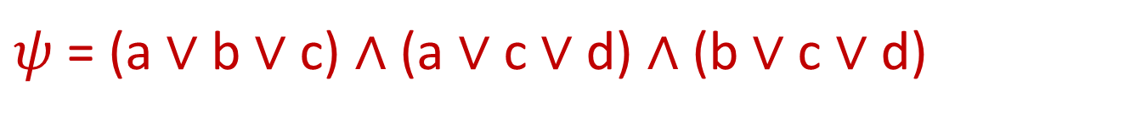
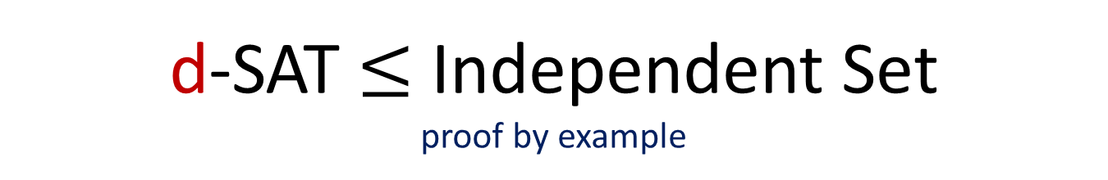
d-SAT $≤$ Independent Set proof by example
$ψ$ = (a $∨$ b $∨$ c) $∧$ (a $∨$ c $∨$ d) $∧$ (b $∨$ c $∨$ d)
b
c
c
a
c
a
d
b
d
a
t
f
t
f
t
f
b
t
f
t
f
t
f
c
t
f
t
f
t
f
d
t
f
t
f
t
f

Slide 17
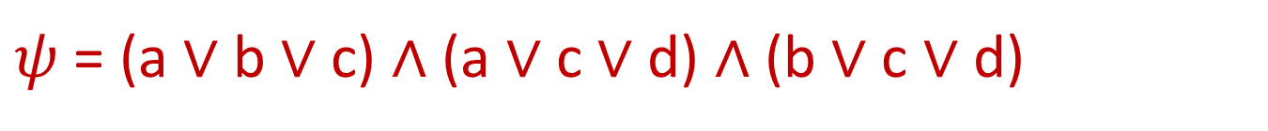

Independent Sets $↔$ Assignments
$ψ$ = (a $∨$ b $∨$ c) $∧$ (a $∨$ c $∨$ d) $∧$ (b $∨$ c $∨$ d)
b
c
c
But what about the
first true then false independent sets?
a
c
a
d
b
d
True
a
t
f
t
f
t
f
False
b
t
f
t
f
t
f
True
c
t
f
t
f
t
f
False
d
t
f
t
f
t
f

Slide 18
Dealing with true→false
Clause
gadgets
1
2
3
1
2
3
1
2
3
1
2
3
1
2
3
a
b
c
d
Every variable flips true→false at most once!

Slide 19
Treewidth Bound by picture
d
b
c
c
a
c
a
d
b
d
a
…
t
f
t
f
t
f
b
…
t
f
t
f
t
f
n
c
…
t
f
t
f
t
f
d
…
t
f
t
f
t
f
Formal proof - exercise

Slide 20
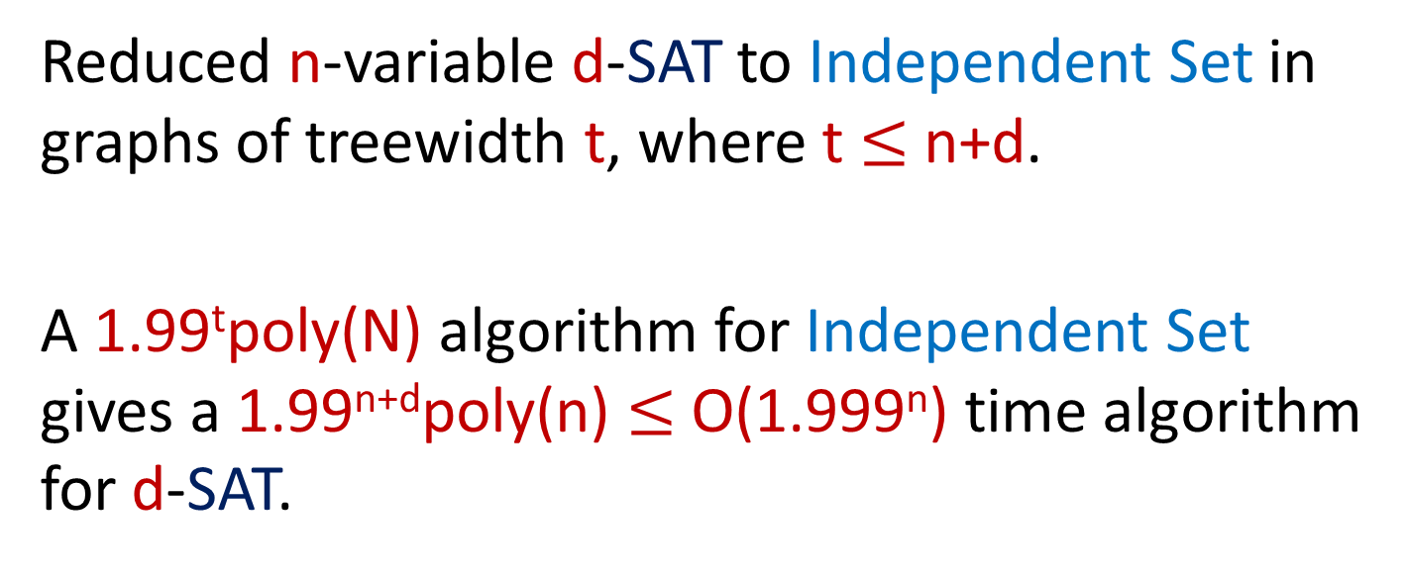
Independent Set / Treewidth wrap up
Reduced n-variable d-SAT to Independent Set in graphs of treewidth t, where t $≤$n+d.
A 1.99^{t}poly(N) algorithm for Independent Set gives a 1.99^{n+d}poly(n) $≤$ O(1.999^{n}) time algorithm for d-SAT.
Thus, no 1.99^{t} algorithm for
Independent Set assuming SETH

Slide 21
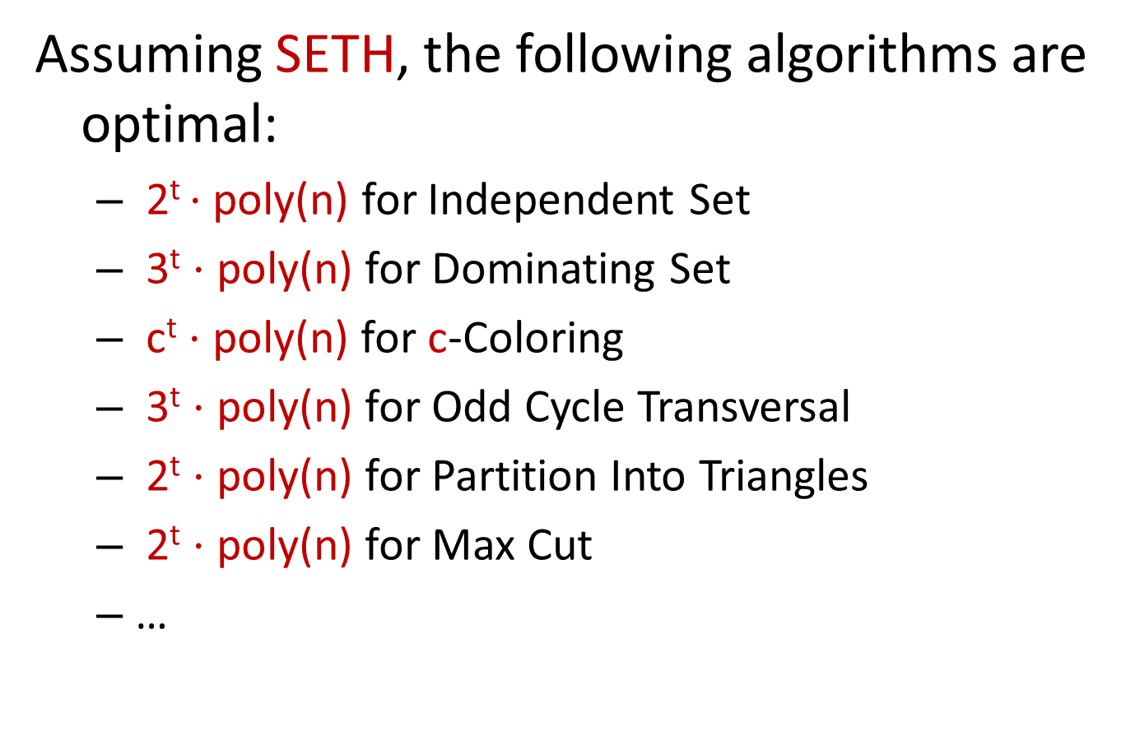
Assuming SETH, the following algorithms are optimal:
  2^{t} $⋅$ poly(n) for Independent Set
  3^{t} $⋅$ poly(n) for Dominating Set
  c^{t} $⋅$ poly(n) for c-Coloring
  3^{t} $⋅$ poly(n) for Odd Cycle Transversal
  2^{t} $⋅$ poly(n) for Partition Into Triangles
  2^{t} $⋅$ poly(n) for Max Cut
  …

Slide 22
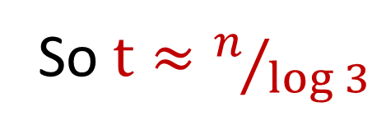
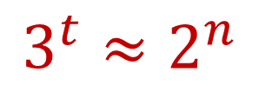
3^{t} lower bound for Dominating Set?
Need to reduce k-SAT formulas on n-variables to Dominating Set in graphs of treewidth t, where
$$3^{t}≈2^{n}$$
So $t≈n/{\log{3}}$

Slide 23
Conclusions
SETH can be used to give very tight running time bounds.
SETH recently has been used to give lower bounds for polynomial time solvable problems, and for running time of approximation algorithms.

Slide 24
Important Open Problems
Can we show a 2^{n} lower bound for Set Cover assuming SETH?
Can we show a 1.00001 lower bound for 3-SAT assuming SETH?

