Slide 1
Minicourse on parameterized algorithms and complexity
Part 1: Basic techniques
Insert
«Academic unit»
on every page:
1 Go to the menu «Insert»
2 Choose: Date and time
3 Write the name of your faculty or department in the field «Footer»
4 Choose «Apply to all"
Dániel Marx
(slides by Bart M. P. Jansen)
Jagiellonian University in Kraków
April 21-23, 2015

Slide 2
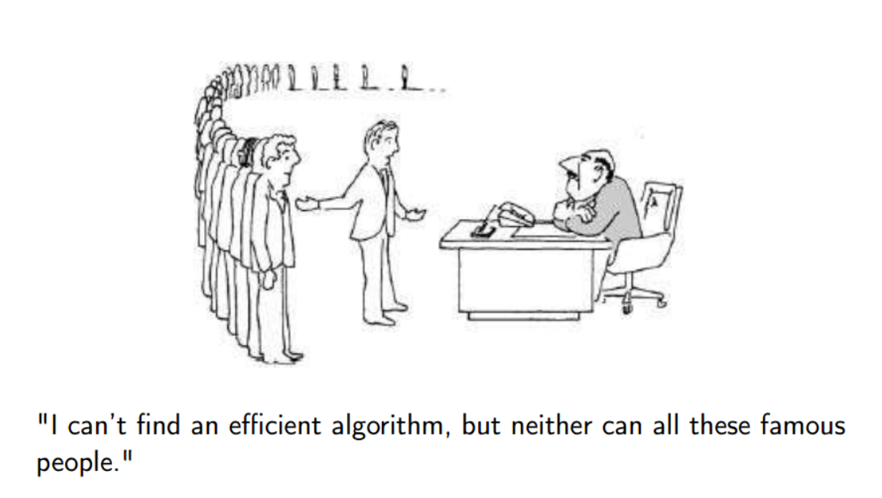

Why we are here
To create the recipes that make computers solve our problems efficiently
  With a bounded number of resources (memory, time)
We measure the quality of an algorithm by the dependence of its running time on the size $n$ of the input
  For an $n$-bit input, the running time can be $n^{2}, 6n \log{n}, 2^{n}⋅3n^{6},…$
  Smaller functions are better, but as a general guideline:
    Polynomials are good, exponential functions are bad
Unfortunately, many problems are NP-complete
We believe that for NP-complete problems, there is no algorithm that:
  always gives the right answer, and whose
  running time is bounded by a polynomial function of the input size

Slide 3
Dealing with NP-complete problems
Approximation
Sacrifice quality of the solution: quickly find a solution that is provably not very bad
Local search
Quickly find a solution for which you cannot give any quality guarantee (but which might often be good)
Branch & bound
Sacrifice running time guarantees: create an algorithm for which you do not know how long it will take (but which might do well on the inputs you use)
Parameterized algorithms
Sacrifice the running time: allow the running time to have an exponential factor, but ensure that the exponential dependence is not on the entire input size but just on some parameter that is hopefully small
Kernelization
Quickly shrink the input by preprocessing so that afterward running an exponential-time algorithm on the shrunk instance is fast enough

Slide 4
Fixed-parameter tractability

Slide 5
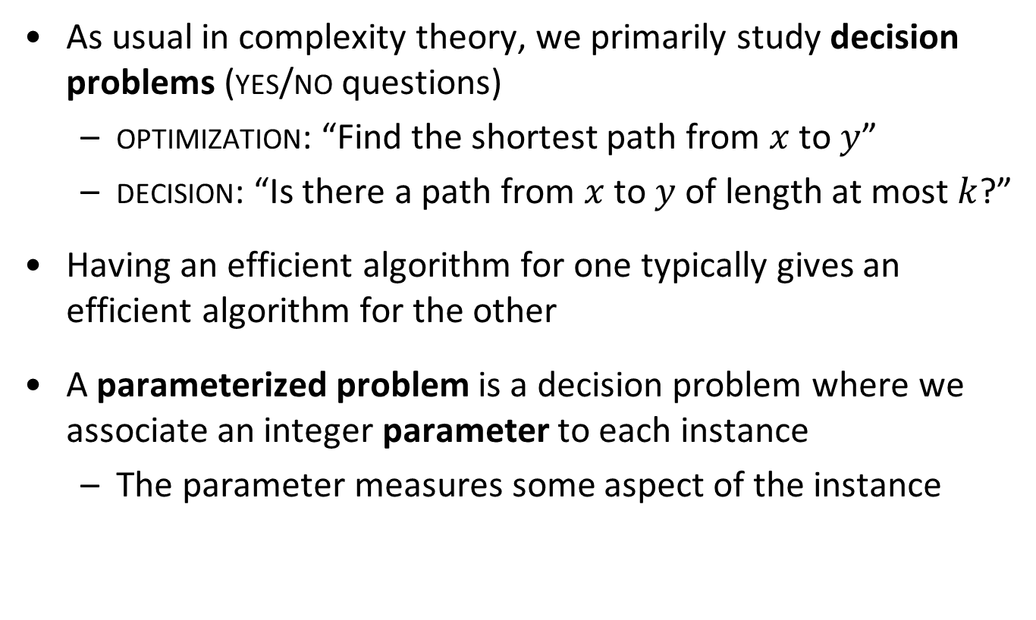
Parameterized problems
As usual in complexity theory, we primarily study decision problems (yes/no questions)
  optimization: “Find the shortest path from $x$ to $y$”
  decision: “Is there a path from $x$ to $y$ of length at most $k$?”
Having an efficient algorithm for one typically gives an efficient algorithm for the other
A parameterized problem is a decision problem where we associate an integer parameter to each instance
  The parameter measures some aspect of the instance

Slide 6
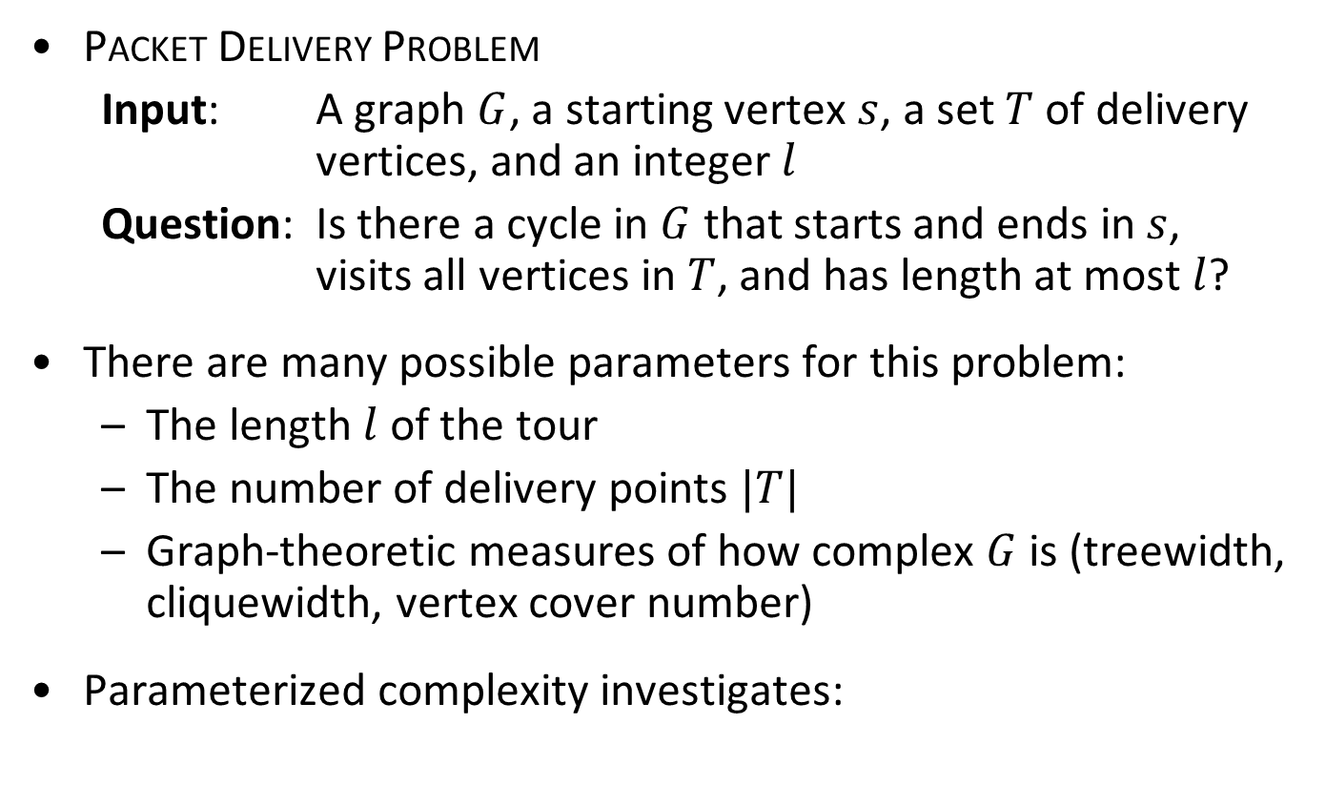
Problem parameterizations
Packet Delivery Problem
  Input: A graph $G$, a starting vertex $s$, a set $T$ of delivery vertices, and an integer $l$
  Question: Is there a cycle in $G$ that starts and ends in $s$, visits all vertices in $T$, and has length at most $l$?
There are many possible parameters for this problem:
  The length $l$ of the tour
  The number of delivery points $|T|$
  Graph-theoretic measures of how complex $G$ is (treewidth, cliquewidth, vertex cover number)
Parameterized complexity investigates:
  Can the problem be solved efficiently,
  if the parameter is small?

Slide 7
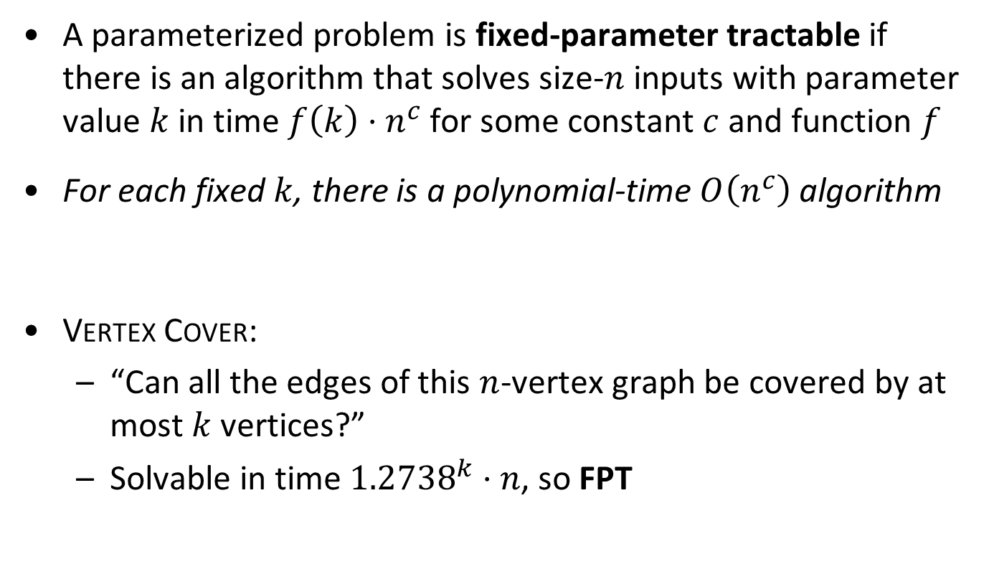
Fixed-parameter tractability – informally
A parameterized problem is fixed-parameter tractable if there is an algorithm that solves size-$n$ inputs with parameter value $k$ in time $f\left(k\right)⋅n^{c}$ for some constant $c$ and function $f$
For each fixed $k$, there is a polynomial-time $O\left(n^{c}\right)$ algorithm
Vertex Cover:
  “Can all the edges of this $n$-vertex graph be covered by at most $k$ vertices?”
  Solvable in time ${1.2738}^{k}⋅n$, so FPT

Slide 8
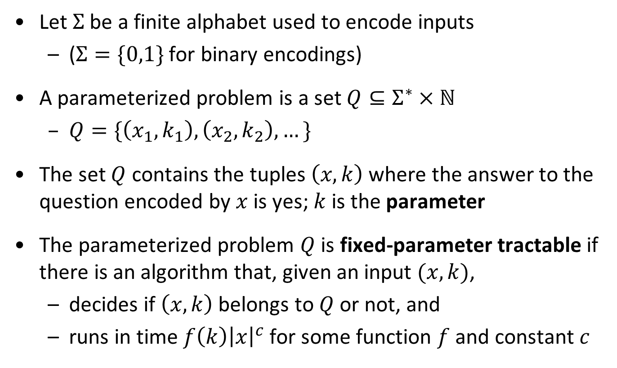
Fixed-parameter tractability – formally
Let $Σ$ be a finite alphabet used to encode inputs
  ($Σ=\{0,1\}$ for binary encodings)
A parameterized problem is a set $Q⊆Σ^{∗}×ℕ$
  $Q=\{\left(x_{1},k_{1}\right), \left(x_{2},k_{2}\right), …\}$
The set $Q$ contains the tuples $\left(x,k\right)$ where the answer to the question encoded by $x$ is yes; $k$ is the parameter
The parameterized problem $Q$ is fixed-parameter tractable if there is an algorithm that, given an input $(x,k)$,
  decides if $\left(x,k\right)$ belongs to $Q$ or not, and
  runs in time $f\left(k\right){\left|x\right|}^{c}$ for some function $f$ and constant $c$

Slide 9
kernelization

Slide 10
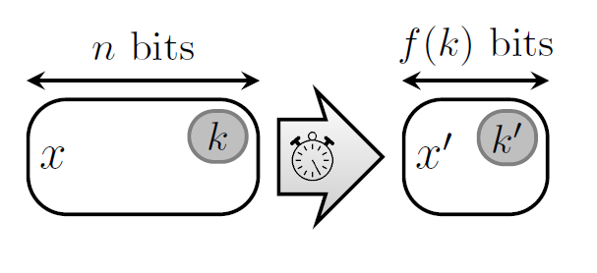
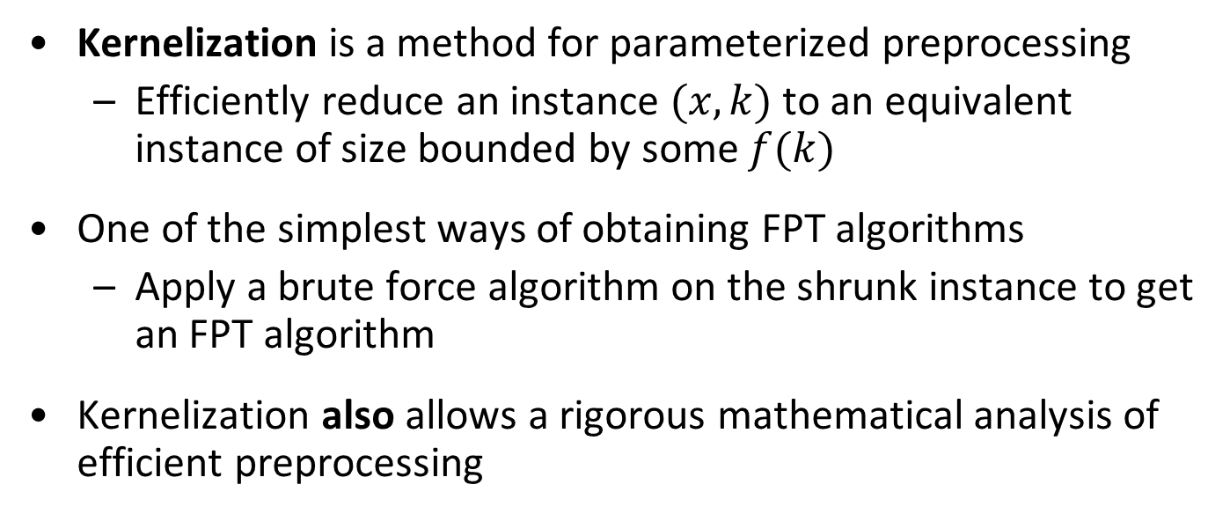
Data reduction with a guarantee
Kernelization is a method for parameterized preprocessing
  Efficiently reduce an instance $(x,k)$ to an equivalent instance of size bounded by some $f(k)$
One of the simplest ways of obtaining FPT algorithms
  Apply a brute force algorithm on the shrunk instance to get an FPT algorithm
Kernelization also allows a rigorous mathematical analysis of efficient preprocessing
Notes:
Let’s look at an example before giving the formal definition

Slide 11
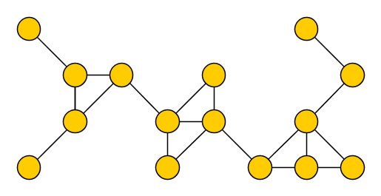
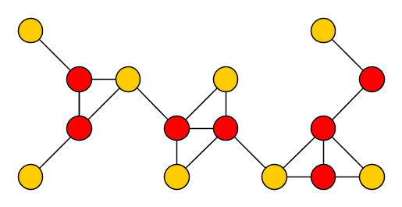

The Vertex Cover problem
Input: An undirected graph $G$ and an integer $k$
Parameter: $k$
Question: Is there a set $S$ of at most $k$ vertices in $G$, such that each edge of $G$ has an endpoint in $S$?
Such a set S is a vertex cover of $G$

Slide 12
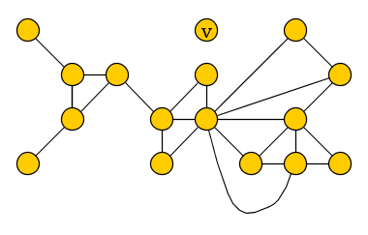
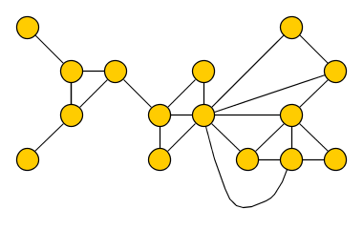

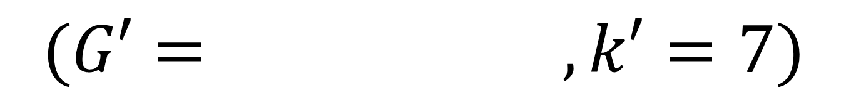
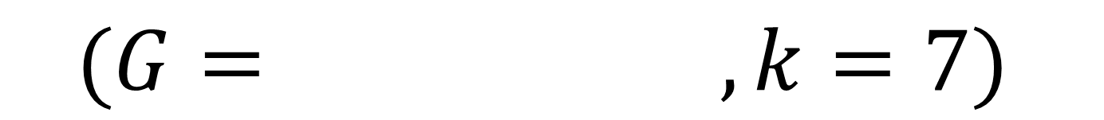
Reduction rules for Vertex Cover – (R1)
(R1) If there is an isolated vertex $v$, delete $v$ from $G$
  Reduce to the instance $\left(G−v,k\right)$
$$(G= , k=7)$$
$$(G′= , k′=7)$$

Slide 13
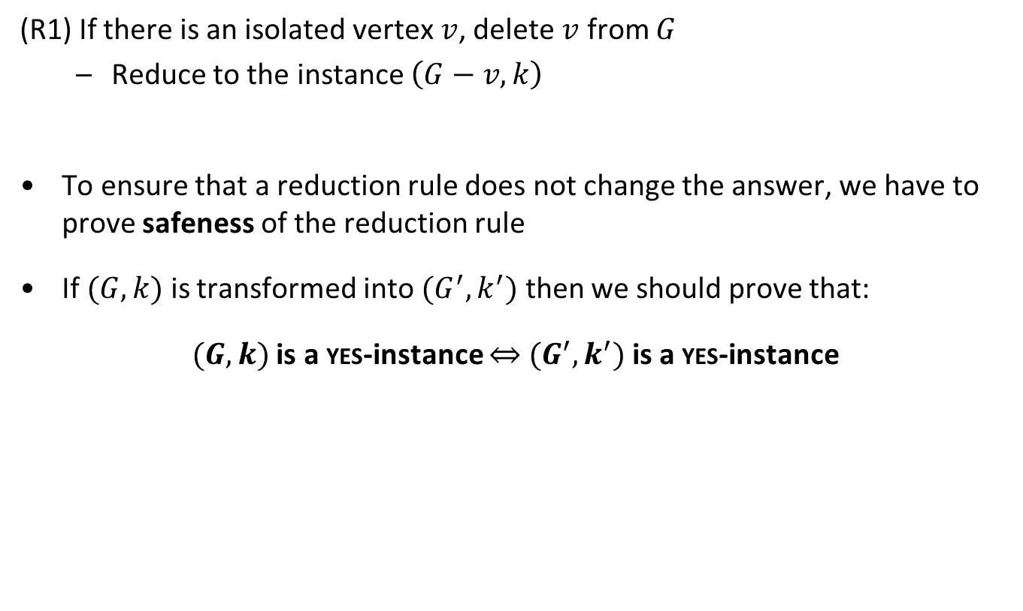
Reduction rules for Vertex Cover – (R1)
(R1) If there is an isolated vertex $v$, delete $v$ from $G$
  Reduce to the instance $\left(G−v,k\right)$
To ensure that a reduction rule does not change the answer, we have to prove safeness of the reduction rule
If $(G,k)$ is transformed into $(G^{′},k^{′})$ then we should prove that:
$(G,k)$ is a yes-instance $⇔$ $(G^{′},k^{′})$ is a yes-instance

Slide 14
Reduction rules for Vertex Cover – (R1)
(R1) If there is an isolated vertex $v$, delete $v$ from $G$
  Reduce to the instance $\left(G−v,k\right)$
$$(G= , k=7)$$
$$(G′= , k′=7)$$

Slide 15
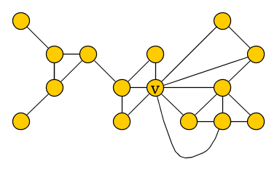
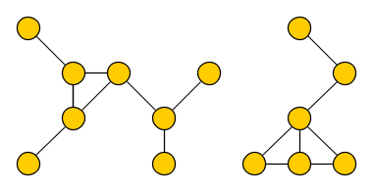
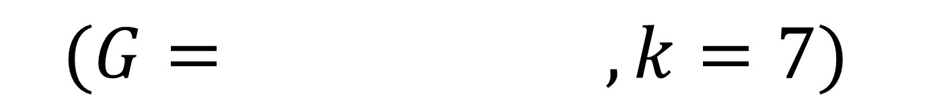

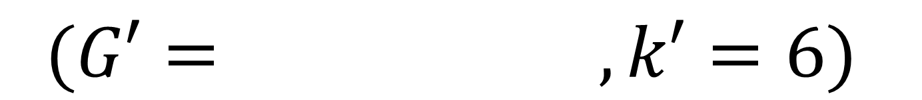
Reduction rules for Vertex Cover – (R2)
(R2) If there is a vertex $v$ of degree more than $k$, then delete $v$ (and its incident edges) from $G$ and decrease the parameter by 1
  Reduce to the instance $\left(G−v,k−1\right)$
$$(G= , k=7)$$
$$(G′= , k′=6)$$

Slide 16

Reduction rules for Vertex Cover – (R3)
(R3) If the previous rules are not applicable and $G$ has more than $k^{2}+k$ vertices or more than $k^{2}$ edges, then conclude that we are dealing with a no-instance

Slide 17
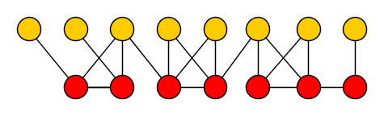
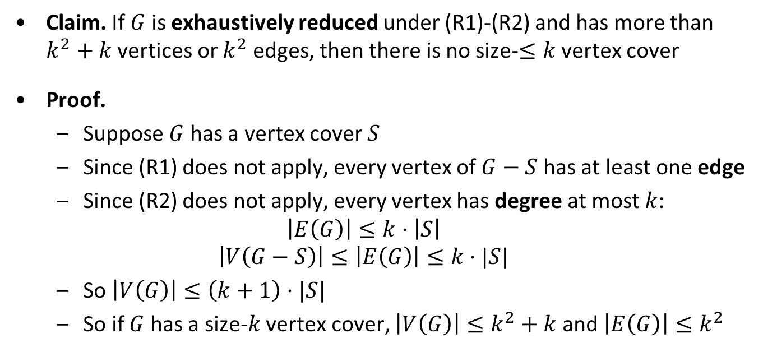

Correctness of the cutoff rule
Claim. If $G$ is exhaustively reduced under (R1)-(R2) and has more than $k^{2}+k$ vertices or $k^{2}$ edges, then there is no size-$≤k$ vertex cover
Proof.
  Suppose $G$ has a vertex cover $S$
  Since (R1) does not apply, every vertex of $G−S$ has at least one edge
  Since (R2) does not apply, every vertex has degree at most $k$:
  $$\left|E\left(G\right)\right|≤k⋅\left|S\right|$$
  $$\left|V\left(G−S\right)\right|≤\left|E\left(G\right)\right|≤k⋅|S|$$
  So $\left|V\left(G\right)\right|≤\left(k+1\right)⋅|S|$
  So if $G$ has a size-$k$ vertex cover, $\left|V\left(G\right)\right|≤k^{2}+k$ and $\left|E\left(G\right)\right|≤k^{2}$
S
$$≤k$$

Slide 18
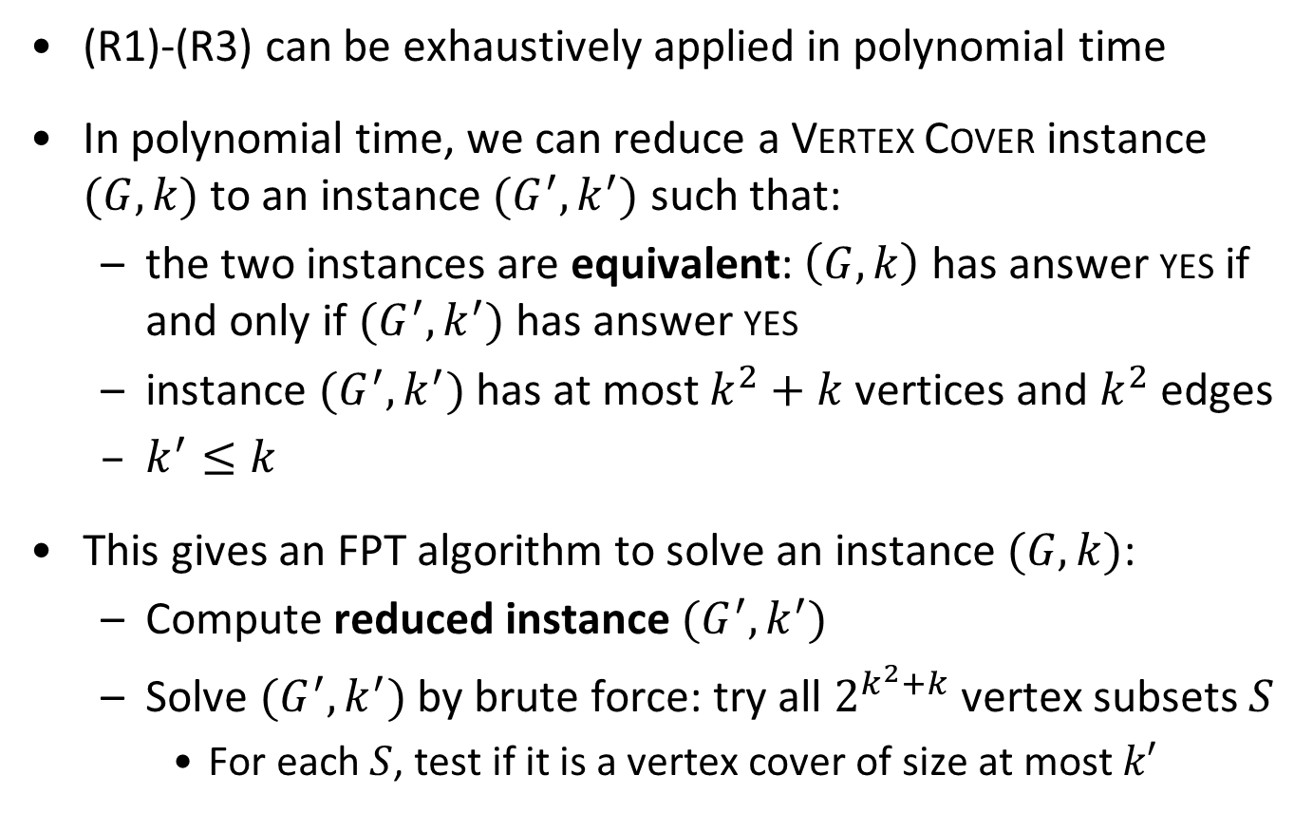
Preprocessing for Vertex Cover
(R1)-(R3) can be exhaustively applied in polynomial time
In polynomial time, we can reduce a Vertex Cover instance $(G,k)$ to an instance $(G^{′},k^{′})$ such that:
  the two instances are equivalent: $\left(G,k\right)$ has answer yes if and only if $(G^{′},k^{′})$ has answer yes
  instance $(G^{′},k^{′})$ has at most $k^{2}+k$ vertices and $k^{2}$ edges
  $k^{′}≤k$
This gives an FPT algorithm to solve an instance $(G,k)$:
  Compute reduced instance $(G^{′},k^{′})$
  Solve $(G^{′},k^{′})$ by brute force: try all $2^{k^{2}+k}$ vertex subsets $S$
    For each $S$, test if it is a vertex cover of size at most $k′$
Theorem. $k$-Vertex Cover is fixed-parameter tractable

Slide 19
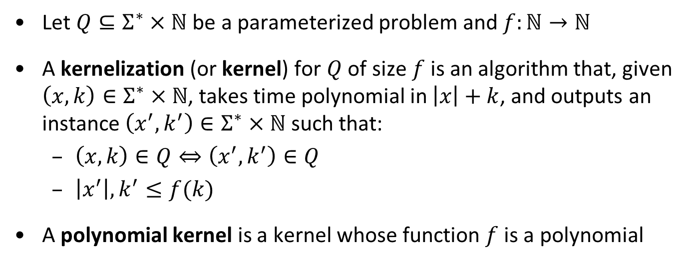
Kernelization – formally
Let $Q⊆Σ^{∗}×ℕ$ be a parameterized problem and $f:ℕ→ℕ$
A kernelization (or kernel) for $Q$ of size $f$ is an algorithm that, given $\left(x,k\right)∈Σ^{∗}×ℕ$, takes time polynomial in $\left|x\right|+k$, and outputs an instance $\left(x^{′},k^{′}\right)∈Σ^{∗}×ℕ$ such that:
  $\left(x,k\right)∈Q⇔\left(x^{′},k^{′}\right)∈Q$
  $\left|x^{′}\right|,k^{′}≤f(k)$
A polynomial kernel is a kernel whose function $f$ is a polynomial
  Theorem. A parameterized problem is fixed-parameter tractable if and only if it is decidable and has a kernel (of arbitrary size)

Slide 20
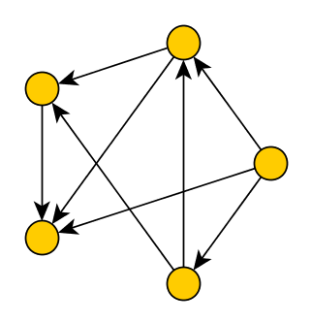
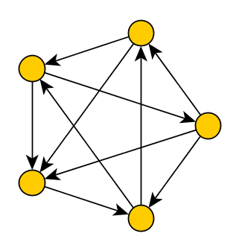

Kernel for Feedback Arc Set in Tournaments
Input: A tournament $G$ and an integer $k$
Parameter: $k$
Question: Is there a set $S$ of at most $k$ directed edges in $G$, such that $G−S$ is acyclic?

Slide 21
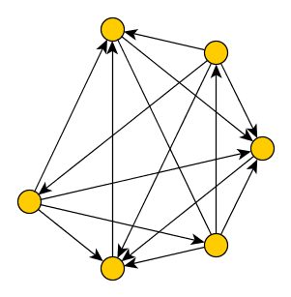
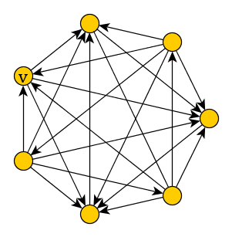
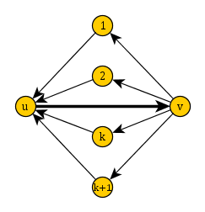
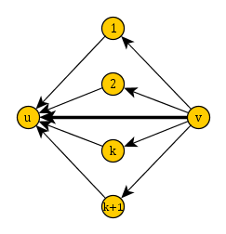
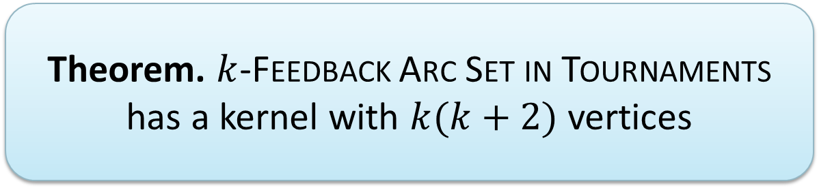

Reduction rules for Feedback Arc Set
(R1) If vertex $v$ is not in any triangle, then remove $v$
(R2) If edge $(u,v)$ is in at least $k+1$ distinct triangles, reverse it and decrease $k$ by one
(R3) If the previous rules are not applicable and $G$ has more than $k(k+2)$ vertices, then conclude that we are dealing with a no-instance
Theorem. $k$-Feedback Arc Set in Tournaments has a kernel with $k(k+2)$ vertices

Slide 22
High-level kernelization strategy
Compare to Vertex Cover:
  (R1) deals with elements that do not constrain the solution
  (R2) deals with elements that must be in any solution
  (R3) deals with graphs that remain large after reduction

Slide 23
Bounded-depth search trees

Slide 24
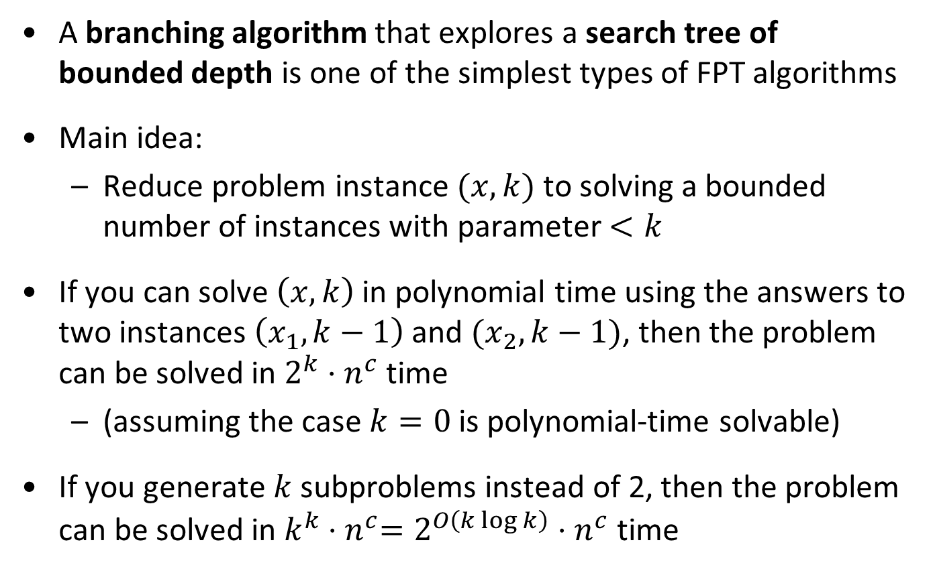
Background
A branching algorithm that explores a search tree of bounded depth is one of the simplest types of FPT algorithms
Main idea:
  Reduce problem instance $(x,k)$ to solving a bounded number of instances with parameter $<k$
If you can solve $\left(x,k\right)$ in polynomial time using the answers to two instances $\left(x_{1},k−1\right)$ and $(x_{2},k−1)$, then the problem can be solved in $2^{k}⋅n^{c}$ time
  (assuming the case $k=0$ is polynomial-time solvable)
If you generate $k$ subproblems instead of 2, then the problem can be solved in $k^{k}{⋅n}^{c}=2^{O\left(k\log{k}\right)}⋅n^{c}$ time

Slide 25





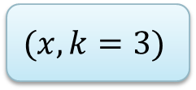









A search tree
$$(x,k=3)$$
$$(x_{1},2)$$
$$(x_{2},2)$$
$$(x_{3},1)$$
$$(x_{4},1)$$
$$(x_{5},1)$$
$$(x_{6},1)$$
$$(x_{7},0)$$
$$(x_{8},0)$$
$$(x_{9},0)$$
$$(x_{10},0)$$
$$(x_{11},0)$$
$$(x_{12},0)$$
$$(x_{13},0)$$
$$(x_{14},0)$$

Slide 26
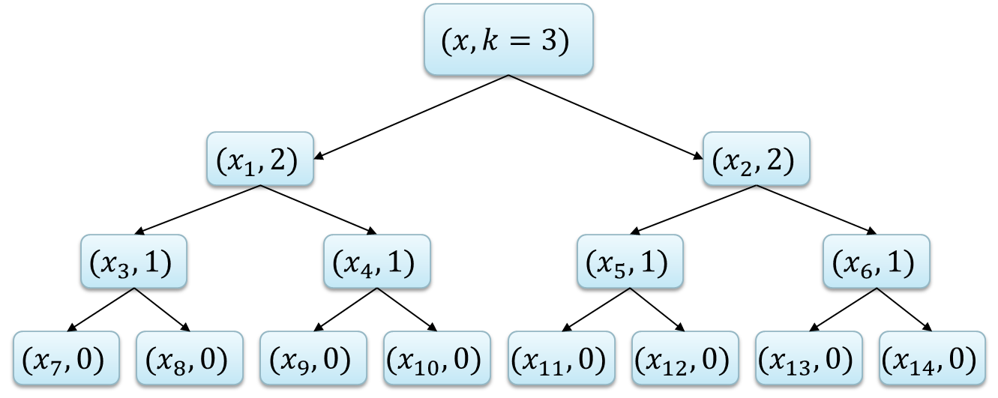
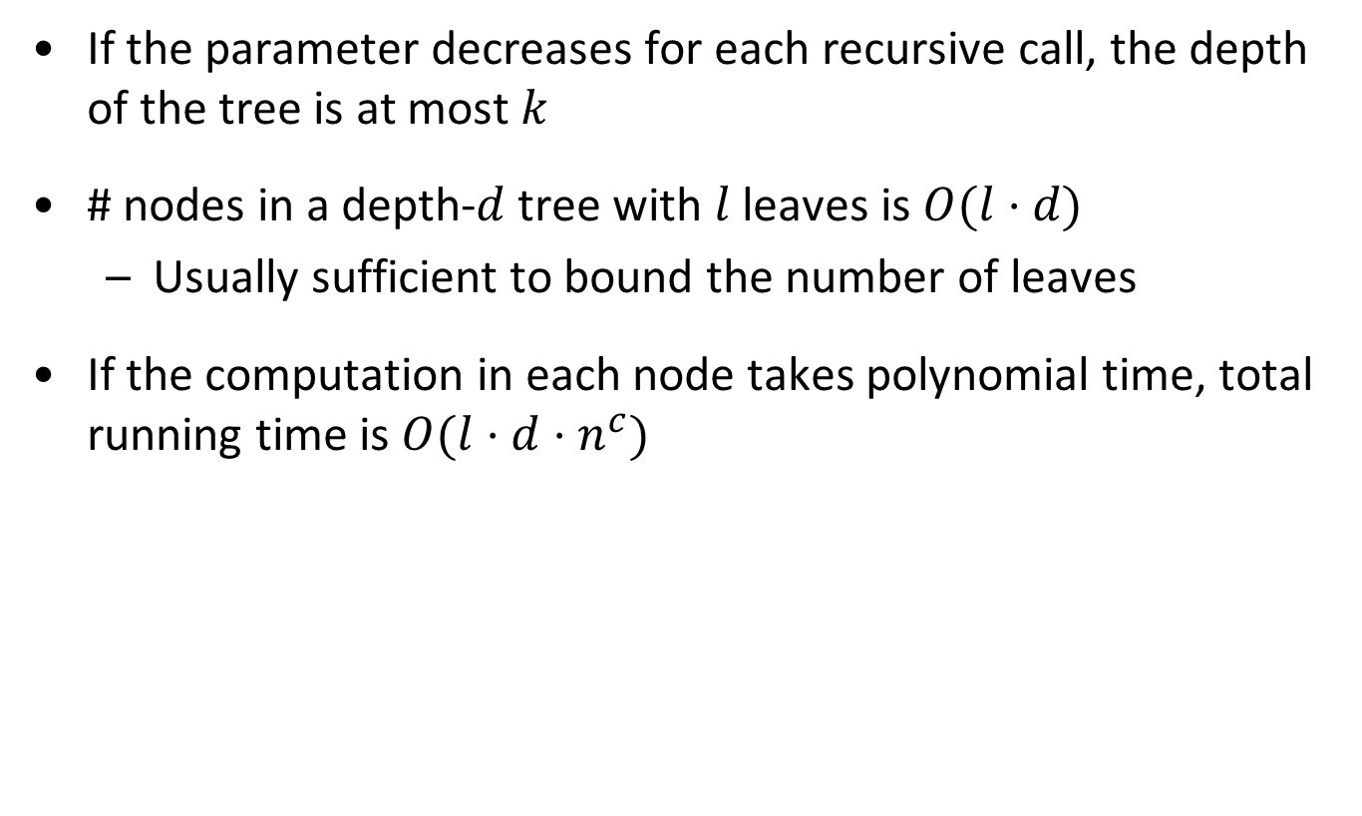
Analysis of bounded-depth search trees
If the parameter decreases for each recursive call, the depth of the tree is at most $k$
# nodes in a depth-$d$ tree with $l$ leaves is $O(l⋅d)$
  Usually sufficient to bound the number of leaves
If the computation in each node takes polynomial time, total running time is $O(l⋅d⋅n^{c})$

Slide 27
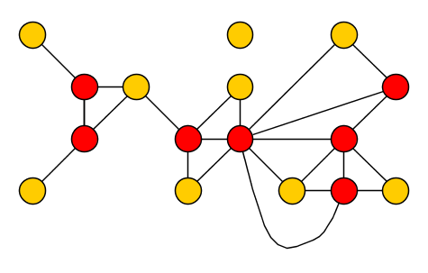
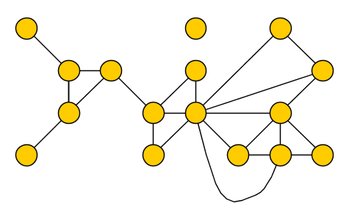

Vertex Cover revisited
Input: A graph $G$ and an integer $k$
Parameter: $k$
Question: Is there a set $S$ of at most $k$ vertices in $G$, such that each edge has an endpoint in $S$?

Slide 28
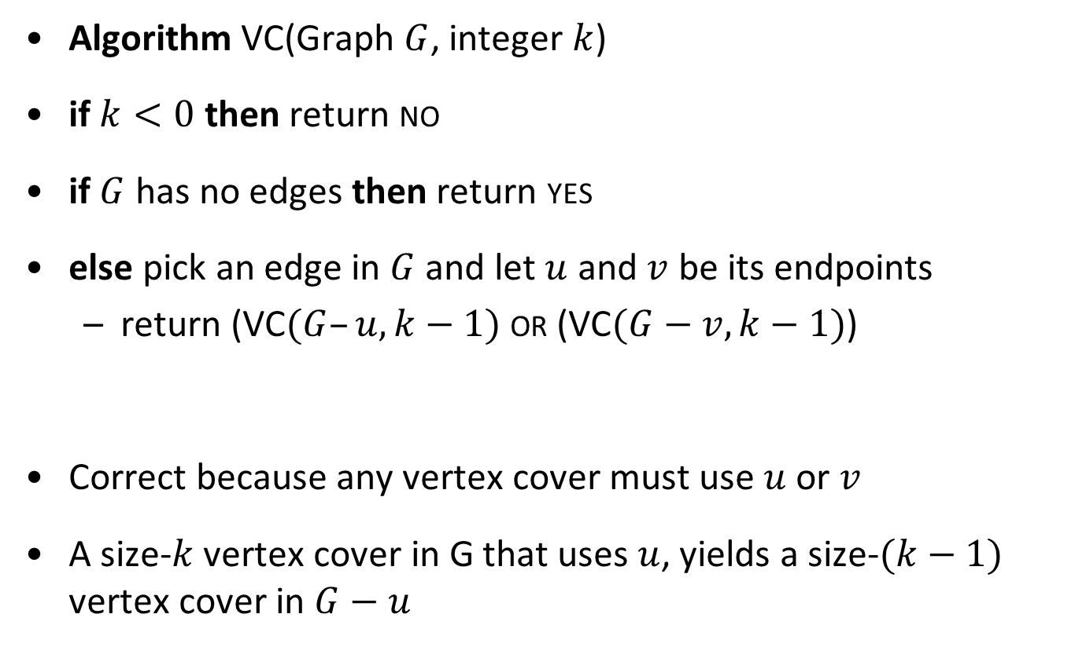
Algorithm for Vertex Cover
Algorithm VC(Graph $G$, integer $k$)
if $k<0$ then return no
if $G$ has no edges then return yes
else pick an edge in $G$ and let $u$ and $v$ be its endpoints
  return (VC$(G–u, k−1)$ or (VC$(G−v, k−1)$)
Correct because any vertex cover must use $u$ or $v$
A size-$k$ vertex cover in G that uses $u$, yields a size-$(k−1)$ vertex cover in $G−u$

Slide 29
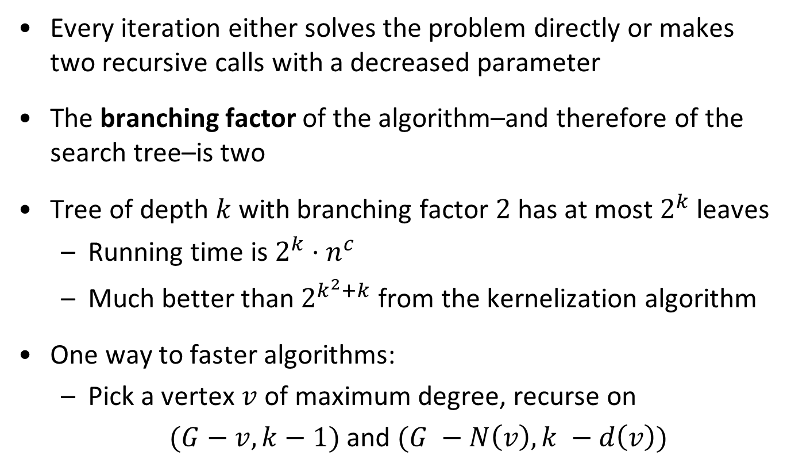
Running time for Vertex Cover
Every iteration either solves the problem directly or makes two recursive calls with a decreased parameter
The branching factor of the algorithm–and therefore of the search tree–is two
Tree of depth $k$ with branching factor $2$ has at most $2^{k}$ leaves
  Running time is $2^{k}⋅n^{c}$
  Much better than $2^{k^{2}+k}$ from the kernelization algorithm
One way to faster algorithms:
  Pick a vertex $v$ of maximum degree, recurse on
  $(G−v, k−1)$ and $(G −N\left(v\right), k −d\left(v\right))$

Slide 30
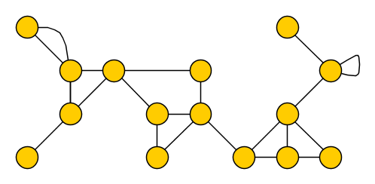
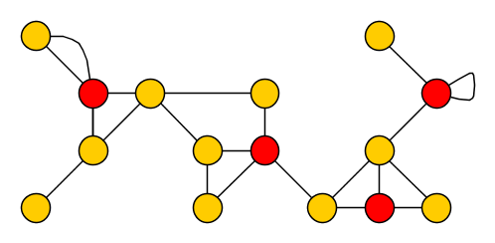
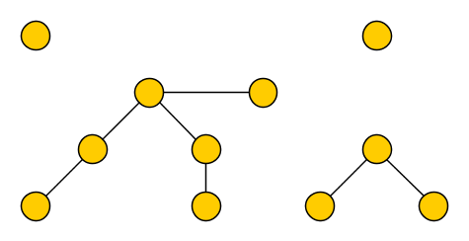

The Feedback Vertex Set problem
Input: An undirected (multi)graph $G$ and an integer $k$
Parameter: $k$
Question: Is there a set $S$ of at most $k$ vertices in $G$, such that each cycle contains a vertex of $S$?
We allow multiple edges and self-loops
Such a set $S$ is a feedback vertex set of $G$
  Removing $S$ from $G$ results in an acyclic graph, a forest

Slide 31
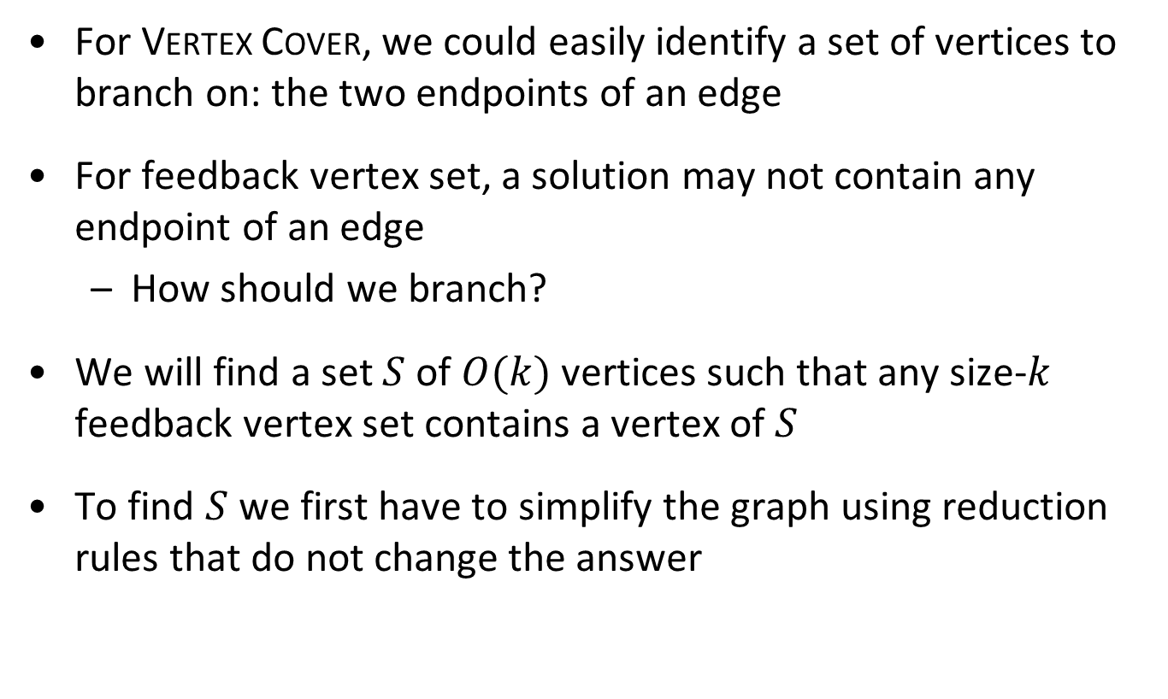
Branching for Feedback Vertex Set
For Vertex Cover, we could easily identify a set of vertices to branch on: the two endpoints of an edge
For feedback vertex set, a solution may not contain any endpoint of an edge
  How should we branch?
We will find a set $S$ of $O(k)$ vertices such that any size-$k$ feedback vertex set contains a vertex of $S$
To find $S$ we first have to simplify the graph using reduction rules that do not change the answer

Slide 32

























Reduction rules
(R1) If there is a loop at vertex $v$, then delete $v$ and decrease $k$ by one
(R2) If there is an edge of multiplicity larger than $2$, then reduce its multiplicity to $2$
(R3) If there is a vertex $v$ of degree at most $1$, then delete $v$
(R4) If there is a vertex $v$ of degree two, then delete $v$ and add an edge between $v$’s neighbors
  If (R1-R4) cannot be applied anymore,
  then the minimum degree is at least $3$
  Observation. If $\left(G,k\right)$ is transformed into $(G^{′},k^{′})$, then:
  fvs of size $≤k$ in $G⇔$ fvs of size $≤k′$ in $G′$
  Any feedback vertex set in $G′$ is a feedback vertex set in $G$ when combined with the vertices deleted by (R1)

Slide 33

Identifying a set to branch on
Let $G$ be a graph whose vertices have degree three or more
  Order the vertices as $v_{1}, v_{2}, … , v_{n}$ by decreasing degree
  Let $V_{3k}≔\{v_{1},…, v_{3k}\}$ be the $3k$ largest-degree vertices
Lemma. If all vertices of $G$ have degree 3 or more, then any size-$≤k$ feedback vertex set of $G$ contains a vertex from $V_{3k}$
So if there is a size-$≤k$ solution, it contains a vertex of $V_{3k}$
  For each $v∈V_{3k}$ recurse on the instance $(G−v,k−1)$
Gives an algorithm with running time ${\left(3k\right)}^{k}⋅n^{c}$
  Apply the reduction rules, compute $V_{3k}$, then branch

Slide 34

A useful claim
Claim. If $X$ is a feedback vertex set of $G$, then
$\sum_{v∈X}{\left(d\left(v\right)−1\right)≥\left|E\left(G\right)\right|−\left|V\left(G\right)\right|+1}$
Proof. Graph $F :=G –X$ is a forest
  So $\left|E\left(F\right)\right|≤\left|V\left(F\right)\right|−1=|V(G)|−|X|−1$
  Every edge not in $F$, is incident with a vertex of $X$
  $\sum_{v∈X}{d(v)}+\left|V\left(G\right)\right|−\left|X\right|− 1≥|E(G)|$
With this claim, we can prove the degree lemma

Slide 35

Proving the degree lemma
Lemma. If all vertices of $G$ have degree 3 or more, then any size-$≤k$ feedback vertex set of G contains a vertex from $V_{3k}$
Proof by contradiction.
  Let $X$ be a size-$≤k$ feedback vertex set with $X∩V_{3k}=∅$
  By choice of $V_{3k}$ we have:
  $\min_{v∈V_{3k}}{d(v)≥\max_{v∈X}{d\left(v\right)}}$, so:
  $$\sum_{v∈V_{3k}}{\left(d\left(v\right)−1\right)≥3⋅\sum_{v∈X}{\left(d\left(v\right)−1\right)}≥3⋅\left(\left|E\left(G\right)\right|−\left|V\left(G\right)\right|+1\right).}$$
  Define $V^{+}≔V\left(G\right)∖V_{3k}$. Since $X⊆V^{+}$:
  $$\sum_{v∈V^{+}}{(d\left(v\right)−1)}≥\sum_{v∈X}{\left(d\left(v\right)−1\right)}≥\left|E\left(G\right)\right|−\left|V\left(G\right)\right|+1 \\ \sum_{v∈V\left(G\right)}{\left(d\left(v\right)−1\right)≥}4⋅\left(\left|E\left(G\right)\right|−\left|V\left(G\right)\right|+1\right).$$
By the previous claim

Slide 36

Proving the degree lemma (II)
$\sum_{v∈V\left(G\right)}{\left(d\left(v\right)−1\right)≥}4⋅\left(\left|E\left(G\right)\right|−\left|V\left(G\right)\right|+1\right)$
The degree sum counts every edge twice:
$\sum_{v∈V\left(G\right)}{d\left(v\right)}=2⋅|E(G)|$
Combining these:
$4⋅\left(\left|E\left(G\right)\right|−\left|V\left(G\right)\right|+1\right)≤\sum_{v∈V\left(G\right)}{\left(d\left(v\right)−1\right)}=2⋅\left|E\left(G\right)\right|−|V\left(G\right)|$
So $2⋅\left|E\left(G\right)\right|<3⋅|V\left(G\right)|$
But since all vertices have degree $≥3$ we have:
$2⋅\left|E\left(G\right)\right|=\sum_{v∈V\left(G\right)}{d\left(v\right)}≥3⋅\left|V\left(G\right)\right|,$
Contradiction

Slide 37

A final word on bounded-depth search trees
The degree lemma proves the correctness of our branching strategy for Feedback Vertex Set
When building a branching algorithm for a parameterization by the solution size:
  Find an $f(k)$-size set that contains a vertex of the solution
  Branch in $f(k)$ directions, trying all possibilities
  We get a search tree of depth $k$ and branching factor $f(k)$
You can think of the branching process as guessing

Slide 38
Dynamic programming

Slide 39






The Set Cover problem
Input: A set family $ℱ$ over a universe $U$ and an integer $k$
Parameter: $|U|$
Question: Is there a subfamily $ℱ^{′}⊆ℱ$ of at most $k$ sets,
such that $\bigcup_{F∈ℱ′}{F}=U?$
The subfamily $ℱ′$ covers the universe $U$
Set Cover parameterized by the universe size is FPT
  Algorithm with running time $2^{\left|U\right|}⋅{\left(\left|U\right|+\left|ℱ\right|\right)}^{c}$
  Based on dynamic programming
$$F_{2}$$
$$F_{3}$$
$$F_{1}$$
$$F_{4}$$

Slide 40

Dynamic programming for Set Cover
Let $ℱ=\{F_{1},F_{2},…,F_{m}\}$
We define a DP table for $X⊆U$ and $j∈\{0,1,…, m\}$
  $T\left[X,j\right]$ = min nr. of sets from $F_{1},…, F_{j}$ needed to cover $X$
  Or $+∞$ if impossible
The value $T[U,m]$ gives the minimum size of a set cover
  To solve the problem, compute $T$ using base cases and a recurrence

Slide 41

Filling the dynamic programming table
$T\left[X,j\right]$ = min nr. of sets from $F_{1},…, F_{j}$ needed to cover $X$
Base case: $j=0$
  $T\left[X,j\right]=0$ if $X=∅$, otherwise it is $+∞$
Recursive step: $j>0$
  $$T\left[X,j\right]=min⁡(T\left[X,j−1\right],1+T\left[X\backslash F_{j},j−1\right])$$
Skip set $F_{j}$, or pay for $F_{j}$ and afterwards cover $X\backslash F_{j}$
Each entry can be computed in polynomial time
  $(\left|ℱ\right|+1)⋅2^{\left|U\right|}$ entries in total

Slide 42

More on dynamic programming
Dynamic programming is a memory-intensive algorithmic paradigm that yields FPT algorithms in various situations
  Here: dynamic programming over subsets of $U$
  Later: dynamic programming over tree decompositions
Research challenge:
  Determine whether the $2^{\left|U\right|}$ factor can be improved to ${\left(2−ε\right)}^{\left|U\right|}$ for some $ε>0$

